Slide 1
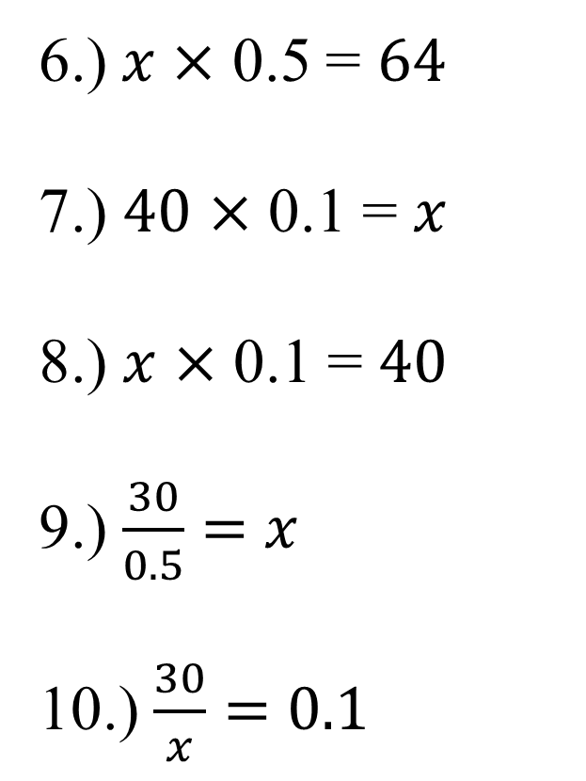
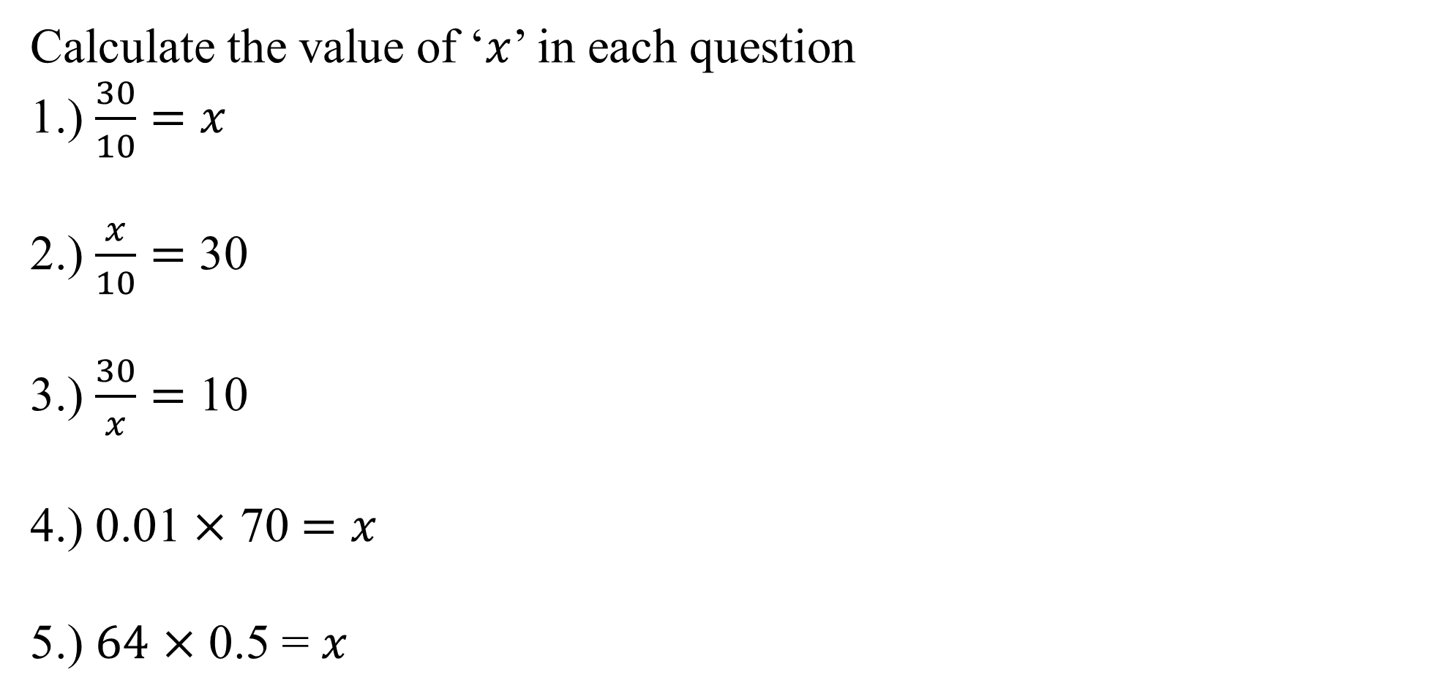
Proportion
L.O: to be able to solve inverse and direct proportion questions
Calculate the value of ‘$x$’ in each question
1.) $\frac{30}{10}=x$
2.) $\frac{x}{10}=$ 30
3.) $\frac{30}{x}=$ 10
4.) 0.01 $×$ 70 $=x$
5.) $64$ $×$ 0.5 = $x$
6.)$x$ $×$ 0.5 = $64$
7.) $40$ $×$ 0.1 = $x$
8.) $x$ $×$ 0.1 = $40$
9.) $\frac{30}{0.5}=$ $x$
10.) $\frac{30}{x}=$ $0.1$

Slide 2
2 | 2 | 2.4 | 4
5 | 7 | 10 | 25
40 | 80 | 1.6 | 200

Slide 3
A is directly proportional to B If A = 5 and B = 100 Find B when A = 4 | C is inversely proportional to D If C = 3 and D = 10 Find C when D = 6 | E is directly proportional to F If E = 14 and F = 56 Find F when E = 10 | G is inversely proportional to H If G = 8 and H = 5 Find H when G = 10
J is directly proportional to K If J = 7 and K = 56 Find J when K = 80 | L is directly proportional to M If L = 10 and M = 12 Find M when L = 2 | N is directly proportional to P If N = 3 and P = 300 Find P when N = 0.07 | Q is inversely proportional to R If Q = 0.1 and R = 80 Find R when Q = 4
S is directly proportional to T If S = 6 and T = 2.4 Find S when T = 10 | U is inversely proportional to V If U = 0.8 and V = 0.4 Find U when V = 0.2 | W is directly proportional to X If W = 0.5 and X = 16 Find W when X = 64 | Y is inversely proportional to Z If Y = 0.01 and Z = 4000 Find Z when Y = 0.2

Slide 4
A is directly proportional to B If A = 5 and B = 100 Find B when A = 4 | C is inversely proportional to D If C = 3 and D = 10 Find C when D = 6 | E is directly proportional to F If E = 14 and F = 56 Find F when E = 10 | G is inversely proportional to H If G = 8 and H = 5 Find H when G = 10
J is directly proportional to K If J = 7 and K = 56 Find J when K = 80 | L is directly proportional to M If L = 10 and M = 12 Find M when L = 2 | N is directly proportional to P If N = 3 and P = 300 Find P when N = 0.07 | Q is inversely proportional to R If Q = 0.1 and R = 80 Find R when Q = 4
S is directly proportional to T If S = 6 and T = 2.4 Find S when T = 10 | U is inversely proportional to V If U = 0.8 and V = 0.4 Find U when V = 0.2 | W is directly proportional to X If W = 0.5 and X = 16 Find W when X = 64 | Y is inversely proportional to Z If Y = 0.01 and Z = 4000 Find Z when Y = 0.2

