Slide 1
























$$x+4$$
$$x+4$$
$$2x+4$$
?
 | ?
$$7$$
$$7$$
$$7$$
$$x+5$$
$$x+5$$
$$x+5$$
$$?$$
$$x$$
$$2x+4$$
$$2x+4$$
$$2x+4$$
 | ?
?
$$7$$
$$7$$
$$7$$
$$x+5$$
$$x+5$$
$$x+5$$
$$?$$
$$x$$
$$x$$
$$x$$

Slide 2

































$$Find the area of the yellow section$$
$$Find the area of the yellow section$$
$$Find the area of the yellow section$$
$$3x+5$$
$$3x+5$$
$$3x+5$$
$$2x+3$$
$$2x+3$$
$$2x+3$$
$$3$$
$$3$$
$$5$$
$$5$$
$$x$$
$$Find the area of the yellow section$$
$$Find the area of the yellow section$$
$$Find the area of the white section$$
$$2$$
$$3x+5$$
$$2$$
$$3x+5$$
$$2$$
$$3x+5$$
$$x$$
$$x$$
$$x$$
$$x$$
$$2x+3$$
$$2x+3$$
$$2x+3$$
$$3$$
$$3$$
$$3$$
$$5$$
$$x$$
$$5$$
$$x$$
$$5$$
$$x$$

Slide 3

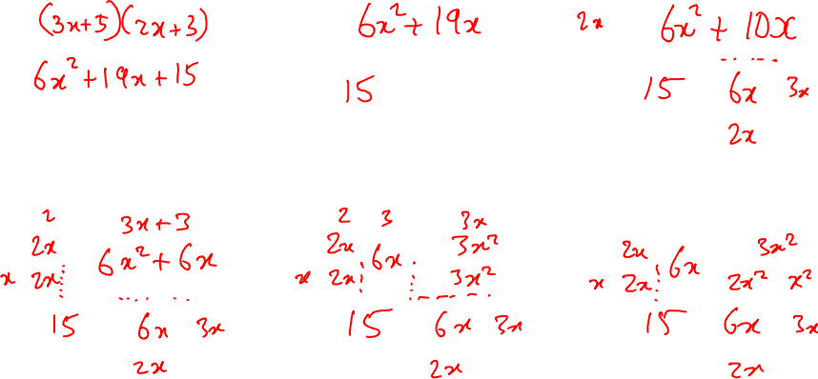
$$Find the area of the yellow section$$
$$Find the area of the yellow section$$
$$Find the area of the yellow section$$
$$3x+5$$
$$3x+5$$
$$3x+5$$
$$2x+3$$
$$2x+3$$
$$2x+3$$
$$3$$
$$3$$
$$5$$
$$5$$
$$x$$
$$Find the area of the yellow section$$
$$Find the area of the yellow section$$
$$Find the area of the white section$$
$$2$$
$$3x+5$$
$$2$$
$$3x+5$$
$$2$$
$$3x+5$$
$$x$$
$$x$$
$$x$$
$$2x+3$$
$$2x+3$$
$$2x+3$$
$$3$$
$$3$$
$$3$$
$$5$$
$$x$$
$$5$$
$$x$$
$$5$$
$$x$$

Slide 4

$$Find the area of the yellow section$$
$$Find the area of the yellow section$$
$$Find the area of the yellow section$$
$$3x+5$$
$$3x+5$$
$$3x+5$$
$$2x+3$$
$$2x+3$$
$$2x+3$$
$$3$$
$$3$$
$$5$$
$$5$$
$$x$$
$$Find the area of the yellow section$$
$$Find the area of the yellow section$$
$$Find the area of the white section$$
$$2$$
$$3x+5$$
$$2$$
$$3x+5$$
$$2$$
$$3x+5$$
$$x$$
$$x$$
$$x$$
$$2x+3$$
$$2x+3$$
$$2x+3$$
$$3$$
$$3$$
$$3$$
$$5$$
$$x$$
$$5$$
$$x$$
$$5$$
$$x$$

Slide 5


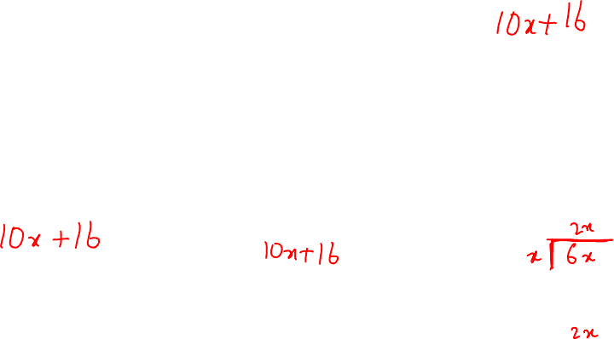
$$Find the area of the yellow section$$
$$Find the area of the yellow section$$
$$Find the area of the yellow section$$
$$3x+5$$
$$3x+5$$
$$3x+5$$
$$2x+3$$
$$2x+3$$
$$2x+3$$
$$3$$
$$3$$
$$5$$
$$5$$
$$x$$
$$Find the area of the yellow section$$
$$Find the area of the yellow section$$
$$Find the area of the white section$$
$$2$$
$$3x+5$$
$$2$$
$$3x+5$$
$$2$$
$$3x+5$$
$$x$$
$$x$$
$$x$$
$$2x+3$$
$$2x+3$$
$$2x+3$$
$$3$$
$$3$$
$$3$$
$$5$$
$$x$$
$$5$$
$$x$$
$$5$$
$$x$$

