Slide 1
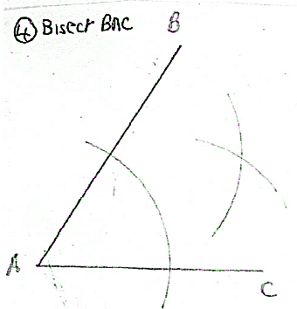
Bisect the angle BAC
What is wrong with this construction?

Slide 2
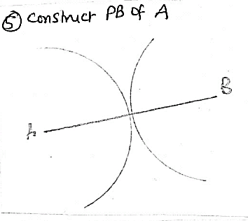
Construct the Perpendicular Bisector of AB
What is wrong with this construction?

Slide 3
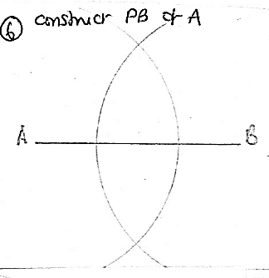
Construct the Perpendicular Bisector of AB
What is wrong with this construction?

Slide 4
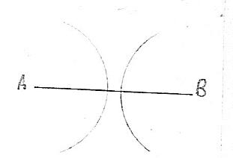
Construct the Perpendicular Bisector of AB
What is wrong with this construction?

Slide 5
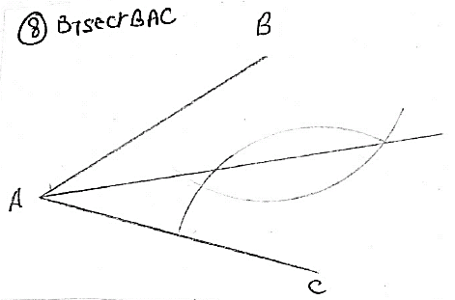
Bisect the angle BAC
What is wrong with this construction?

Slide 6
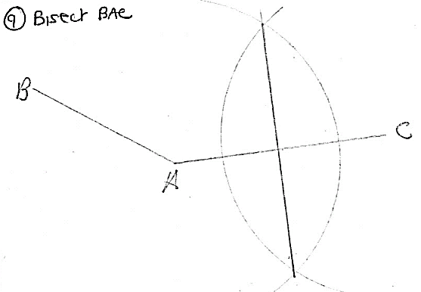
Bisect the angle BAC
What is wrong with this construction?

Slide 7
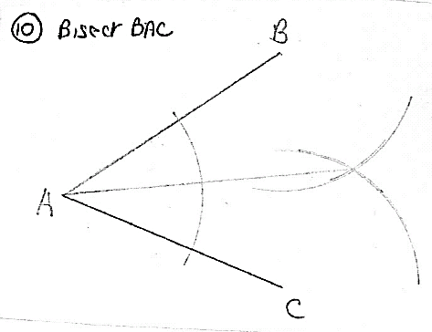
Bisect the angle BAC
What is wrong with this construction?

