Slide 1
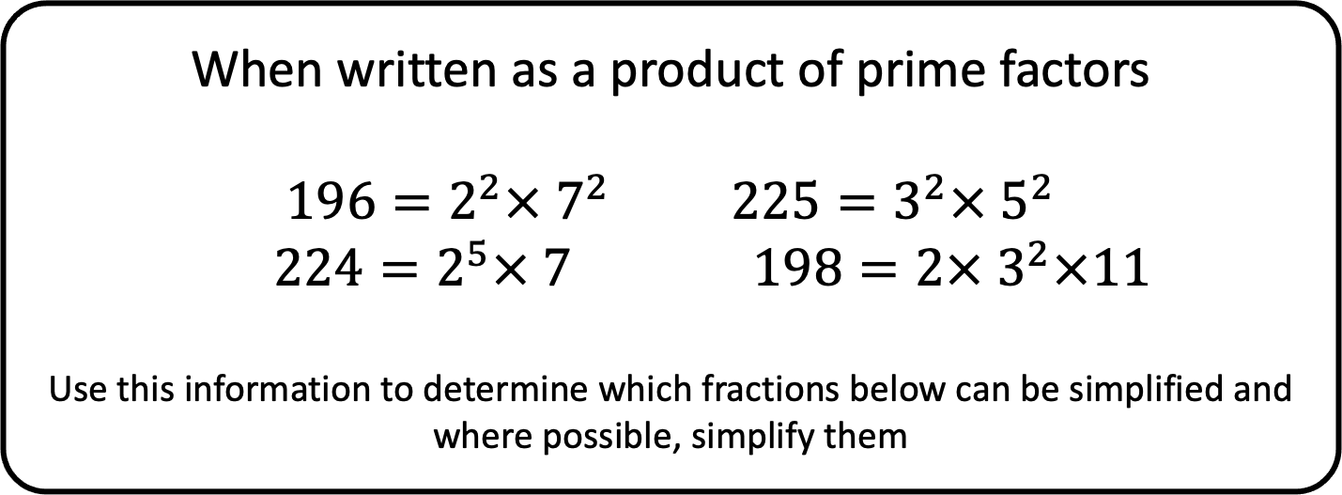




When written as a product of prime factors
$$196=2^{2}× 7^{2} {225=3}^{2}× 5^{2}$$
$$224=2^{5}× 7 198=2× 3^{2}×11$$
Use this information to determine which fractions below can be simplified and where possible, simplify them
$$\frac{196}{225}$$
$$\frac{198}{225}$$
$$\frac{196}{224}$$
$$\frac{224}{225}$$

