Slide 1
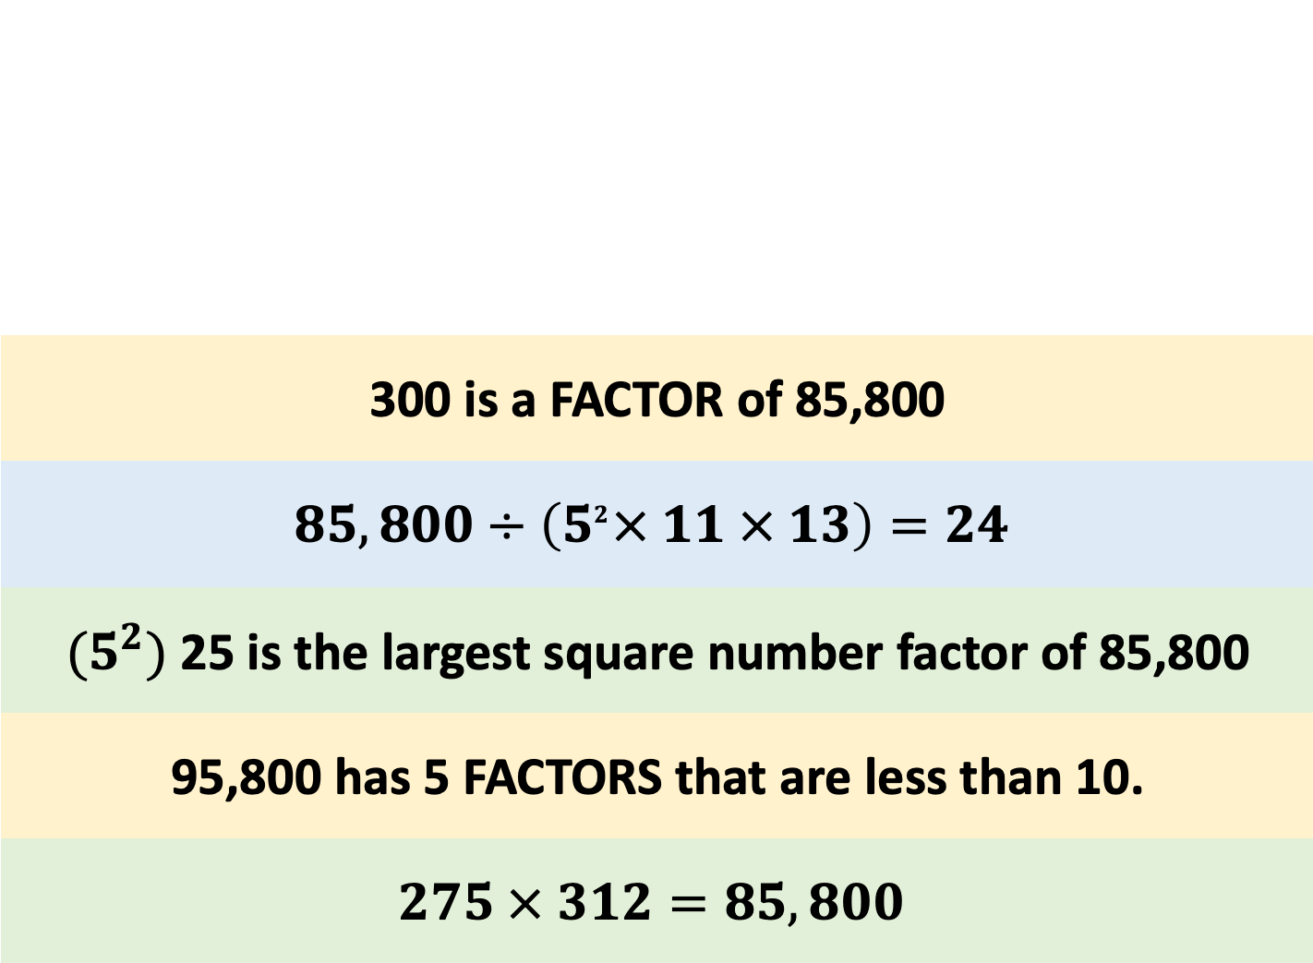
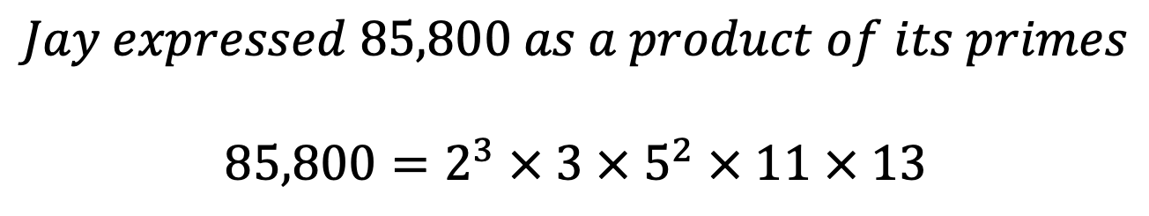
300 is a FACTOR of 85,800
$$85,800÷\left(5^{2}× 11 × 13\right)=24$$
${(5}^{2})$25 is the largest square number factor of 85,800
95,800 has 5 FACTORS that are less than 10.
$$275 × 312=85,800$$
$$Jay expressed 85,800 as a product of its primes$$
$$85,800=2^{3} × 3 × 5^{2} × 11 × 13$$

Slide 2
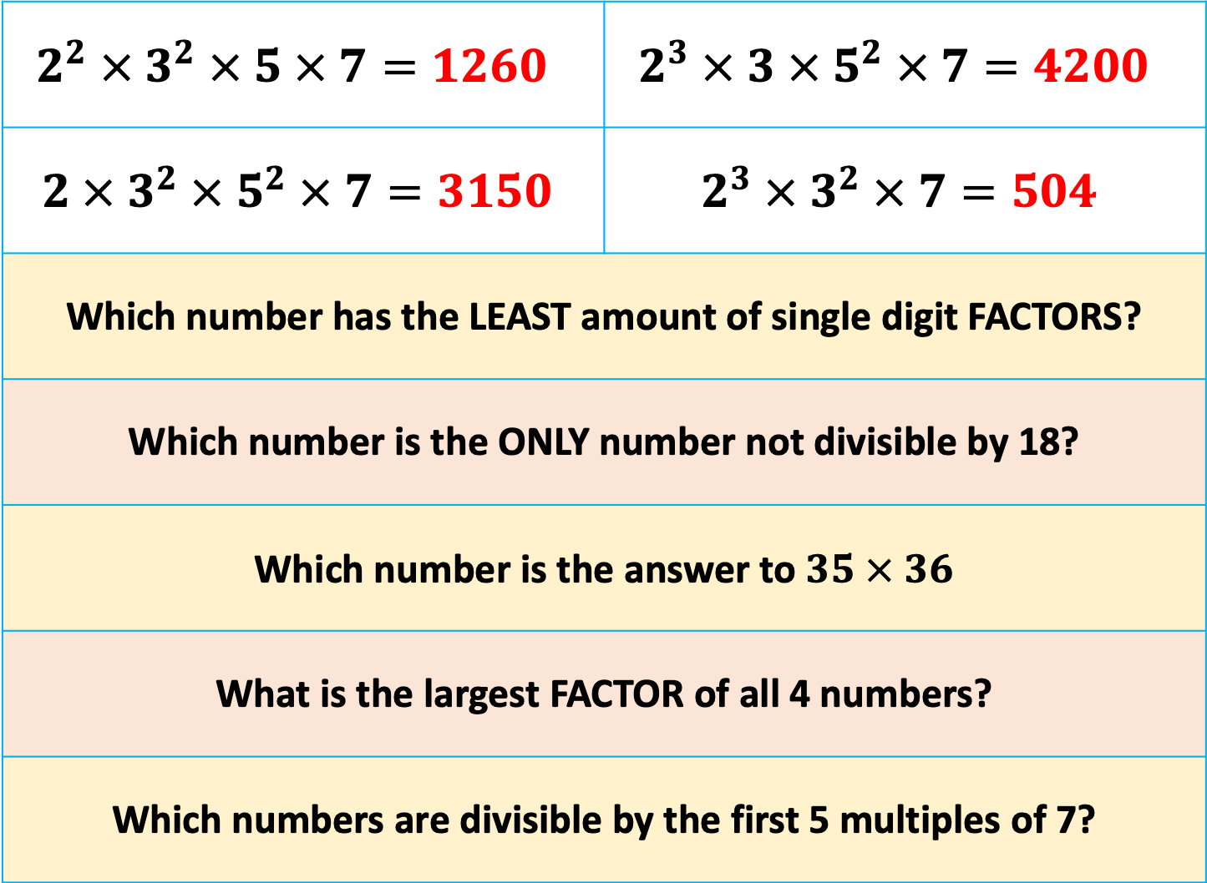
$$2^{2} ×{ 3}^{2} × 5 × 7=1260$$ | $$2^{3} × 3 × 5^{2} × 7=4200$$
$$2 ×{ 3}^{2} × 5^{2} × 7=3150$$ | $$2^{3} ×{ 3}^{2} × 7=504$$
Which number has the LEAST amount of single digit FACTORS?
Which number is the ONLY number not divisible by 18?
Which number is the answer to $35 × 36$
What is the largest FACTOR of all 4 numbers?
Which numbers are divisible by the first 5 multiples of 7?
Notes:
1, 2, 3, 4, 5, 6, 7, 9
1, 2, 3, 4, 5, 6, 7, 8
1, 2, 3, 5, 6, 7, 9
1, 2, 3, 4, 6, 7, 8, 9

