Slide 1
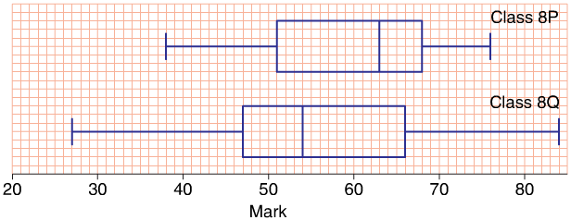





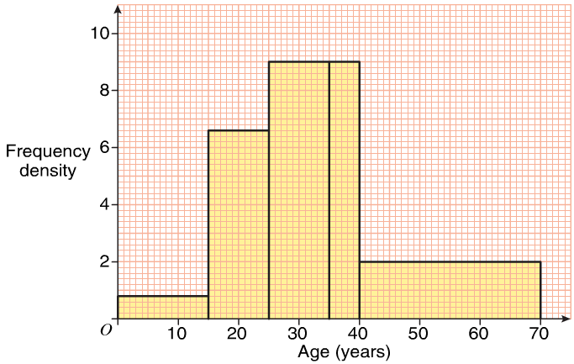
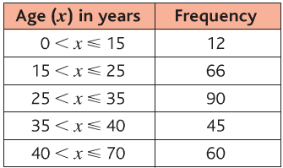
1.Students in class 8P and 8Q took the same test. Their results were organised in box plots.
a. In which class was the highest mark?
b. In which class did the students
perform better in the test? Give reasons.
2. Express as a standard form
3. Work out
5. Work out
6. Draw a histogram for the following data:
8P
8P, median higher than 8Q

Slide 2


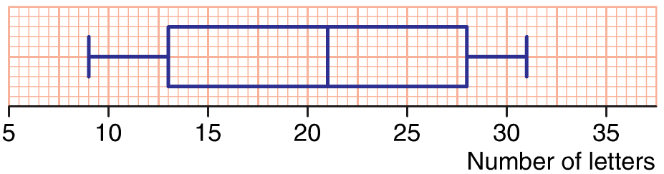
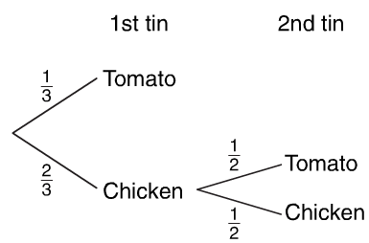




1. Work out
2. Draw a box plot for this data.
3.A box contains 3 tins of soup. 2 of the tins are chicken soup and 1 is tomato soup. Betty wants tomato soup.
She picks a tin at random from the box.
If not tomato she gives the tin to her son
And then picks another one at random.
Draw a probability tree.
Find the probability that betty does not pick tomato soup.
4. Express as a standard form
5. Work out

Slide 3





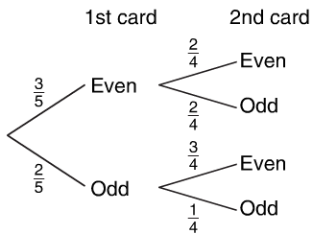
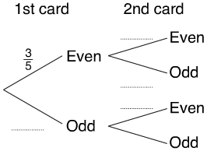
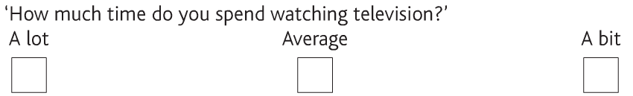
Express as a standard form
Work out
Mandy has these five cards.
Each card has a number on it.
She chooses two cards at random without replacement and records the number on each card.
Complete the prob tree.
Find the probability that both numbers
are even.
c. Find the probability that the sum of the two
Numbers are even numbers.
4.Angela carries out a survey of the amount of TV watched by the public. State the
Mistakes.

Slide 4



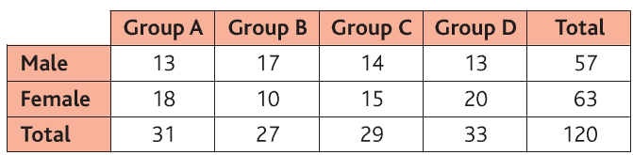

Express as a standard form
Work out
The two-way table shows the group and gender of 120 students in year 9. A stratified sample of 30 students is to be surveyed.
Work out the number of Group D female students.
Work out the number of Group A male students.
Work out the number of Group C female students.

Slide 5



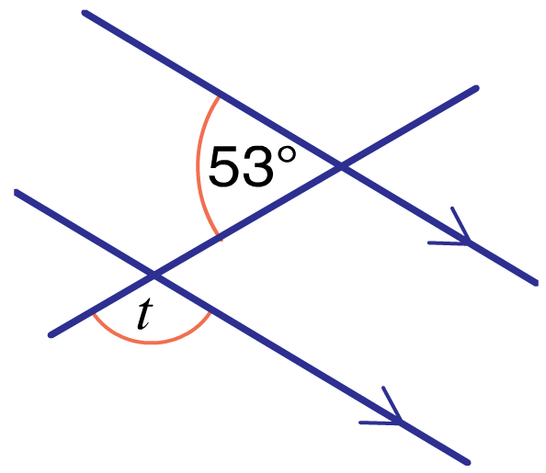


1.Using a stratified sample of 60 students, calculate the number of students in each year group.
2. The probability a biased dice will land on a 1 is 0.09. If I roll it 300 times. Find an estimate for the number of times its lands on 1.
3. Work out
4. a = 3×10⁸ , b = 2×10⁷ and Find y in SF to 2 s.f.
5. Calculate
6. Work out t. Give reasons to your answer.
Y7=15
Y8, Y9=12
Y10=11
Y11=10
300×0.09=27
1/512
0.19×10⁴⁹
127°

Slide 6
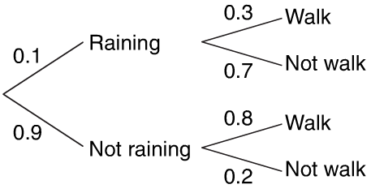


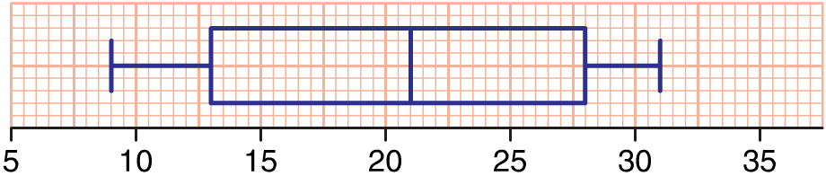
1. Michael returns to school tomorrow. If it is raining the P(he walks to school) = 0.3. If it is not raining the P(Michael walks to school) = 0.8. The P(it will rain tomorrow) = 0.1.
a. Draw a probability tree diagram.
b. Find the probability that Michael
will walk to school tomorrow.
2. Work out
3. Work out
4. Draw a box plot for the following data:
5. Find the equation of the line perpendicular to y=⅓x+4 and passes through (-2, 4)
9
6
Y= -3x - 2

Slide 7




The table shows the results of throwing a dice 600 times.
a. Estimate the probability to get a 2.
b. Estimate the probability to get an even number.
c. If the same dice is thrown 200 times, Estimate the number
times you will get a 6.
2.Write in the form (x + p)² +q:
3.Simplify
4. Convert as a single fraction.
5. Work out the size of each interior angle of a regular pentagon and a regular hexagon.
6.Write down the equation of the lines going through:
a.(-4,-3) and (-4,1) b. (-2,4) and (2,2)
120/600= 0.2
318/600=0.53
0.17×200=34
(x+3)² + 1 (x+4)² + 4
323/990
108° and 120°
X=-4
Y=-1/2x +1

Slide 8





1.Anil has 13 coins in his pocket, 6 pound coins, 3 twenty-pence coins and 4 two-pence coins. He picks two coins at random from his pocket. Work out the probability that the two coins each have the same value.
2. Simplify
3. Work out
4. Find the set of 3-point moving averages for this information.
5. Find the range and the interquartile range of the following data:
6. Find the Equation of a line going through (-3,1) and (2,6)
7.Convert 0.343434 into a single fraction.
6/13 × 5/12 + 4/13 × 3/12 + 3/12 × 2/12 = 4/13
360, 490, 530, 770, 970
R=56,I=42
34/99
Y=5/6x +7/2

Slide 9
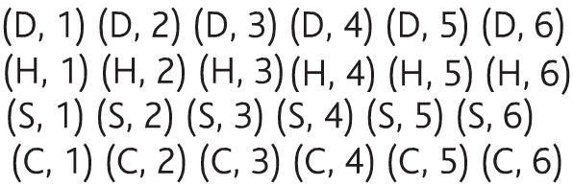




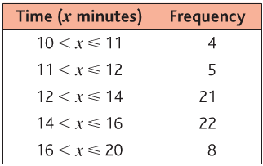
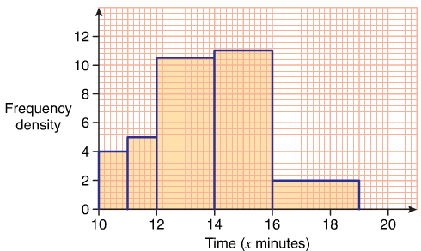
1. Ryan has four cards, the ace of hearts, diamonds, spades and clubs. He also has a fair dice. He rolls the dice and takes a card.
a.Write down the sample space diagram. (eg:D,4)
b.Find the probability that a red ace is taken.
2.Write in standard form
3.Work out
4.Work out
5.Write as an ordinary number
6.Draw an histogram to illustrate this information:
1/2
64,420

Slide 10







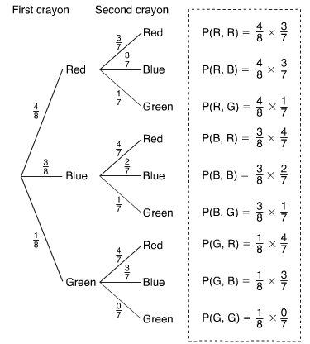
1.Work out the first two 4-month moving averages for this data:
2.Work out
3.Work out
4.Write as a standard form
5.Work out
6.There are 4 red, 3 blue and 1 green crayon.
A crayon is taken at random and not replaced,
then a second one is taken.
a.Draw and complete
a probability tree diagram.
b. Find the probability that
Exactly one of the crayons will be red.
1/4

Slide 11
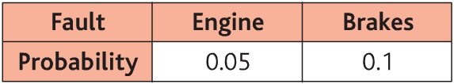




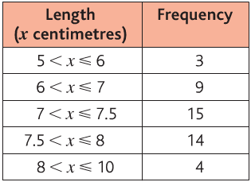
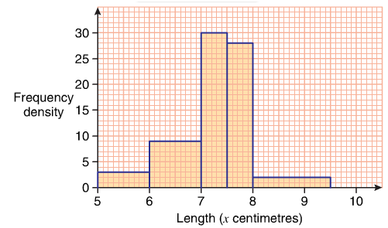
1.The table shows the probability of different mechanical faults in a car. Find the probability that the car will have
a. A faulty engine and faulty brakes
b. No faults
c. Exactly one fault.
2.Write in standard form
3.Work out
4.Work out
5.Draw a histogram to illustrate this information:
0.855
0.005
0.14

Slide 12
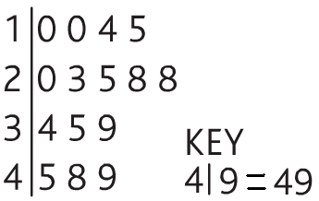




1.Draw a stem and leaf diagram to show this information
a.Find the range, the interquartile range.
2.Work out
3.Work out
4. Write as standard form
5.Find the equation of a line going through (-2,4) and (4,3)
6.Work out
7.When ringing the health centre the probability that the phone is engaged is 0.35. Edna needs to ring at 9am on both Monday and Tuesday. Find the probability that at 9am the phone will:
Be engaged on both Monday and Tuesday
Not be engaged on Monday but will be engaged on Tuesday
Be engaged on at least one day.
R=39,I=24
1/5
Y= -1/6x +12
0.1225
0.2275
0.5775

