Slide 1
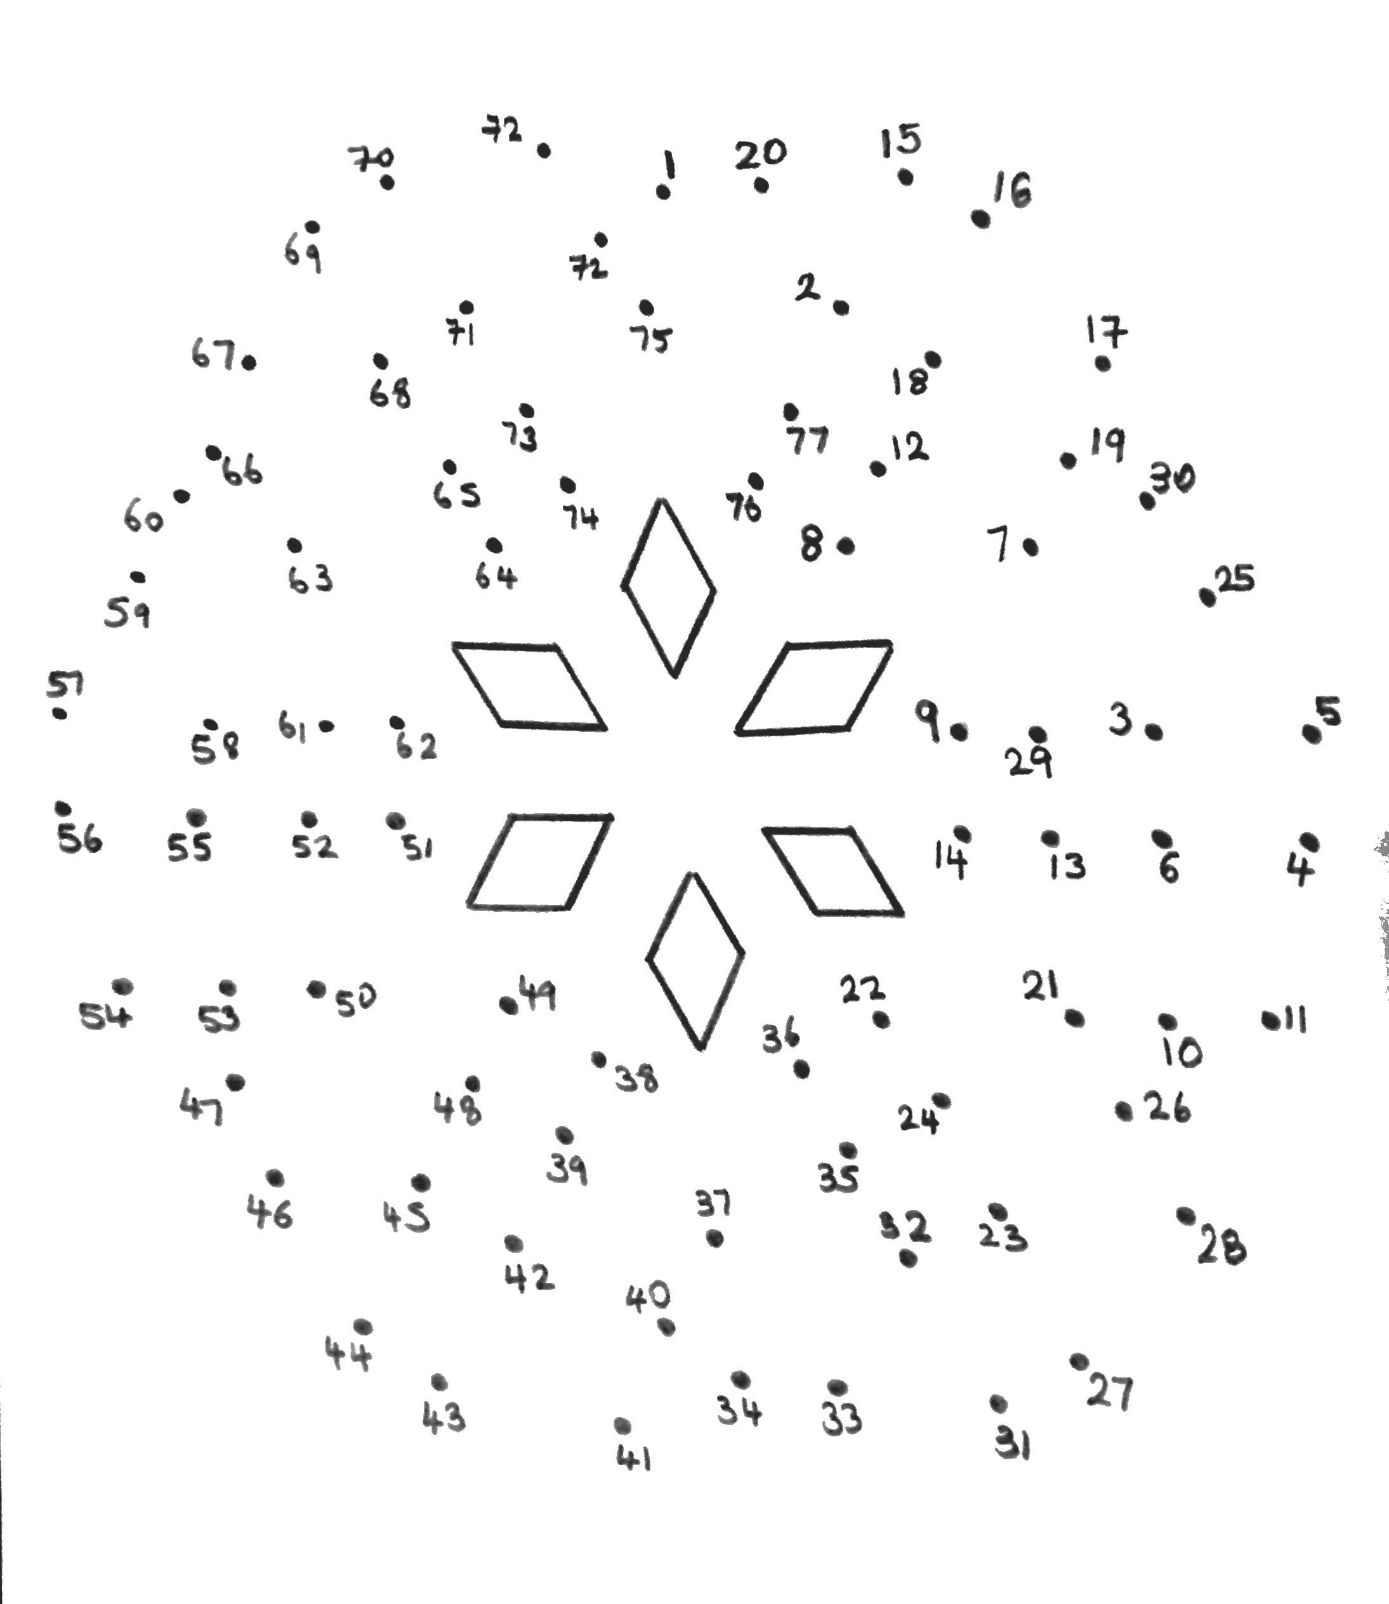
Dot to Dot Types of Number
Join 1 to the next term in the sequence:5, 8, 11, 14, 17…
Join that to the only even prime number
Join that to the missing factor of 15; 1, 3, 5 …
Join that to 4 squared
Join that to the 3rd multiple of 6
Join that to the 7th Prime number
Join that to the largest prime factor of 57
Join that to the LCM of 3 and 4
Join that to 2 cubed
Join that to the 4th Prime Number
Join that to 3 squared
Join that to the next number in the sequence:5, 11, 17, 23, …
Join that to the LCM of 5 and 6
Join that to 5 squared
Join that to the next 2 odd numbers after 1
Join that to the next 2 even numbers after 2
Join that to the 5th prime number
Join that to the missing factor of 20; 1,2,4,5,20
Join that to the 6th prime number
Join that to 1² + 2² + 3²
Join that to the 7th multiple of 3
Join that to the first 4 terms in the sequence; 2n + 20
Join that to the 9th prime number
Join that to missing factor of 27; 1,3,9 …
To finish the pattern join the last point to 31 and continue to join the dots in order until you reach 77
Then join that to 1

