Slide 1
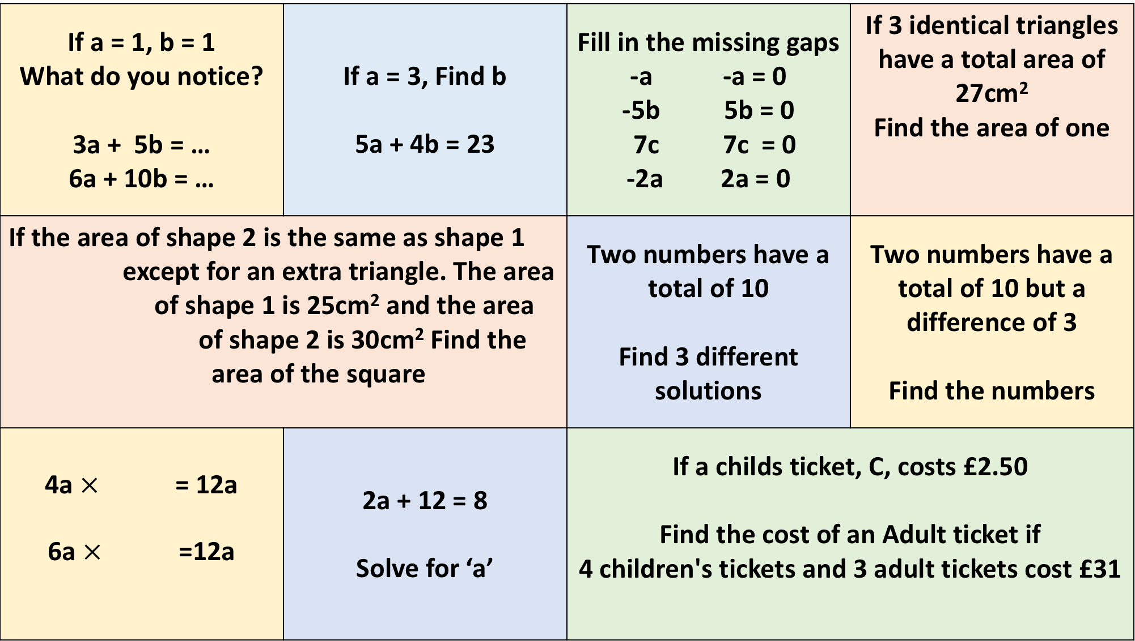
If a = 1, b = 1 What do you notice? 3a + 5b = … 6a + 10b = … | If a = 3, Find b 5a + 4b = 23 | Fill in the missing gaps -a -a = 0 -5b 5b = 0 7c 7c = 0 -2a 2a = 0 | If 3 identical triangles have a total area of 27cm² Find the area of one
If the area of shape 2 is the same as shape 1 except for an extra triangle. The area of shape 1 is 25cm² and the area of shape 2 is 30cm² Find the area of the square |  | Two numbers have a total of 10 Find 3 different solutions | Two numbers have a total of 10 but a difference of 3 Find the numbers
4a $×$ = 12a 6a $×$ =12a | 2a + 12 = 8 Solve for ‘a’ | If a childs ticket, C, costs £2.50 Find the cost of an Adult ticket if 4 children's tickets and 3 adult tickets cost £31
Equal

