Slide 1
The fractions I used to complete the circle:
Equivalent fractions:
Rules
Roll the dice
Follow the rules
on the screen
Put the slice/sector onto your plate. The first to fill their plate is the winner. You can’t overlap pieces or leave gaps.

Slide 2
The fractions I used to complete the circle:
Equivalent fractions:
Rules
Roll the dice
Follow the rules
on the screen
Put the slice/sector onto your plate. The first to fill their plate is the winner. You can’t overlap pieces or leave gaps.

Slide 3
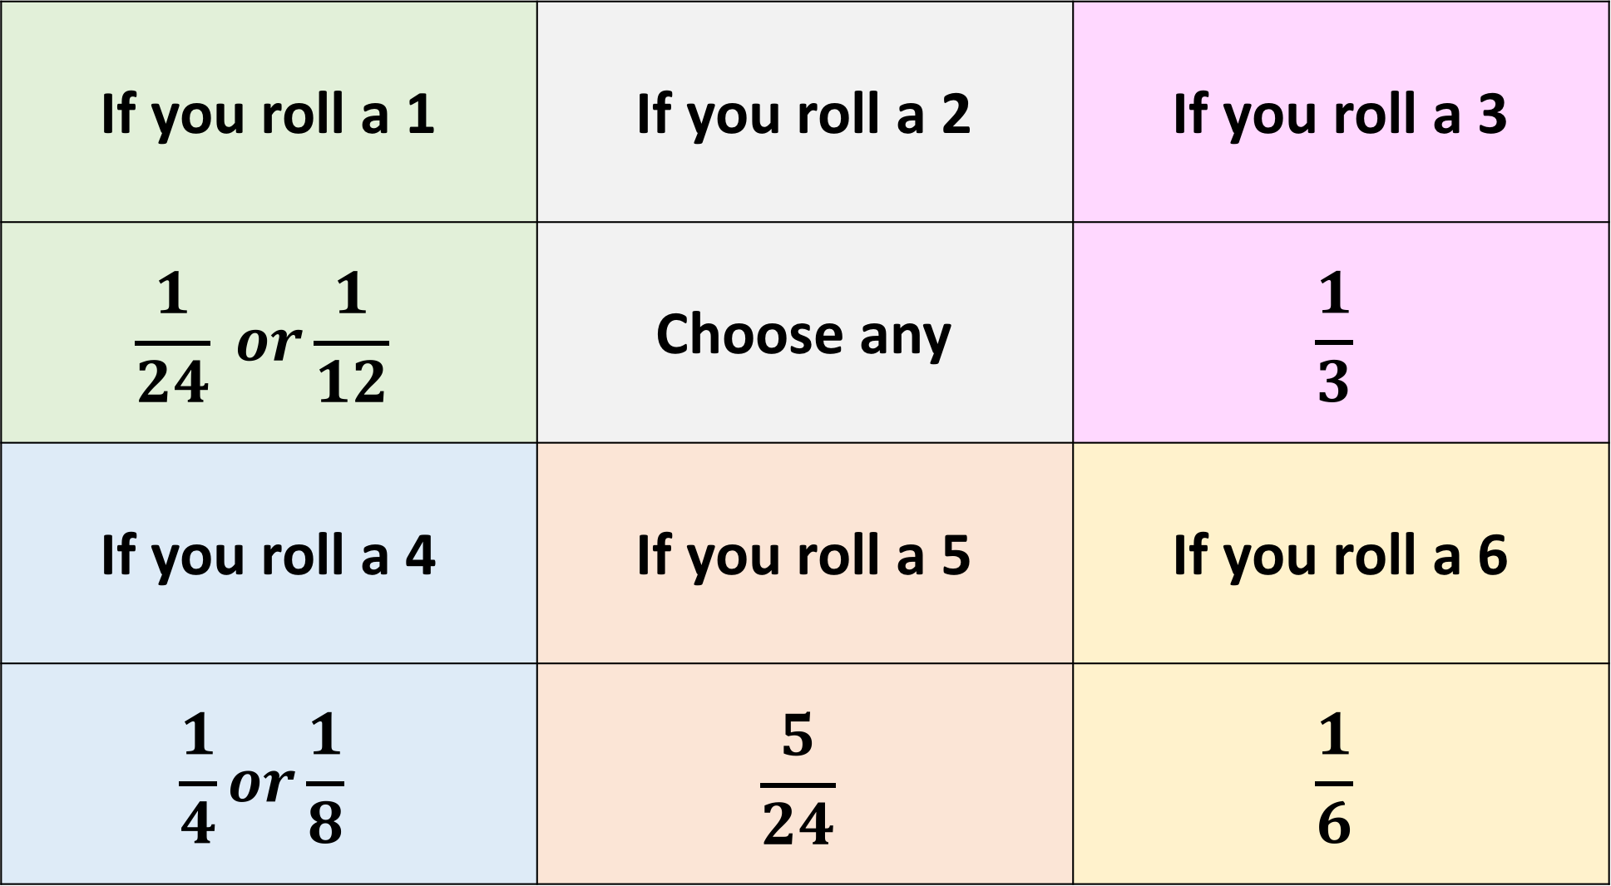
If you roll a 1 | If you roll a 2 | If you roll a 3
$$\frac{1}{24} or\frac{1}{12}$$ | Choose any | $$\frac{1}{3}$$
If you roll a 4 | If you roll a 5 | If you roll a 6
$$\frac{1}{4}or\frac{1}{8}$$ | $$\frac{5}{24}$$ | $$\frac{1}{6}$$

Slide 4
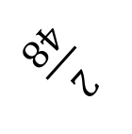
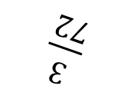
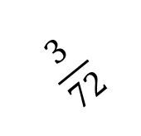
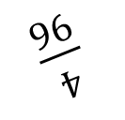

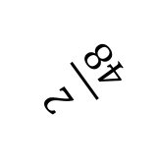
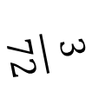
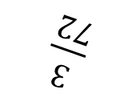

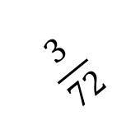
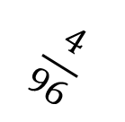
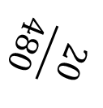
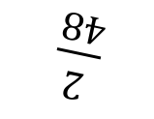
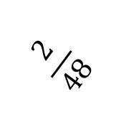
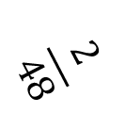
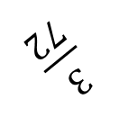
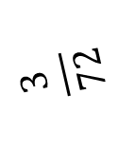
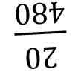
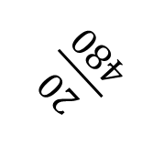
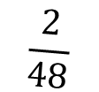
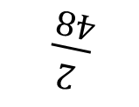
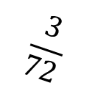
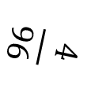
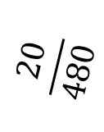
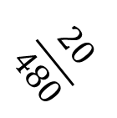
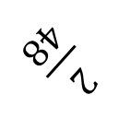
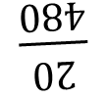
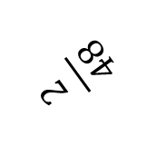
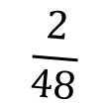
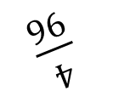

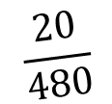
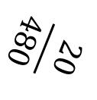
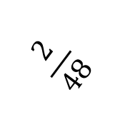
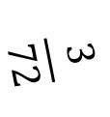
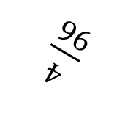
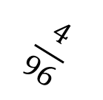
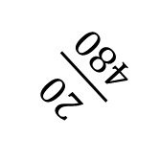
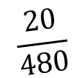
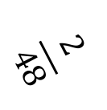
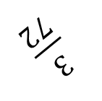
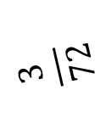

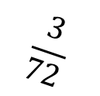
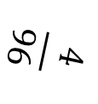
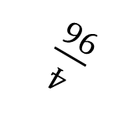
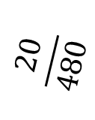
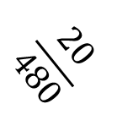
$$\frac{20}{480}$$
$$\frac{2}{48}$$
$$\frac{20}{480}$$
$$\frac{2}{48}$$
$$\frac{4}{96}$$
$$\frac{3}{72}$$
$$\frac{4}{96}$$
$$\frac{3}{72}$$
$$\frac{3}{72}$$
$$\frac{4}{96}$$
$$\frac{3}{72}$$
$$\frac{4}{96}$$
$$\frac{2}{48}$$
$$\frac{20}{480}$$
$$\frac{2}{48}$$
$$\frac{20}{480}$$
$$\frac{20}{480}$$
$$\frac{2}{48}$$
$$\frac{20}{480}$$
$$\frac{2}{48}$$
$$\frac{4}{96}$$
$$\frac{3}{72}$$
$$\frac{4}{96}$$
$$\frac{3}{72}$$
$$\frac{3}{72}$$
$$\frac{4}{96}$$
$$\frac{3}{72}$$
$$\frac{4}{96}$$
$$\frac{2}{48}$$
$$\frac{20}{480}$$
$$\frac{2}{48}$$
$$\frac{20}{480}$$
$$\frac{20}{480}$$
$$\frac{2}{48}$$
$$\frac{20}{480}$$
$$\frac{2}{48}$$
$$\frac{4}{96}$$
$$\frac{3}{72}$$
$$\frac{4}{96}$$
$$\frac{3}{72}$$
$$\frac{3}{72}$$
$$\frac{4}{96}$$
$$\frac{3}{72}$$
$$\frac{4}{96}$$
$$\frac{2}{48}$$
$$\frac{20}{480}$$
$$\frac{2}{48}$$
$$\frac{20}{480}$$
Notes:
8/24
6/24
5/24
4/24
3/24
2/24
1/24

Slide 5
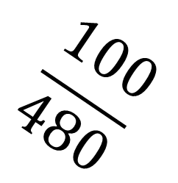
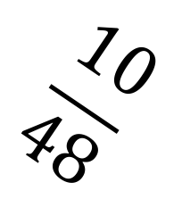
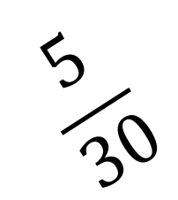
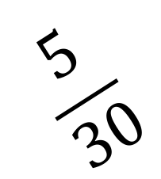
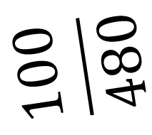





$$\frac{5}{30}$$
$$\frac{10}{48}$$
$$\frac{5}{30}$$
$$\frac{100}{480}$$
$$\frac{100}{480}$$
$$\frac{10}{48}$$
$$\frac{100}{480}$$
$$\frac{10}{48}$$
$$\frac{10}{48}$$
$$\frac{100}{480}$$

Slide 6
























$$\frac{4}{48}$$
$$\frac{5}{60}$$
$$\frac{4}{48}$$
$$\frac{5}{60}$$
$$\frac{3}{36}$$
$$\frac{6}{72}$$
$$\frac{3}{36}$$
$$\frac{6}{72}$$
$$\frac{2}{24}$$
$$\frac{7}{84}$$
$$\frac{2}{24}$$
$$\frac{7}{84}$$
$$\frac{2}{24}$$
$$\frac{7}{84}$$
$$\frac{2}{24}$$
$$\frac{7}{84}$$
$$\frac{3}{36}$$
$$\frac{6}{72}$$
$$\frac{3}{36}$$
$$\frac{6}{72}$$
$$\frac{4}{48}$$
$$\frac{5}{60}$$
$$\frac{4}{48}$$
$$\frac{5}{60}$$

Slide 7
















$$\frac{4}{32}$$
$$\frac{5}{40}$$
$$\frac{4}{32}$$
$$\frac{5}{40}$$
$$\frac{4}{32}$$
$$\frac{5}{40}$$
$$\frac{4}{32}$$
$$\frac{5}{40}$$
$$\frac{10}{80}$$
$$\frac{7}{56}$$
$$\frac{10}{80}$$
$$\frac{7}{56}$$
$$\frac{10}{80}$$
$$\frac{7}{56}$$
$$\frac{10}{80}$$
$$\frac{7}{56}$$

Slide 8











$$\frac{5}{30}$$
$$\frac{5}{30}$$
$$\frac{7}{42}$$
$$\frac{7}{42}$$
$$\frac{5}{30}$$
$$\frac{5}{30}$$
$$\frac{3}{18}$$
$$\frac{3}{18}$$
$$\frac{7}{42}$$
$$\frac{7}{42}$$
$$\frac{3}{18}$$
$$\frac{3}{18}$$

Slide 9








$$\frac{3}{12}$$
$$\frac{3}{12}$$
$$\frac{5}{20}$$
$$\frac{5}{20}$$
$$\frac{3}{12}$$
$$\frac{3}{12}$$
$$\frac{5}{20}$$
$$\frac{5}{20}$$

Slide 10






$$\frac{7}{21}$$
$$\frac{6}{18}$$
$$\frac{7}{21}$$
$$\frac{6}{18}$$
$$\frac{7}{21}$$
$$\frac{6}{18}$$

