Slide 1
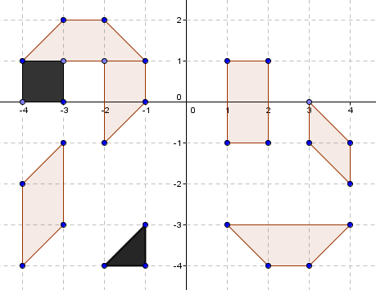





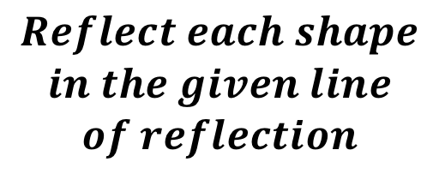

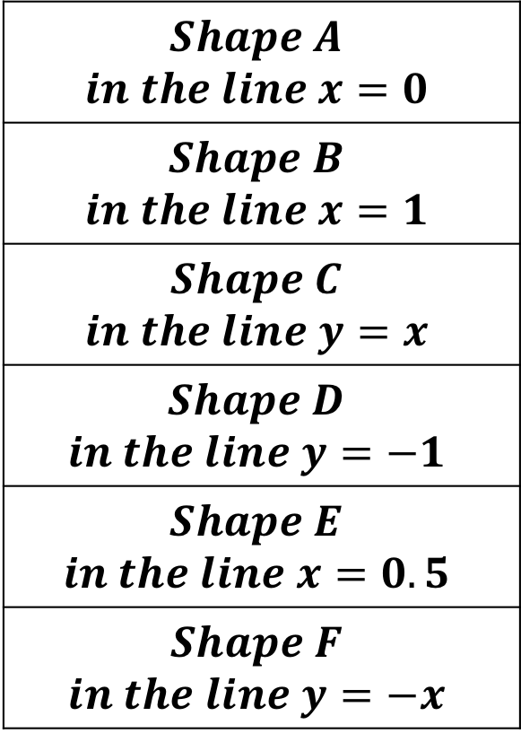
$$Reflect each shape$$
$$in the given line$$
$$of reflection$$
$$A$$
$$B$$
$$Shape A$$ $$in the line x=0$$
$$Shape B$$ $$in the line x=1$$
$$Shape C$$ $$in the line y=x$$
$$Shape D$$ $$in the line y=−1$$
$$Shape E$$ $$in the line x=0.5$$
$$Shape F$$ $$in the line y=−x$$
$$D$$
$$E$$
$$C$$
$$F$$

Slide 2
$$Reflect each shape$$
$$in the given line$$
$$of reflection$$
$$A$$
$$B$$
$$Shape A$$ $$in the line x=0$$
$$Shape B$$ $$in the line x=1$$
$$Shape C$$ $$in the line y=x$$
$$Shape D$$ $$in the line y=−1$$
$$Shape E$$ $$in the line x=0.5$$
$$Shape F$$ $$in the line y=−x$$
$$D$$
$$E$$
$$C$$
$$F$$

Slide 3
$$Reflect each shape$$
$$in the given line$$
$$of reflection$$
$$A$$
$$B$$
$$Shape A$$ $$in the line x=0$$
$$Shape B$$ $$in the line x=1$$
$$Shape C$$ $$in the line y=x$$
$$Shape D$$ $$in the line y=−1$$
$$Shape E$$ $$in the line x=0.5$$
$$Shape F$$ $$in the line y=−x$$
$$D$$
$$E$$
$$C$$
$$F$$

Slide 4
$$Reflect each shape$$
$$in the given line$$
$$of reflection$$
$$A$$
$$B$$
$$Shape A$$ $$in the line x=0$$
$$Shape B$$ $$in the line x=1$$
$$Shape C$$ $$in the line y=x$$
$$Shape D$$ $$in the line y=−1$$
$$Shape E$$ $$in the line x=0.5$$
$$Shape F$$ $$in the line y=−x$$
$$D$$
$$E$$
$$C$$
$$F$$

Slide 5
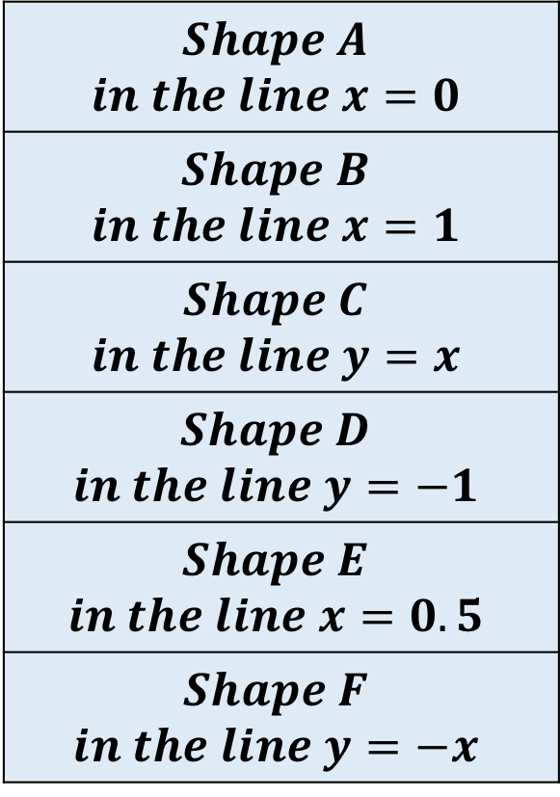
$$Reflect each shape$$
$$in the given line$$
$$of reflection$$
$$A$$
$$B$$
$$Shape A$$ $$in the line x=0$$
$$Shape B$$ $$in the line x=1$$
$$Shape C$$ $$in the line y=x$$
$$Shape D$$ $$in the line y=−1$$
$$Shape E$$ $$in the line x=0.5$$
$$Shape F$$ $$in the line y=−x$$
$$D$$
$$E$$
$$C$$
$$F$$

Slide 6
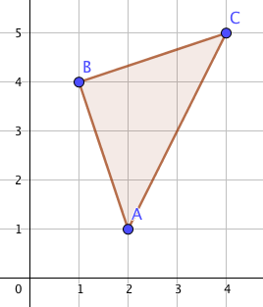
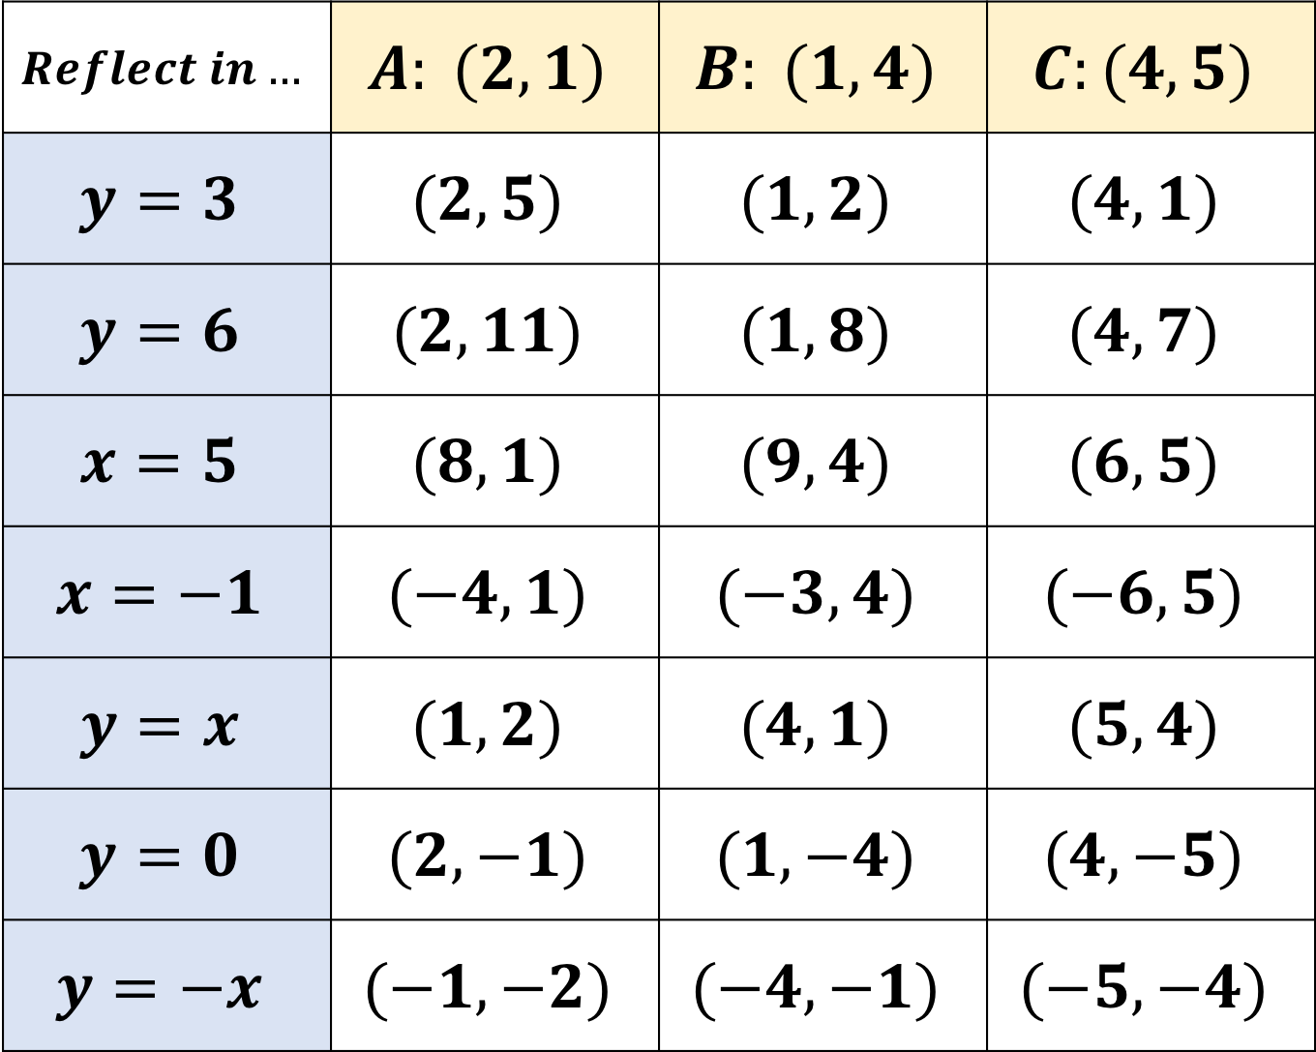
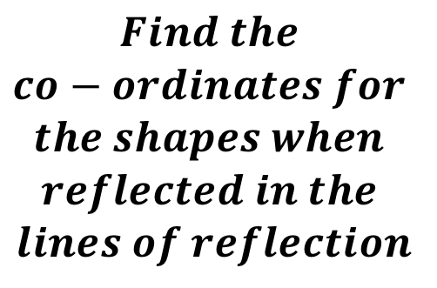
$$Reflect in…$$ | $$A: (2, 1)$$ | $$B: (1, 4)$$ | $$C:(4, 5)$$
$$y=3$$ | $$(2, 5)$$ | $$(1, 2)$$ | $$(4, 1)$$
$$y=6$$ | $$(2, 11)$$ | $$(1, 8)$$ | $$(4, 7)$$
$$x=5$$ | $$(8, 1)$$ | $$(9, 4)$$ | $$(6, 5)$$
$$x=−1$$ | $$(−4, 1)$$ | $$(−3, 4)$$ | $$(−6, 5)$$
$$y=x$$ | $$(1, 2)$$ | $$(4, 1)$$ | $$(5, 4)$$
$$y=0$$ | $$(2, −1)$$ | $$(1, −4)$$ | $$(4, −5)$$
$$y=−x$$ | $$(−1, −2)$$ | $$(−4, −1)$$ | $$(−5, −4)$$
$$Find the$$
$$co−ordinates for$$
$$the shapes when$$
$$reflected in the$$
$$lines of reflection$$

Slide 7
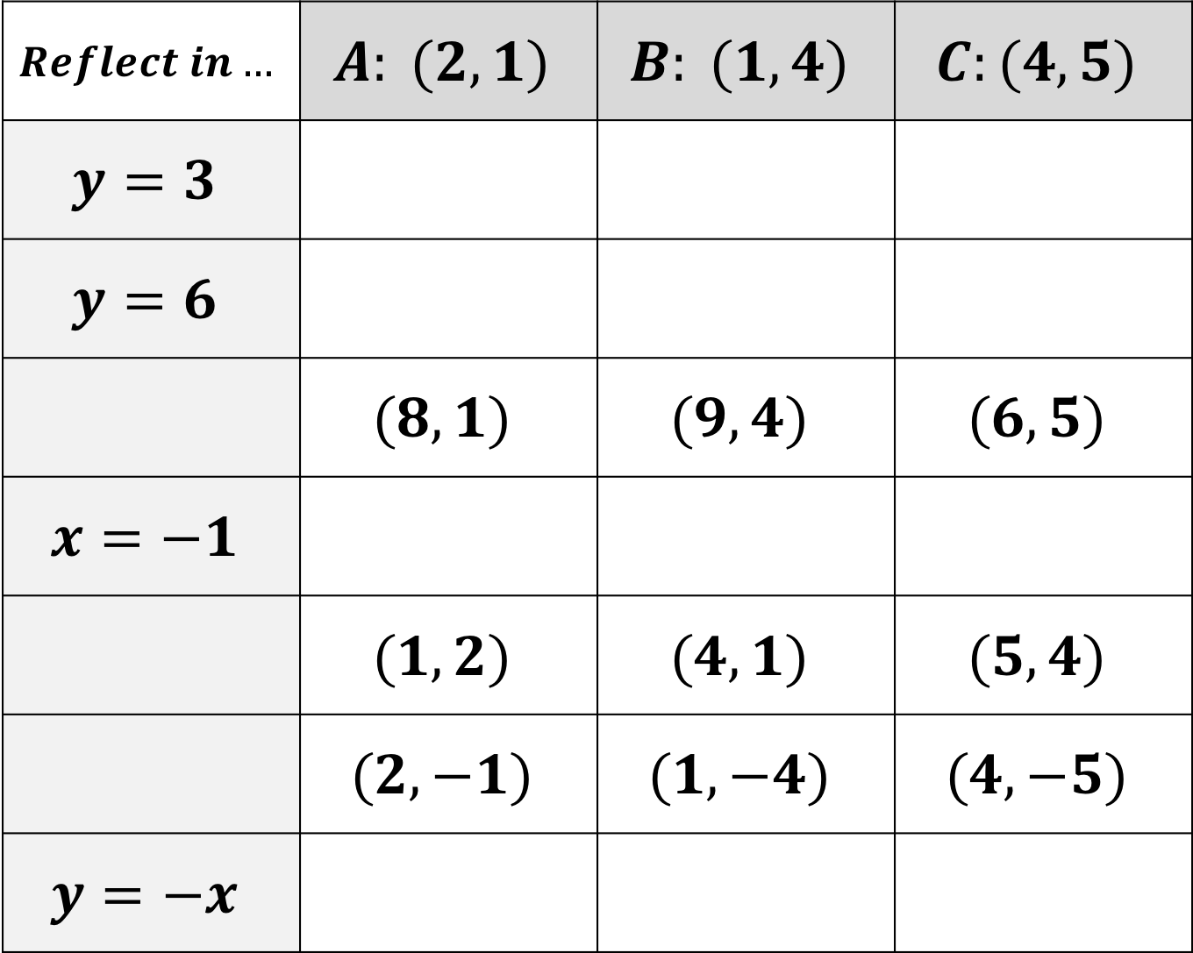
$$Reflect in…$$ | $$A: (2, 1)$$ | $$B: (1, 4)$$ | $$C:(4, 5)$$
$$y=3$$
$$y=6$$
 | $$(8, 1)$$ | $$(9, 4)$$ | $$(6, 5)$$
$$x=−1$$
 | $$(1, 2)$$ | $$(4, 1)$$ | $$(5, 4)$$
 | $$(2, −1)$$ | $$(1, −4)$$ | $$(4, −5)$$
$$y=−x$$
$$Find the$$
$$co−ordinates for$$
$$the shapes when$$
$$reflected in the$$
$$lines of reflection$$

Slide 8
$$Reflect in…$$ | $$A: (2, 1)$$ | $$B: (1, 4)$$ | $$C:(4, 5)$$
$$y=3$$
$$y=6$$
 | $$(8, 1)$$ | $$(9, 4)$$ | $$(6, 5)$$
$$x=−1$$
 | $$(1, 2)$$ | $$(4, 1)$$ | $$(5, 4)$$
 | $$(2, −1)$$ | $$(1, −4)$$ | $$(4, −5)$$
$$y=−x$$
$$Find the$$
$$co−ordinates for$$
$$the shapes when$$
$$reflected in the$$
$$lines of reflection$$

Slide 9
$$Reflect in…$$ | $$A: (2, 1)$$ | $$B: (1, 4)$$ | $$C:(4, 5)$$
$$y=3$$
$$y=6$$
 | $$(8, 1)$$ | $$(9, 4)$$ | $$(6, 5)$$
$$x=−1$$
 | $$(1, 2)$$ | $$(4, 1)$$ | $$(5, 4)$$
 | $$(2, −1)$$ | $$(1, −4)$$ | $$(4, −5)$$
$$y=−x$$
$$Find the$$
$$co−ordinates for$$
$$the shapes when$$
$$reflected in the$$
$$lines of reflection$$

Slide 10
$$Reflect in…$$ | $$A: (2, 1)$$ | $$B: (1, 4)$$ | $$C:(4, 5)$$
$$y=3$$
$$y=6$$
 | $$(8, 1)$$ | $$(9, 4)$$ | $$(6, 5)$$
$$x=−1$$
 | $$(1, 2)$$ | $$(4, 1)$$ | $$(5, 4)$$
 | $$(2, −1)$$ | $$(1, −4)$$ | $$(4, −5)$$
$$y=−x$$
$$Find the$$
$$co−ordinates for$$
$$the shapes when$$
$$reflected in the$$
$$lines of reflection$$

