Slide 1
Product of 455
Product of 96
Product of 220
Product of 616
Product of 200
Product of 78

Slide 2
The numbers in this row have to add up to 12
The numbers in this row have to add up to 27
The numbers in this row have to add up to 31
The numbers in this column add to 19
The numbers in this column add to 29
The numbers in this column add to 22

Slide 3
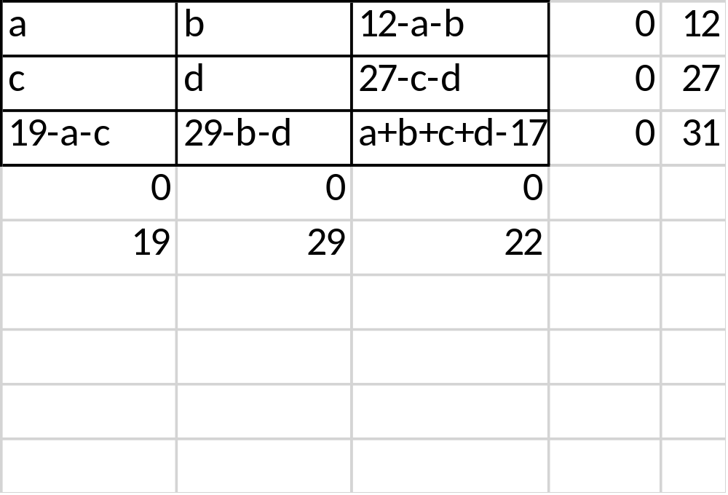

Slide 4
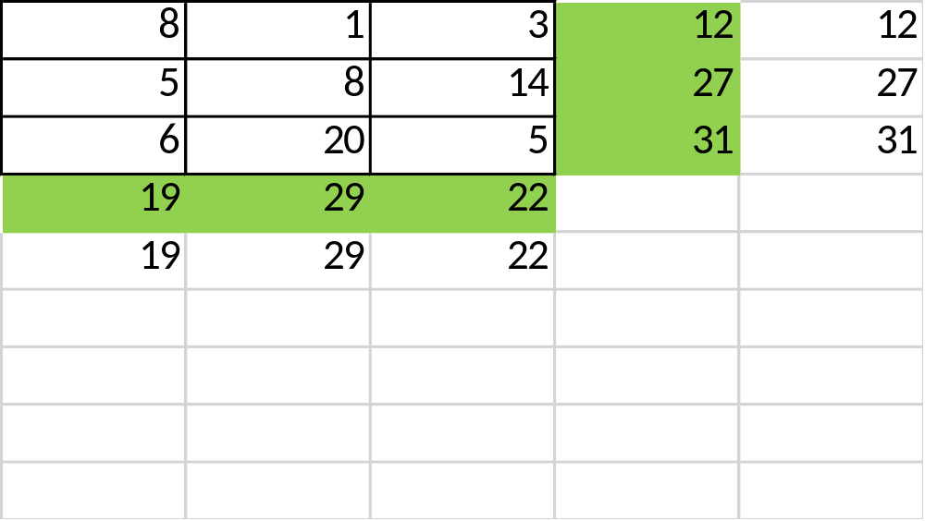

Slide 5
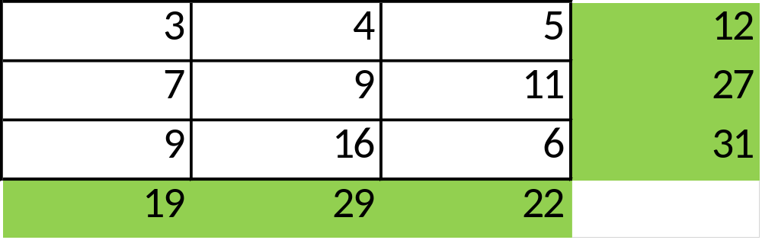

Slide 6
7
1
4
The numbers in this row have to add up to 12
9
11
7
The numbers in this row have to add up to 27
3
18
10
The numbers in this row have to add up to 31
The numbers in this column add to 19
The numbers in this column add to 29
The numbers in this column add to 22

Slide 7
The numbers in this row have to add up to 12
The numbers in this row have to add up to 27
The numbers in this row have to add up to 31
The numbers in this column add to 20
The numbers in this column add to 28
The numbers in this column add to 21
Can this have a solution?

Slide 8
The numbers in this row are consecutive and have to add up to 18
The numbers in this row are consecutive and have to add up to 24
The numbers in this row are consecutive and have to add up to 30
The numbers in this column are consecutive odd numbers
The numbers in this column are consecutive even numbers
The numbers in this column are consecutive odd numbers

Slide 9
x
X+1
X+2
The numbers in this row are consecutive and have to add up to 18
X+2
X+3
X+4
The numbers in this row are consecutive and have to add up to 24
X+4
X+5
X+6
The numbers in this row are consecutive and have to add up to 30
The numbers in this column are consecutive odd numbers
The numbers in this column are consecutive even numbers
The numbers in this column are consecutive odd numbers

Slide 10
5
6
7
The numbers in this row are consecutive and have to add up to 18
7
8
9
The numbers in this row are consecutive and have to add up to 24
9
10
11
The numbers in this row are consecutive and have to add up to 30
The numbers in this column are consecutive odd numbers
The numbers in this column are consecutive even numbers
The numbers in this column are consecutive odd numbers

Slide 11
The numbers in this row are consecutive
The numbers in this row are consecutive
The numbers in this row are consecutive
The numbers in this column are consecutive odd numbers
The numbers in this column are consecutive even numbers
The numbers in this column are consecutive odd numbers

Slide 12
11
12
13
The numbers in this row are consecutive
13
14
15
The numbers in this row are consecutive
15
16
17
The numbers in this row are consecutive
The numbers in this column are consecutive odd numbers
The numbers in this column are consecutive even numbers
The numbers in this column are consecutive odd numbers

Slide 13
The numbers in this row have to be PRIME and add up to 12
The numbers in this row have to be MULTIPLES of 3 and add up to 27
The numbers in this row have to add up to 31
The numbers in this column add to 19
The numbers in this column are ODD
The numbers in this column are EVEN

Slide 14
3
7
2
The numbers in this row have to be PRIME and add up to 12
6
9
12
The numbers in this row have to be MULTIPLES of 3 and add up to 27
10
13
8
The numbers in this row have to add up to 31
The numbers in this column add to 19
The numbers in this column are ODD
The numbers in this column are EVEN

Slide 15
The numbers in this row have to be PRIME and multiply to make 70
The numbers in this row have to be MULTIPLES of 3 & multiply to make 162
The numbers in this row have to multiply to make 32
The numbers in this column multiply to make 168
The numbers in this column are ODD
The numbers in this column are EVEN

Slide 16
7
5
2
The numbers in this row have to be PRIME and multiply to make 70
3
9
6
The numbers in this row have to be MULTIPLES of 3 & multiply to make 162
8
1
4
The numbers in this row have to multiply to make 32
The numbers in this column multiply to make 168
The numbers in this column are ODD
The numbers in this column are EVEN

Slide 17
The numbers in this row have to add up to 12
The numbers in this row have to add up to 27
The numbers in this row have to add up to 31
The numbers in this column add to 19
The numbers in this column add to 29
The numbers in this column add to 22

Slide 18
The numbers in this row are consecutive
The numbers in this row are consecutive
The numbers in this row are consecutive
The numbers in this column are consecutive odd numbers
The numbers in this column are consecutive even numbers
The numbers in this column are consecutive odd numbers

Slide 19
The numbers in this row have to be PRIME and add up to 12
The numbers in this row have to be MULTIPLES of 3 and add up to 27
The numbers in this row have to add up to 31
The numbers in this column add to 19
The numbers in this column are ODD
The numbers in this column are EVEN

Slide 20
The numbers in this row have to be PRIME and multiply to make 70
The numbers in this row have to be MULTIPLES of 3 & multiply to make 162
The numbers in this row have to multiply to make 32
The numbers in this column multiply to make 168
The numbers in this column are ODD
The numbers in this column are EVEN

