Slide 1
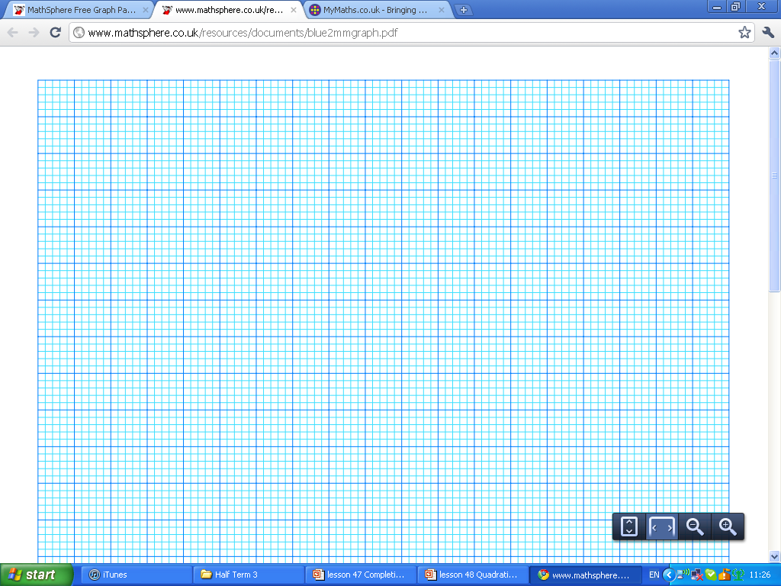
Each graph below crosses the x axis twice like the diagram to the right
Find the length of the GREEN line
-this is the distance between the two x-intercepts.
0
Find the length of the GREEN line
y = (x – 5)(x + 3) | y = (x – 2)(x + 6) | y = (x + 5)(x + 3)
y = (x + 2)(x + 6) | y = (x + 5)(x – 3) | y = (x + 2)(x – 6)
y = (x – 5)(x – 3) | y = (x – 5)(x + 2) | y = (x – 2)(x – 6)

Slide 2
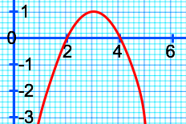
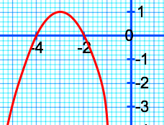
Match the equation with the graph
3
2
2
1
1
y = –(x – 2)(x – 4)
0
0
2
4
6
-8
-6
-4
-2
-1
-1
y = (x + 2)(x + 4)
y = –(x + 2)(x + 4)
y = (x – 2)(x – 4)

Slide 3
A water sprinkler is used to water a lawn.
It creates a path modelled by the equation
y = 0.5(4 – x)(4 + x)
Both scales on the graph are in metres
How far away does the water land from that water sprinkler?
What is the highest point the water sprinkler can reach?
A man, 1.7 metres tall is standing 0.5 metres from the water jet, will he be hit by the water jet?
8m
Water
jet
0
8m

Slide 4

A water sprinkler is used to water a lawn.
It creates a path modelled by the equation
y = 0.5(4 – x)(4 + x)
Both scales on the graph are in metres
What is the furthest distance the water can reach from the water sprinkler?
What is the highest point the water sprinkler can reach?
A man, 1.7 metres tall is standing 0.5 metres from the water sprinkler, will he be hit by the water sprinkler?
10
8
6
4
Water
jet
2
–4
–3
–2
–1
0
1
2
3
4
–2
–4
–6

Slide 5
A water sprinkler is used to water a lawn. The water is released from a pump ‘h’ metres from the ground. It lands 7.5m from where it released.
It creates a path modelled by the equation
y = 0.5(4 – x)(4 + x)
Both scales on the graph are in metres
Find ‘h’
What is the highest point the water sprinkler can reach?
Water
jet
h
0
7.5

Slide 6
A water sprinkler is used to water a lawn. The water is released from a pump ‘h’ metres from the ground. It lands 7.5m from where it released.
It creates a path modelled by the equation
y = 0.5(4 – x)(4 + x)
Both scales on the graph are in metres
Find ‘h’
What is the highest point the water sprinkler can reach?
Water
jet
h
0
7.5

