Slide 1
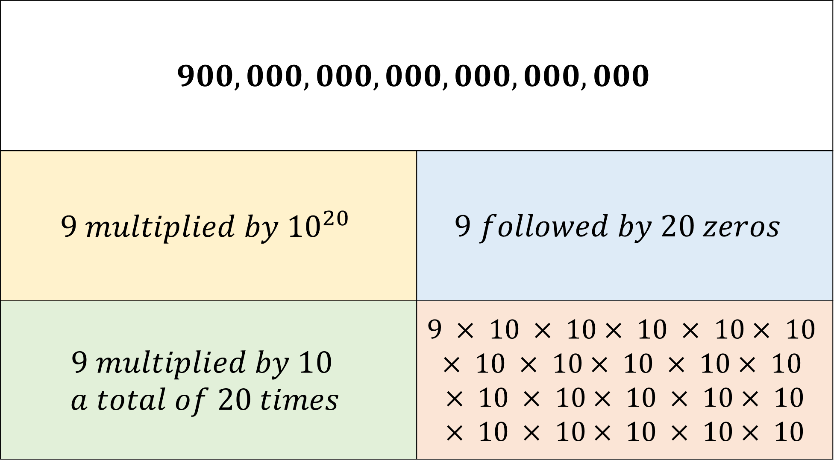
$$900,000,000,000,000,000,000$$
$$9 multiplied by {10}^{20}$$ | $$9 followed by 20 zeros$$
$$9 multiplied by 10$$ $$a total of 20 times$$ | $9 × 10 × 10$ $× 10 × 10$ $× 10$ $× 10 × 10$ $× 10 × 10$ $× 10$ $× 10 × 10$ $× 10 × 10× 10$ $× 10 × 10$ $× 10 × 10× 10$

Slide 2
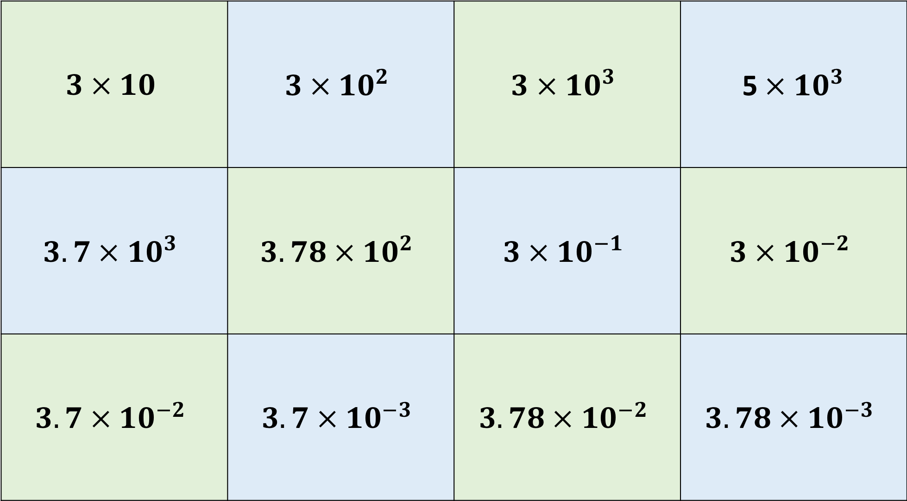
$$3 × 10$$ | $$3 × {10}^{2}$$ | $$3 × {10}^{3}$$ | 5$× {10}^{3}$
$$3.7 × {10}^{3}$$ | $$3.78 × {10}^{2}$$ | $$3 × {10}^{−1}$$ | $$3 × {10}^{−2}$$
$$3.7 × {10}^{−2}$$ | $$3.7 × {10}^{−3}$$ | $$3.78 × {10}^{−2}$$ | $$3.78 × {10}^{−3}$$

Slide 3
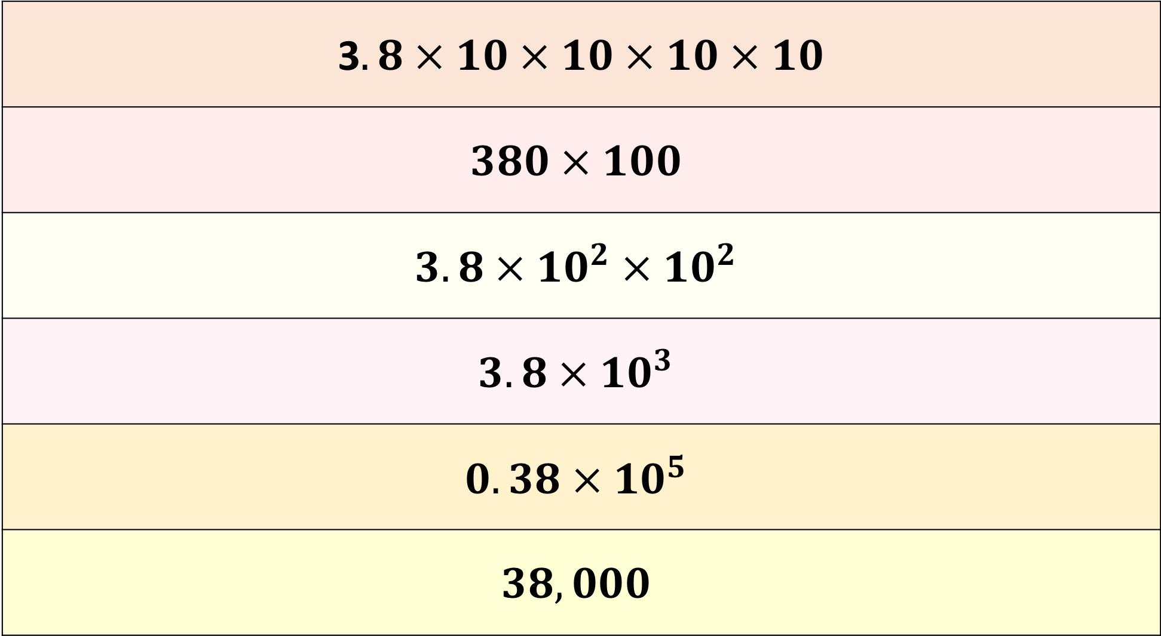
3$.8 × 10 × 10 × 10 × 10$
$$380 × 100$$
$$3.8 × {10}^{2} ×{ 10}^{2}$$
$$3.8 × {10}^{3}$$
$$0.38 × {10}^{5}$$
$$38,000$$

Slide 4
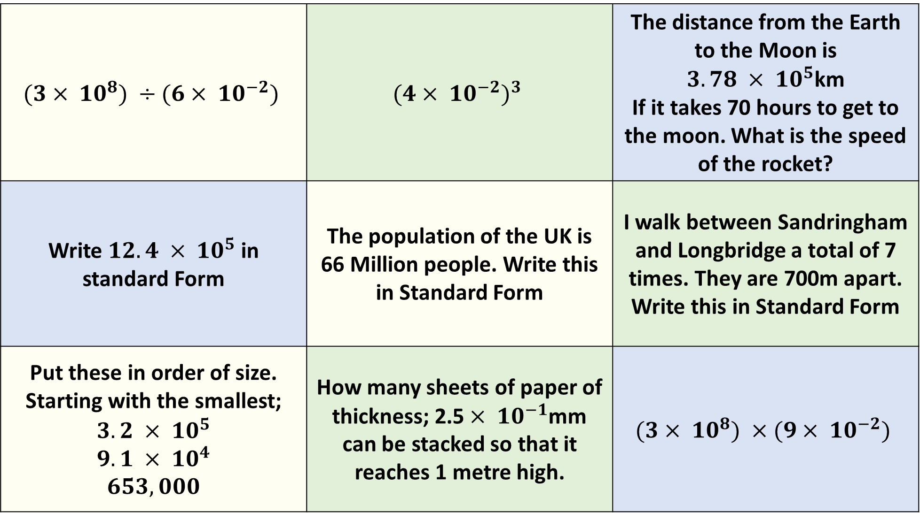
$$(3× {10}^{8}) ÷(6× {10}^{−2})$$ | $${(4× {10}^{−2})}^{3}$$ | The distance from the Earth to the Moon is $3.78 × {10}^{5}$km If it takes 70 hours to get to the moon. What is the speed of the rocket?
Write $12.4 × {10}^{5}$ in standard Form | The population of the UK is 66 Million people. Write this in Standard Form | I walk between Sandringham and Longbridge a total of 7 times. They are 700m apart. Write this in Standard Form
Put these in order of size. Starting with the smallest; $$3.2 × {10}^{5}$$ $$9.1 × {10}^{4}$$ $$653,000$$ | How many sheets of paper of thickness; 2.5$× {10}^{−1}$mm can be stacked so that it reaches 1 metre high. | $$(3× {10}^{8}) ×(9× {10}^{−2})$$

Slide 5
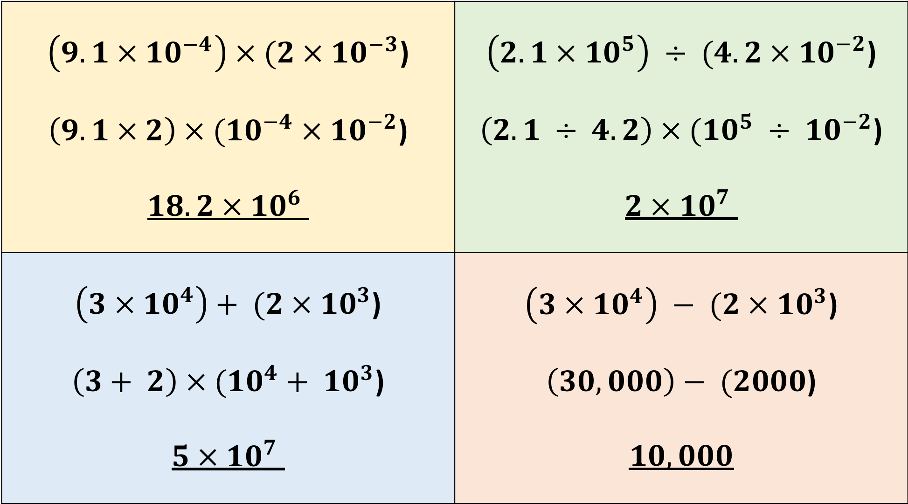
$\left(9.1 × {10}^{−4}\right) × (2 × {10}^{−3}$) $\left(9.1 × 2\right) × ({10}^{−4} × {10}^{−2}$) $$18.2 × {10}^{6}$$ | $\left(2.1 × {10}^{5}\right) ÷ (4.2 × {10}^{−2}$) $\left(2.1 ÷ 4.2\right) × ({10}^{5} ÷ {10}^{−2}$) $$2 × {10}^{7}$$
$$\left(3 × {10}^{4}\right)+ (2 × {10}^{3}\text{)}$$ $$\left(3+ 2\right) × ({10}^{4}+ {10}^{3}\text{)}$$ $$5 × {10}^{7}$$ | $\left(3 × {10}^{4}\right) − (2 × {10}^{3}$) $\left(30,000\right)− (2000$) $$10,000$$

