Slide 1
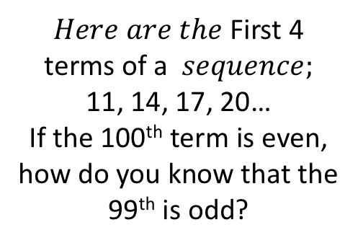
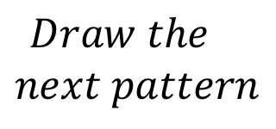
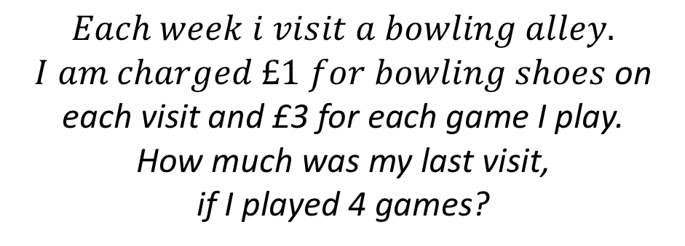
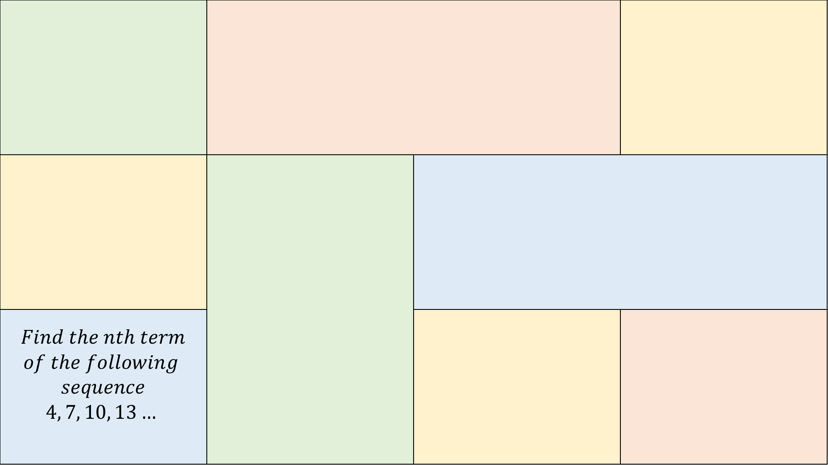
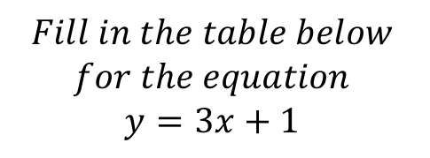

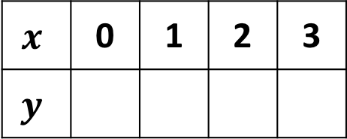
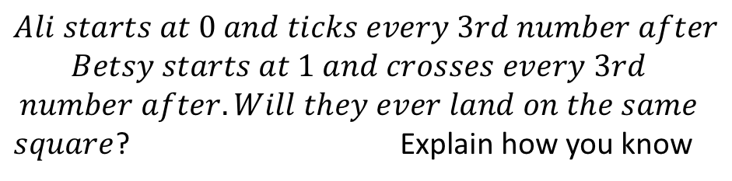
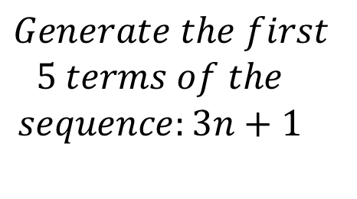
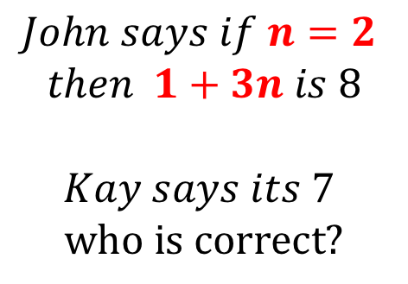
$$Find the nth term$$ $$of the following$$ $$sequence$$ $$4, 7, 10, 13…$$
$$Draw the$$
$$next pattern$$
$$John says if n=2$$
$$then 1+3n is 8$$
$$Kay says its 7$$
$$who is correct?$$
$$Each week i visit a bowling alley.$$
$I am charged £1 for bowling shoes$on each visit and £3 for each game I play.
How much was my last visit,
if I played 4 games?
$$Fill in the table below$$
$$for the equation$$
$$y=3x+1$$
0 | 1 | 2 | 3 | 4 | 5 | 6 | 7 | 8 | 9 | 10 | 11 | 12
C (11, y)
$$Ali starts at 0 and ticks every 3rd number after$$
$$Betsy starts at 1 and crosses every 3rd$$
$$number after. Will they ever land on the same$$
$square$? Explain how you know
$$x$$ | 0 | 1 | 2 | 3
$$y$$
B (8, 25)
$Here are the$First 4 terms of a $sequence;$
11, 14, 17, 20…
If the 100th term is even, how do you know that the 99th is odd?
$$Generate the first$$
$$5 terms of the$$
$$sequence:3n+1$$
A (5, 16)
$$Find ′y′$$

