Slide 1
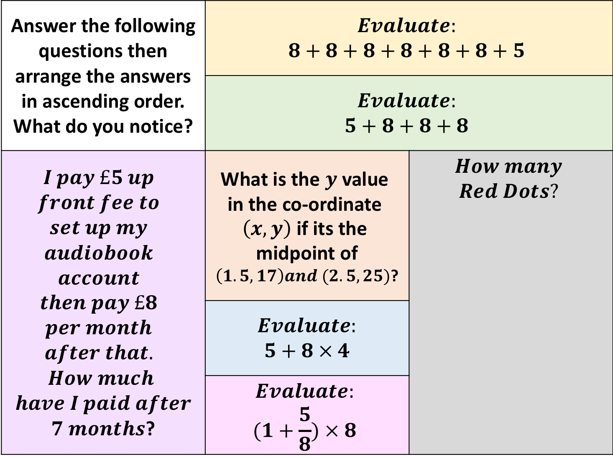
Answer the following questions then arrange the answers in ascending order. What do you notice? | $$Evaluate:$$ $$8+8+8+8+8+8+5$$
 | $$Evaluate:$$ $$5+8+8+8$$
$$I pay £5 up$$ $$front fee to$$ $$set up my$$ $$audiobook$$ $$account$$ $$then pay £8$$ $$per month$$ $$after that.$$ $$How much$$ $$have I paid after$$ $7 months$? | What is the $y \text{value} \text{in} \text{the} \text{co}\text{-}\text{ordinate} \left(x,y\right) \text{if} \text{its} \text{the} \text{midpoint} \text{of}$ $\left(1.5, 17\right)and (2.5,25)$? | $$How many$$ $$Red Dots?$$
 | $$Evaluate:$$ $$5+8 × 4$$
 | $$Evaluate:$$ $$(1+\frac{5}{8}) × 8$$
Notes:
13,29,37,45,53,61

Slide 2
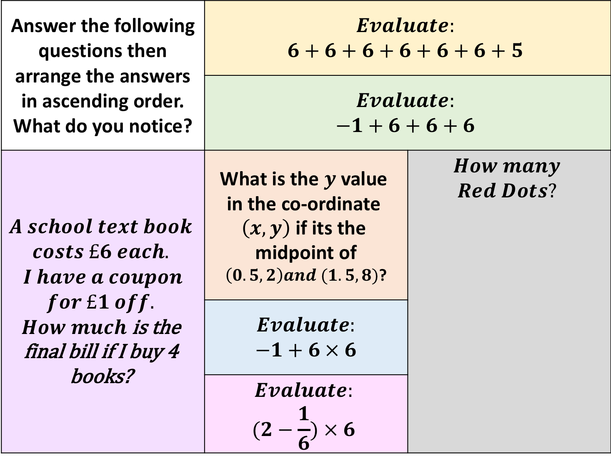
Answer the following questions then arrange the answers in ascending order. What do you notice? | $$Evaluate:$$ $$6+6+6+6+6+6+5$$
 | $$Evaluate:$$ $$−1+6+6+6$$
$$A school text book$$ $$costs £6 each.$$ $$I have a coupon$$ $$for £1 off.$$ $How much$ is the final bill if I buy 4 books? | What is the $y \text{value} \text{in} \text{the} \text{co}\text{-}\text{ordinate} \left(x,y\right) \text{if} \text{its} \text{the} \text{midpoint} \text{of}$ $\left(0.5, 2\right)and (1.5,8)$? | $$How many$$ $$Red Dots?$$
 | $$Evaluate:$$ $$−1+6 × 6$$
 | $$Evaluate:$$ $$(2−\frac{1}{6}) × 6$$
Notes:
5, 11, 17, 23, 29, 35, 41

