Slide 1
12cm
Area
64cm²
Area
100cm²
?
?
Area ?cm²
12cm
Area
36cm²
Total Area ?cm²
6cm
?
Area
64cm²
8cm
Area ?cm²
Area ?cm²
14cm
2cm
Area of shaded shape ?cm²
Total Area 128cm²

Slide 2
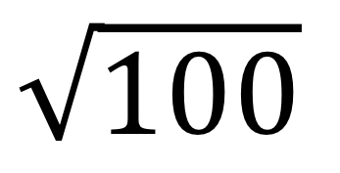
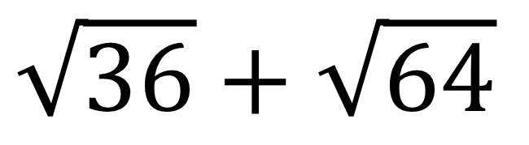
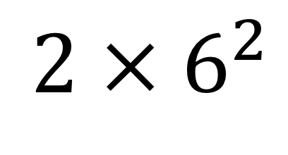
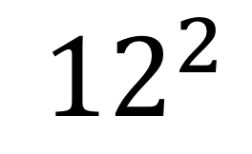
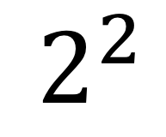
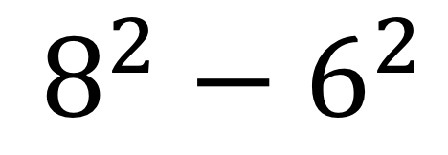
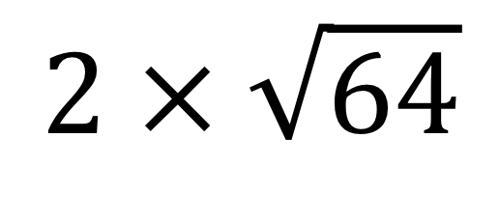
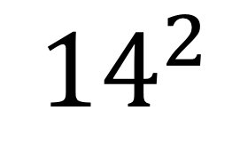
Which of these match with each diagram?
$${12}^{2}$$
$$8^{2}−6^{2}$$
$$\sqrt{100}$$
$$2 × \sqrt{64}$$
$${14}^{2}$$
$$\sqrt{36}+\sqrt{64}$$
$${2 × 6}^{2}$$
$$2^{2}$$

Slide 3
12cm
Area
64cm²
Area
100cm²
?
?
Area ?cm²
12cm
Area
36cm²
Total Area ?cm²
6cm
?
Area
64cm²
8cm
Area ?cm²
Area ?cm²
14cm
2cm
Area of shaded shape ?cm²
Total Area 128cm²

Slide 4
Which of these match with each diagram?
$${12}^{2}$$
$$8^{2}−6^{2}$$
$$\sqrt{100}$$
$$2 × \sqrt{64}$$
$${14}^{2}$$
$$\sqrt{36}+\sqrt{64}$$
$${2 × 6}^{2}$$
$$2^{2}$$

