Slide 1
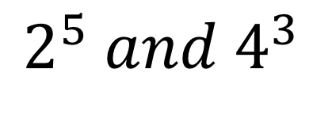
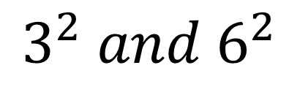
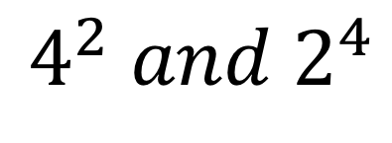
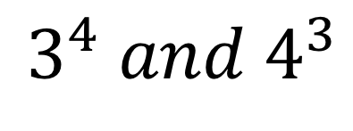
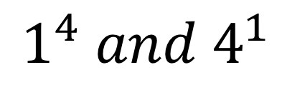
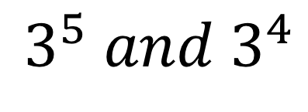
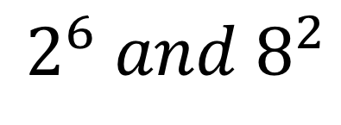
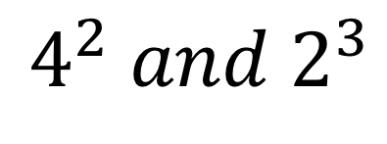
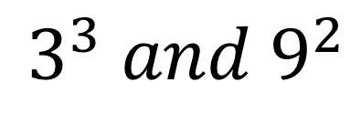
Are equal to each other | One is twice as big as the other | One is 3 times as big as the other | One is 4 times as big as the other
$$2^{6} and 8^{2}$$
$$2^{5} and 4^{3}$$
$$3^{2} and 6^{2}$$
$$1^{4} and 4^{1}$$
$$3^{4} and 4^{3}$$
$$3^{5} and 3^{4}$$
$$3^{3} and 9^{2}$$
$$4^{2} and 2^{3}$$
$$4^{2} and 2^{4}$$

Slide 2
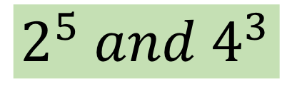
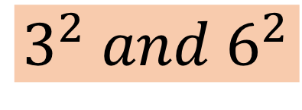
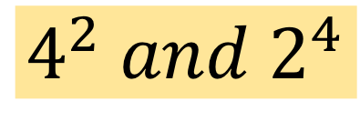
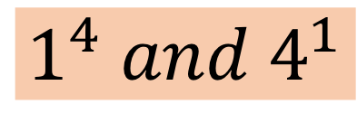
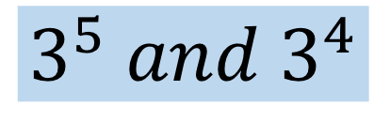
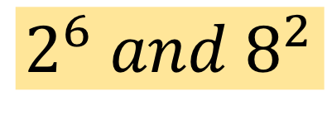
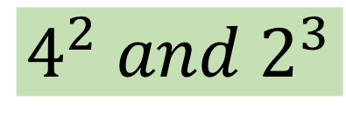
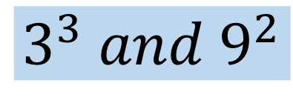
Are equal to each other | One is twice as big as the other | One is 3 times as big as the other | One is 4 times as big as the other
$$2^{6} and 8^{2}$$
$$2^{5} and 4^{3}$$
$$3^{2} and 6^{2}$$
$$1^{4} and 4^{1}$$
$$3^{4} and 4^{3}$$
$$3^{5} and 3^{4}$$
$$3^{3} and 9^{2}$$
$$4^{2} and 2^{3}$$
$$4^{2} and 2^{4}$$

