Slide 1
My annual salary for 4 days a week is £38,400
What would I earn if I worked 5 days a week?
I get £38.40 which is the larger share in the ratio 4 : 1
What is the total amount that is shared?
I buy a bag for £38.40 in a 20% off sale
What did it cost BEFORE the sale?

Slide 2
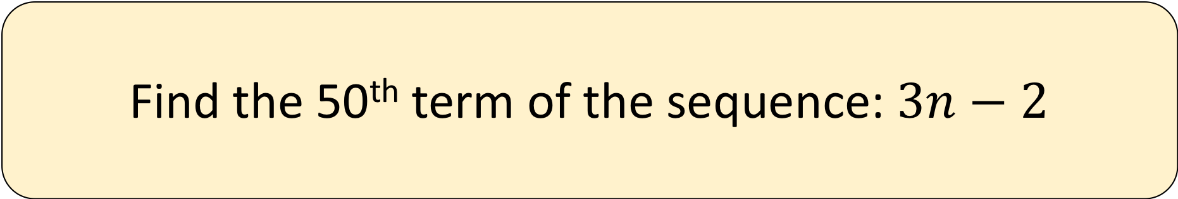
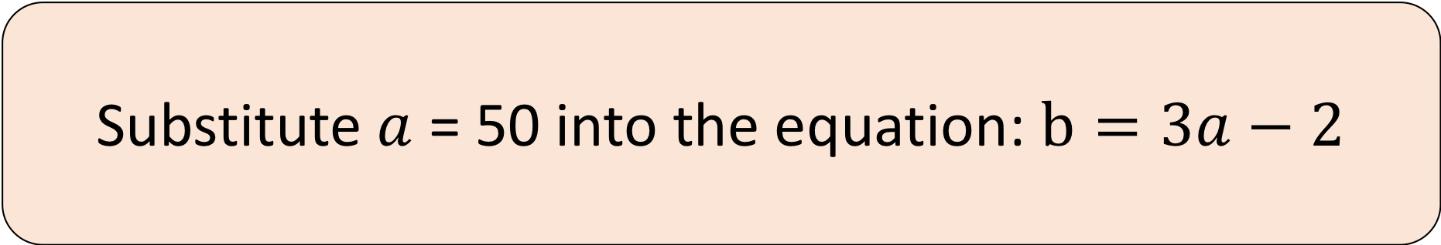
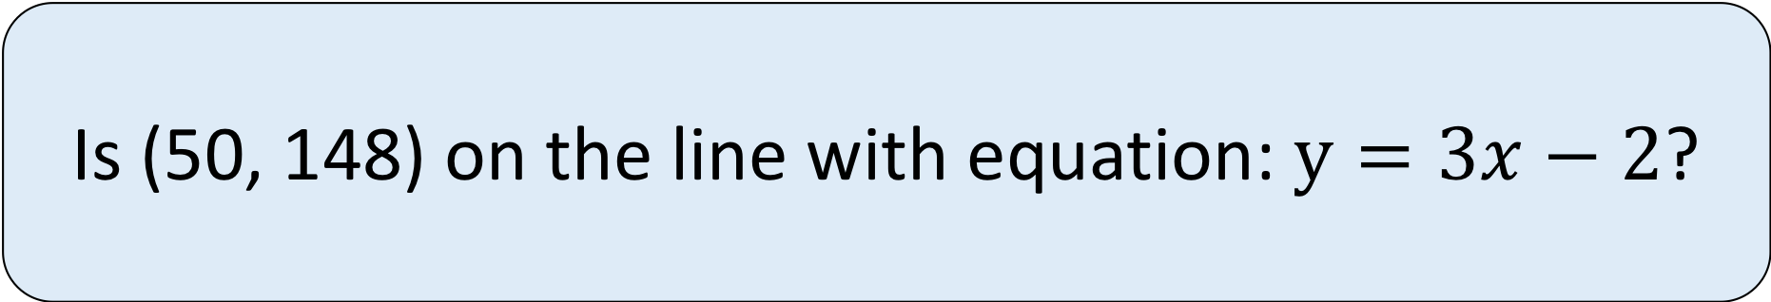
Substitute $a$ = 50 into the equation: $b=3a−2$
Find the 50th term of the sequence: $3n−2$
Is (50, 148) on the line with equation: $y=3x−2$?

Slide 3
Find the area of the trapezium below
Find the midpoint of
the line joining;
(3, -3) and (11, 20)
3cm
Find the median of the 4 amounts; -3, 3, 11, 20
20cm
11cm

Slide 4
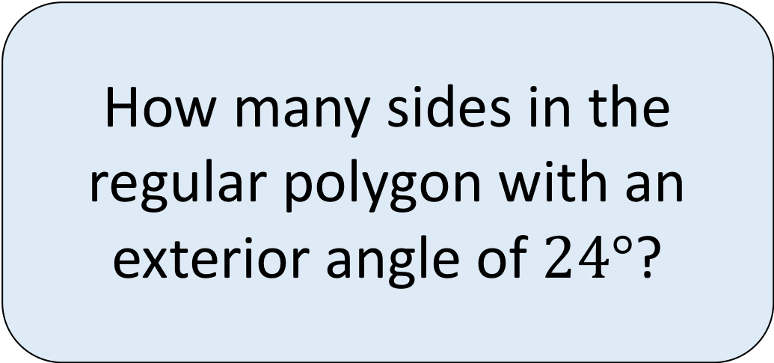


What fraction of the students chose Blue as their favourite colour
(in its simplest form)?
What fraction of an
hour is 4 minutes
(in its simplest form)?
How many sides in the regular polygon with an exterior angle of $24°$?
$$120°$$
$$216°$$

Slide 5
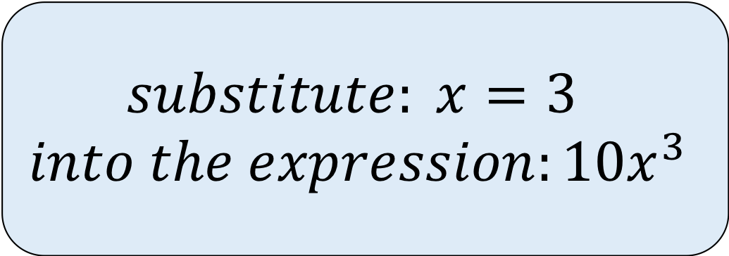
Find the volume of the cube below in mm³
Eli records the height and
volume of 2 similar 3D shapes.
Find the missing volume:
 | Shape A | Shape B
Height | 2cm | 6cm
Volume | 10cm³ | ?
$$\begin{aligned}substitute: x=3 \\ into the expression:10x^{3}\end{aligned}$$
3cm

