Slide 1
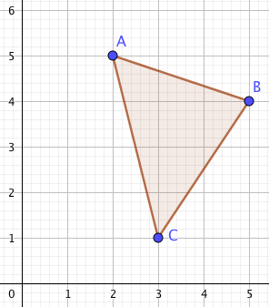
Describe the transformation that maps shape D onto the shape below A’ (2, 1) B’ (4, 2) C’ (3, 5) | The shape D below has co-ordinates; A (2, 5) B (5, 4) C (3, 1) | Describe the transformation that maps shape D onto the shape below A’ (-1, 0) B’ (0, 3) C’ (3, 1)
Describe the transformation that maps shape D onto the shape below A’ (-2, 5) B’ (-5, 4) C’ (-3, 1) |  | Describe the transformation that maps shape D onto the shape below A’ (0, 3) B’ (3, 2) C’ (1, -1)
Describe the transformation that maps shape D onto the shape below A’(1, 2.5) B’(2.5, 2) C’(1.5, 0.5) |  | Describe the transformation that maps shape D onto the shape below A’ (7, 2) B’ (10, 1) C’ (8, -2)

Slide 2
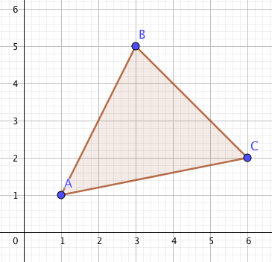
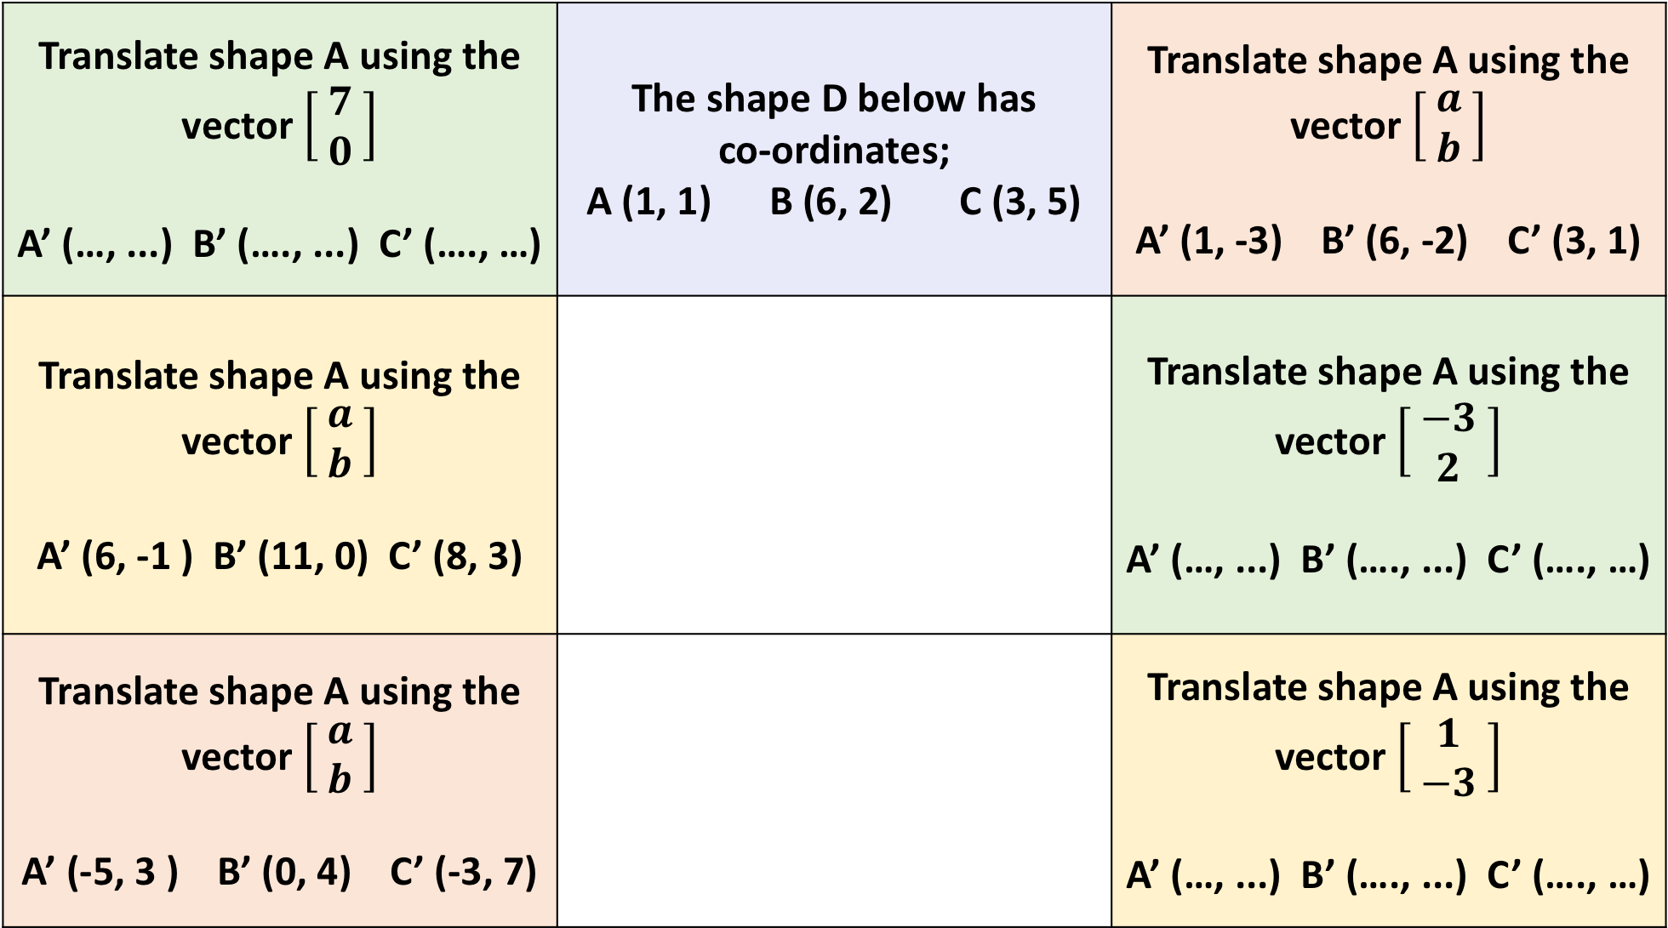
Translate shape A using the vector $\left[\begin{aligned} 7 \\ 0 \end{aligned}\right]$ A’ (…, ...) B’ (…., ...) C’ (…., …) | The shape D below has co-ordinates; A (1, 1) B (6, 2) C (3, 5) | Translate shape A using the vector $\left[\begin{aligned} a \\ b \end{aligned}\right]$ A’ (1, -3) B’ (6, -2) C’ (3, 1)
Translate shape A using the vector $\left[\begin{aligned} a \\ b \end{aligned}\right]$ A’ (6, -1 ) B’ (11, 0) C’ (8, 3) |  | Translate shape A using the vector $\left[\begin{aligned} −3 \\ 2 \end{aligned}\right]$ A’ (…, ...) B’ (…., ...) C’ (…., …)
Translate shape A using the vector $\left[\begin{aligned} a \\ b \end{aligned}\right]$ A’ (-5, 3 ) B’ (0, 4) C’ (-3, 7) |  | Translate shape A using the vector $\left[\begin{aligned} 1 \\ −3 \end{aligned}\right]$ A’ (…, ...) B’ (…., ...) C’ (…., …)
A

Slide 3
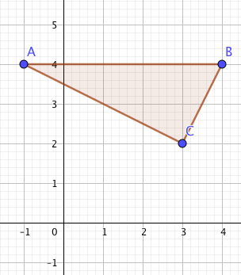
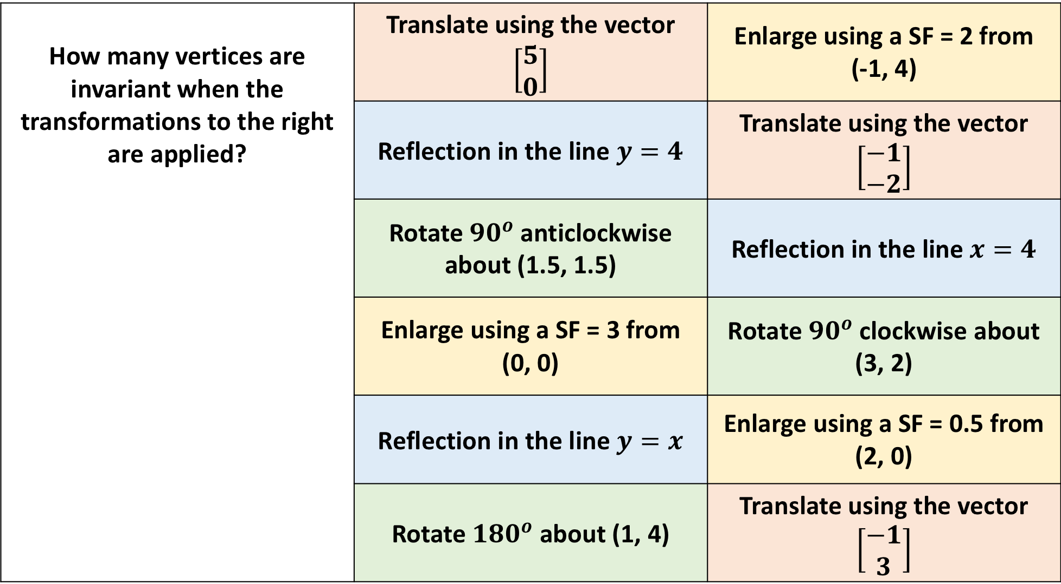
How many vertices are invariant when the transformations to the right are applied? | Translate using the vector $\left[\begin{aligned}5 \\ 0\end{aligned}\right]$ | Enlarge using a SF = 2 from (-1, 4)
 | Reflection in the line $y=4$ | Translate using the vector $\left[\begin{aligned}−1 \\ −2\end{aligned}\right]$
 | Rotate ${90}^{o}$ anticlockwise about (1.5, 1.5) | Reflection in the line $x=4$
 | Enlarge using a SF = 3 from (0, 0) | Rotate ${90}^{o}$ clockwise about (3, 2)
 | Reflection in the line $y=x$ | Enlarge using a SF = 0.5 from (2, 0)
 | Rotate ${180}^{o}$ about (1, 4) | Translate using the vector $\left[\begin{aligned}−1 \\ 3\end{aligned}\right]$
A

Slide 4
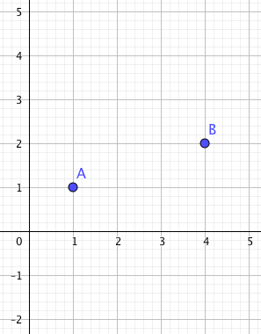
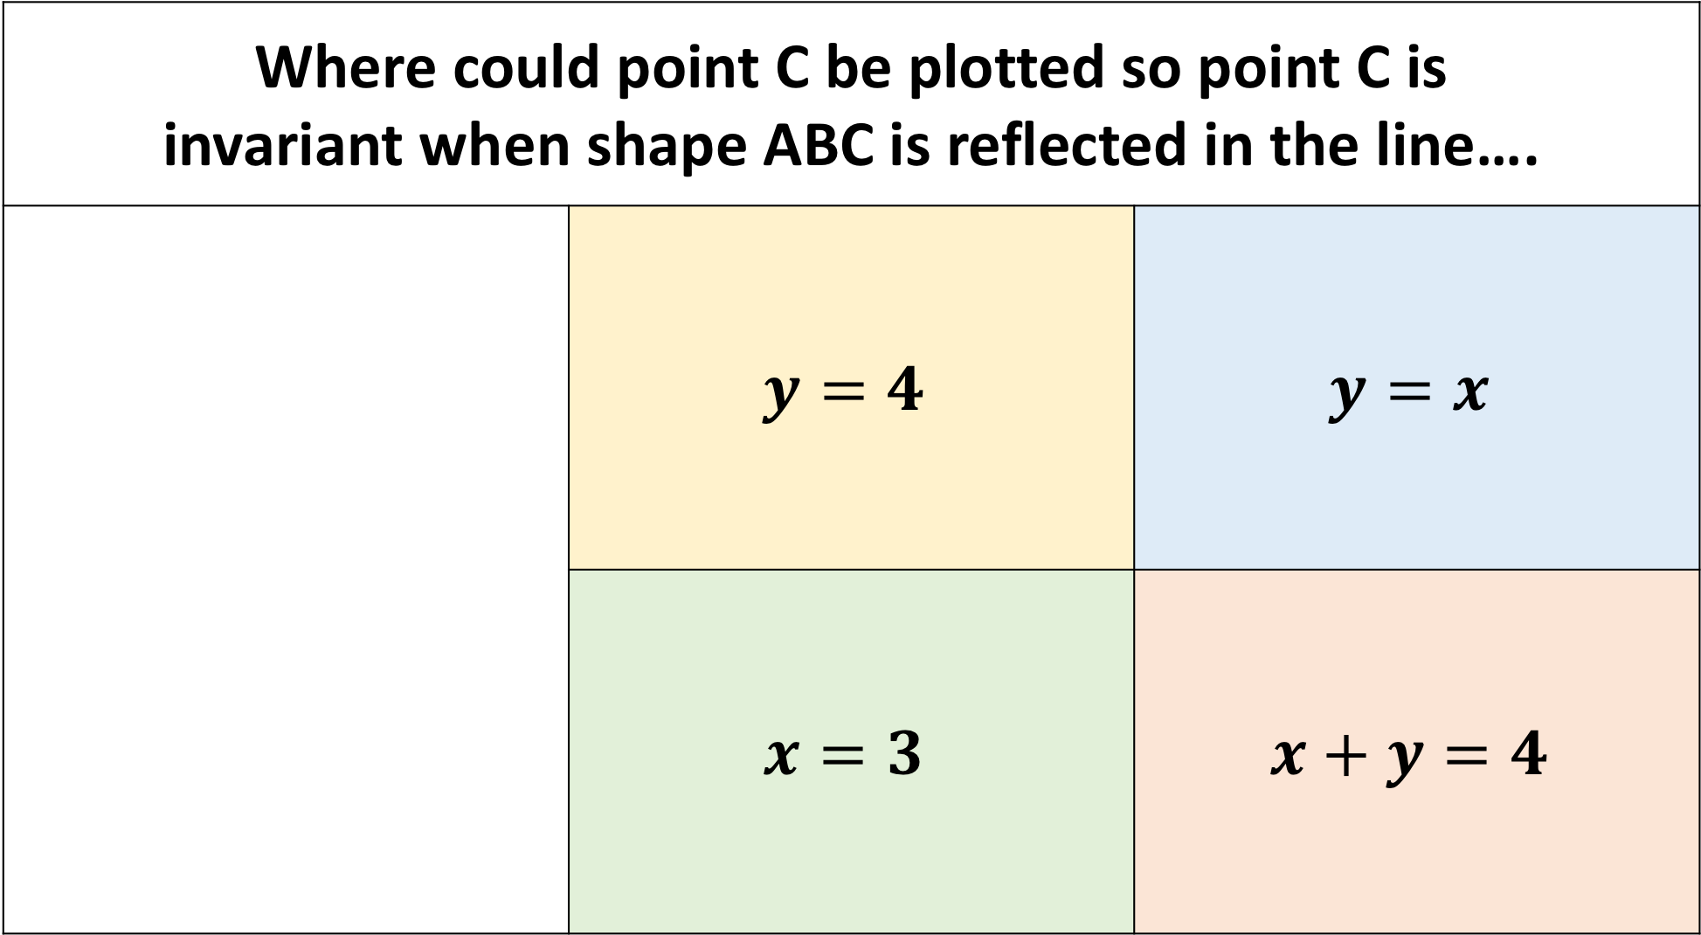
Where could point C be plotted so point C is invariant when shape ABC is reflected in the line….
 | $$y=4$$ | $$y=x$$
 | $$x=3$$ | $$x+y=4$$

Slide 5
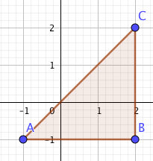
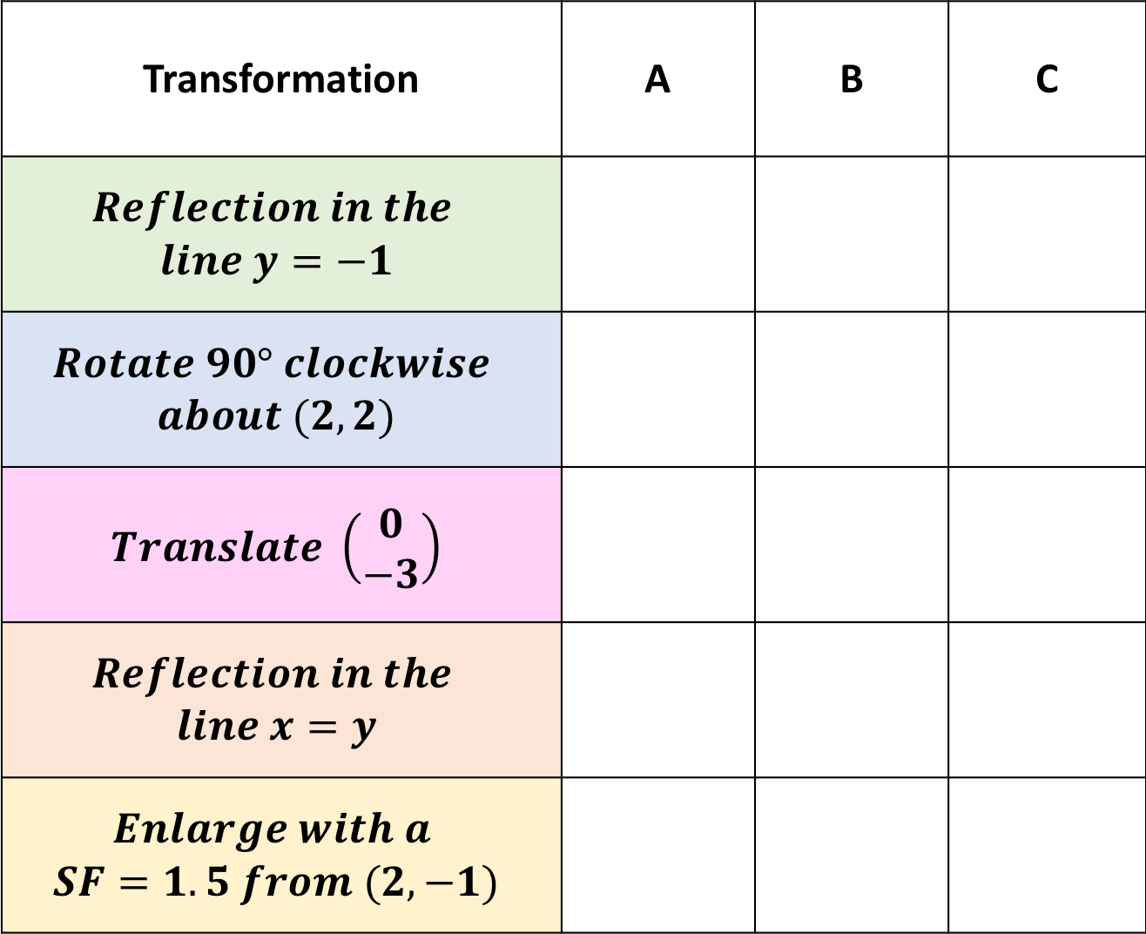
Transformation | A | B | C
$$Reflection in the$$ $$line y=−1$$
$$Rotate 90° clockwise$$ $$about (2, 2)$$
$$Translate \left(\begin{aligned}0 \\ −3\end{aligned}\right)$$
$$Reflection in the$$ $$line x=y$$
$$Enlarge with a$$ $$SF=1.5 from (2, −1)$$
Tick the box for the vertices that are invariant when the transformations to the right are applied to the shape ABC?

