Slide 1
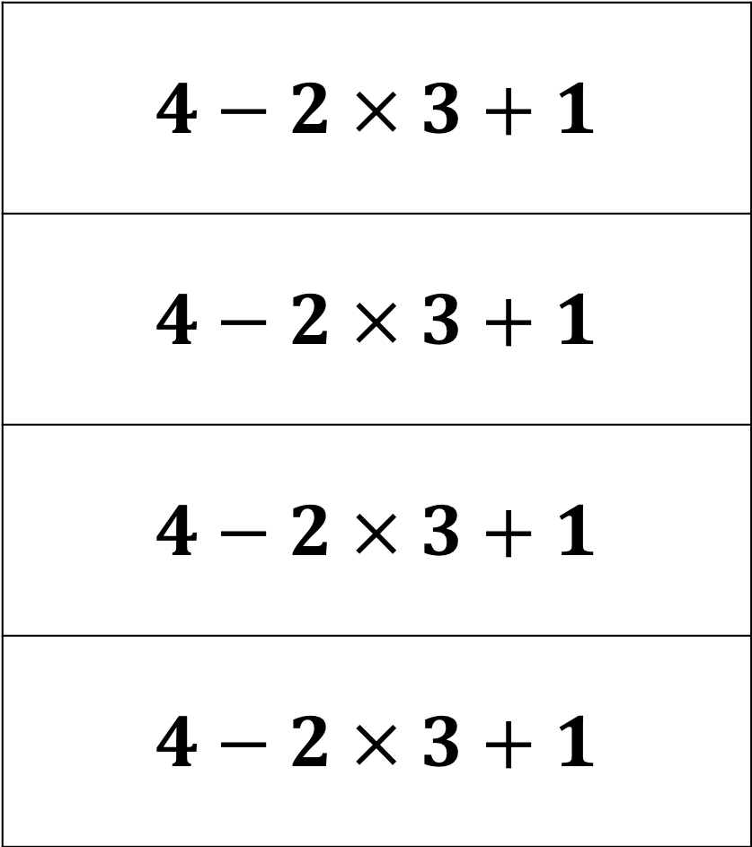
$$4−2 × 3+1$$
$$4−2 × 3+1$$
$$4−2 × 3+1$$
$$4−2 × 3+1$$
By putting brackets into each of the expressions decide which of the following answers can be found
8
7
-1
-3
-2

Slide 2
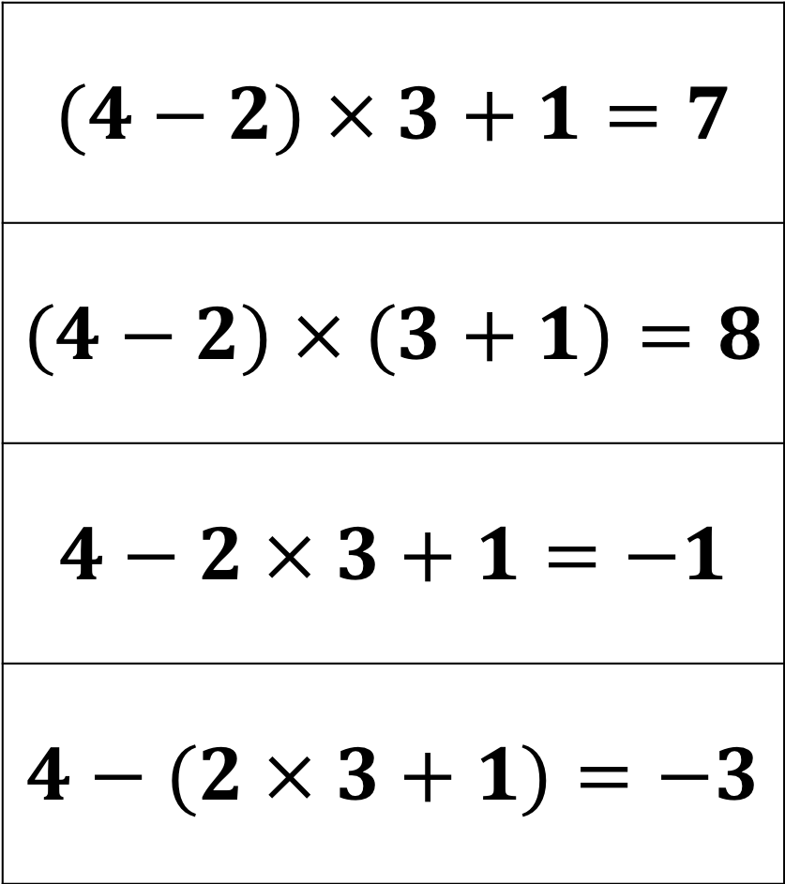
$$(4−2) × 3+1=7$$
$$(4−2) × (3+1)=8$$
$$4−2 × 3+1=−1$$
$$4−(2 × 3+1)=−3$$
By putting brackets into each of the expressions decide which of the following answers can be found
8
7
-1
-3
-2

Slide 3
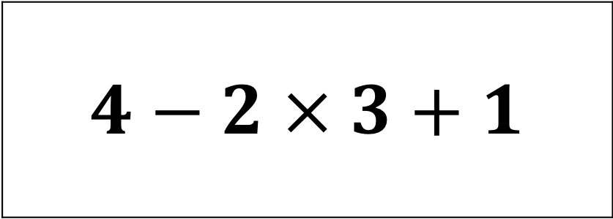
By putting brackets into the expression below.
Find as many different possible answers.
$$4−2 × 3+1$$

