Slide 1
25 students sat a Science Exam and the Mean score was 73.4%.
One student was absent but sat it the next day. Is it possible for the mean to increase to 74% when his score is added?
If so, What is the minimum score needed to make this possible?
Mean: 73.4%

Slide 2
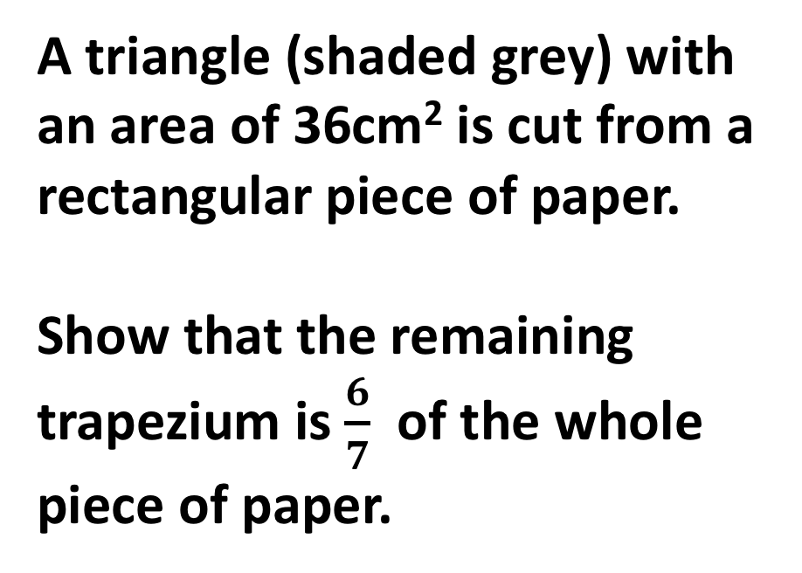
A triangle (shaded grey) with an area of 36cm² is cut from a rectangular piece of paper.
Show that the remaining trapezium is $\frac{6}{7}$ of the whole piece of paper.
6cm
15cm

Slide 3
Alisha and Ben buy exactly the same number of bottles of water but from two different supermarkets.
Alisha buys her bottles for 45p each and also buys a 10p bag
Ben buys his bottles for 60p each but has a coupon for £2.30 off
If their final bill is exactly the same.
How many bottles did they each buy?
45p each
60p each
Notes:
45x + 10 = 60x – 2.30
45x + 2.40 = 60x
2.40 = 0.15x

Slide 4
I choose 4 numbers for a PIN number.
Write down one possible PIN number that satisfy’s ALL the conditions below:
3 of the digits are PRIME numbers and one is a CUBE number
All of the digits are DIFFERENT and two are EVEN numbers
None of the 4 digits are FACTORS of 25
Notes:
2 8 3 7

Slide 5
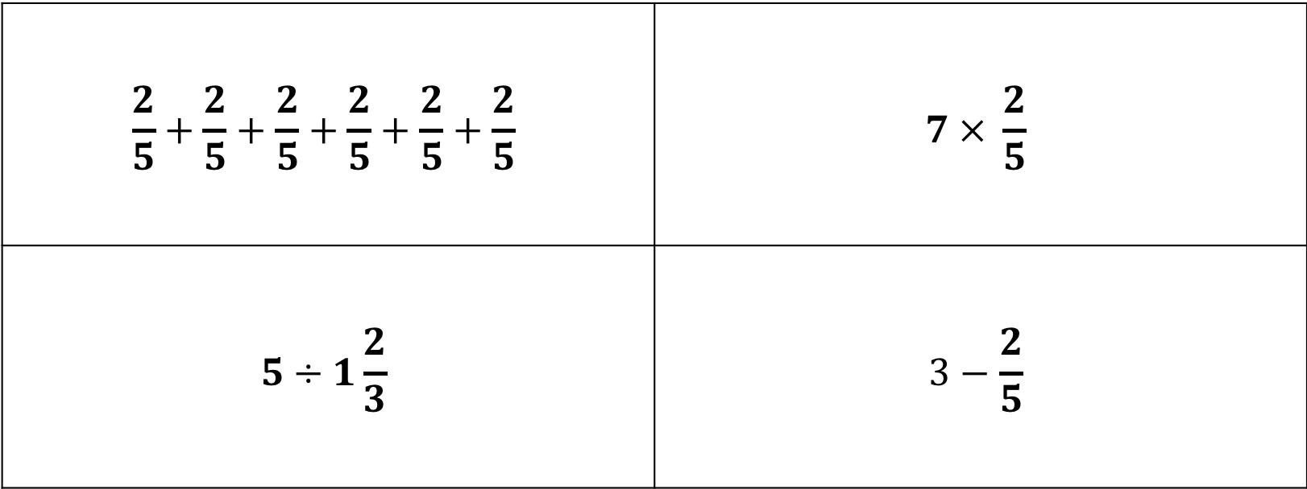
Put the answers to the 4 calculations in order of size,
starting with the smallest
$$\frac{2}{5}+\frac{2}{5}+\frac{2}{5}+\frac{2}{5}+\frac{2}{5}+\frac{2}{5}$$ | $$7 × \frac{2}{5}$$
$$5÷1\frac{2}{3}$$ | $$3−\frac{2}{5}$$
Notes:
12/5
14/5
15/5=3
13/5

