Slide 1
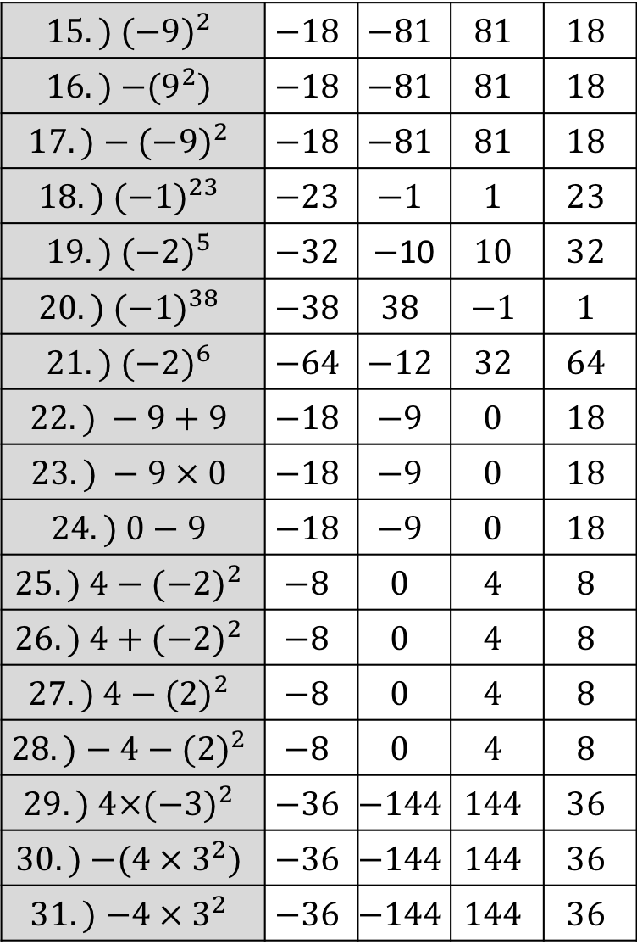
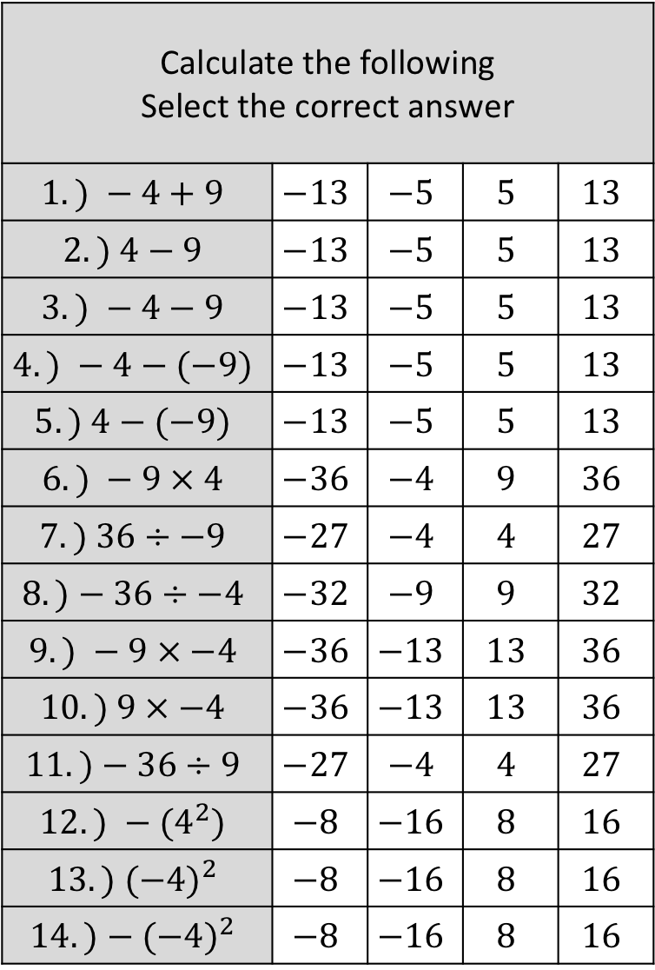
Calculate the following Select the correct answer
$$1.) −4+9$$ | $$−13$$ | $$−5$$ | $$5$$ | $$13$$
$$2.) 4−9$$ | $$−13$$ | $$−5$$ | $$5$$ | $$13$$
$$3.) −4−9$$ | $$−13$$ | $$−5$$ | $$5$$ | $$13$$
$$4.) −4−(−9)$$ | $$−13$$ | $$−5$$ | $$5$$ | $$13$$
$$5.) 4−(−9)$$ | $$−13$$ | $$−5$$ | $$5$$ | $$13$$
$$6.) −9 × 4$$ | $$−36$$ | $$−4$$ | $$9$$ | $$36$$
$$7.) 36÷−9$$ | $$−27$$ | $$−4$$ | $$4$$ | $$27$$
$$8.)−36÷−4$$ | $$−32$$ | $$−9$$ | $$9$$ | $$32$$
$$9.) −9 × −4$$ | $$−36$$ | $$−13$$ | $$13$$ | $$36$$
$$10.) 9 × −4$$ | $$−36$$ | $$−13$$ | $$13$$ | $$36$$
$$11.)−36÷9$$ | $$−27$$ | $$−4$$ | $$4$$ | $$27$$
$$12.) −(4^{2})$$ | $$−8$$ | $$−16$$ | $$8$$ | $$16$$
$$13.){ (−4)}^{2}$$ | $$−8$$ | $$−16$$ | $$8$$ | $$16$$
$$14.)−{(−4)}^{2}$$ | $$−8$$ | $$−16$$ | $$8$$ | $$16$$
$$15.) (−{9)}^{2}$$ | $$−18$$ | $$−81$$ | $$81$$ | $$18$$
$$16.){ −(9}^{2})$$ | $$−18$$ | $$−81$$ | $$81$$ | $$18$$
$$17.)−{(−9)}^{2}$$ | $$−18$$ | $$−81$$ | $$81$$ | $$18$$
$$18.){ (−1)}^{23}$$ | $$−23$$ | $$−1$$ | $$1$$ | $$23$$
$$19.){ (−2)}^{5}$$ | $$−32$$ | $−$10 | $$10$$ | $$32$$
$$20.){ (−1)}^{38}$$ | $$−38$$ | $$38$$ | $$−1$$ | $$1$$
$$21.){ (−2)}^{6}$$ | $$−64$$ | $$−12$$ | $$32$$ | $$64$$
$$22.) −9+9$$ | $$−18$$ | $$−9$$ | $$0$$ | $$18$$
$$23.) −9 × 0$$ | $$−18$$ | $$−9$$ | $$0$$ | $$18$$
$$24.) 0−9$$ | $$−18$$ | $$−9$$ | $$0$$ | $$18$$
$$25.) 4−({−2)}^{2}$$ | $$−8$$ | $$0$$ | $$4$$ | $$8$$
$$26.) 4+({−2)}^{2}$$ | $$−8$$ | $$0$$ | $$4$$ | $$8$$
$$27.) 4−({2)}^{2}$$ | $$−8$$ | $$0$$ | $$4$$ | $$8$$
$$28.)−4−({2)}^{2}$$ | $$−8$$ | $$0$$ | $$4$$ | $$8$$
$$29.){ 4×(−3)}^{2}$$ | $$−36$$ | $$−144$$ | $$144$$ | $$36$$
$$30.){ −(4 × 3}^{2})$$ | $$−36$$ | $$−144$$ | $$144$$ | $$36$$
$$31.){ −4 × 3}^{2}$$ | $$−36$$ | $$−144$$ | $$144$$ | $$36$$

Slide 2
Calculate the following Select the correct answer
$$1.) 9−7+3$$ | $$−1$$ | $$5$$ | $$1$$ | $$19$$
$$2.) 9−7−3$$ | $$−1$$ | $$−5$$ | $$5$$ | $$19$$
$$3.) 9−(7+3)$$ | $$−1$$ | $$5$$ | $$1$$ | $$19$$
$$4.) 9−(7−3)$$ | $$−13$$ | $$−5$$ | $$5$$ | $$13$$
$$5.) 9−(−7−3)$$ | $$−13$$ | $$−5$$ | $$5$$ | $$13$$
$$6.) 9+3×2$$ | $$24$$ | $$12$$ | $$14$$ | $$15$$
$$7.) 9−3×2$$ | $$12$$ | $$3$$ | $$15$$ | $$−3$$
$$8.) (9−3)×2$$ | $$12$$ | $$3$$ | $$15$$ | $$−12$$
$$9.) (3−9)×2$$ | $$12$$ | $$3$$ | $$15$$ | $$−12$$
$$10.) −2\left(3−9\right)$$ | $$12$$ | $$3$$ | $$15$$ | $$−12$$
$$11.) 4×3^{2}$$ | $$24$$ | $$36$$ | $$144$$ | $$13$$
$$12.) 4×({−3)}^{2}$$ | $$−144$$ | $$36$$ | $$144$$ | $$−36$$
$$13.)−4×{−(3}^{2})$$ | $$−144$$ | $$36$$ | $$144$$ | $$−36$$
$$14.)−4×{(−3)}^{2}$$ | $$−144$$ | $$36$$ | $$144$$ | $$−36$$
$$15.) \frac{36}{3×4}$$ | $$3$$ | $$27$$ | $$−3$$ | $$48$$
$$16.) \frac{36}{3}×4$$ | $$3$$ | $$27$$ | $$−3$$ | $$48$$
$$17.) 3×\frac{36}{4}$$ | $$3$$ | $$27$$ | $$−3$$ | $$48$$
$$18.) −3×\frac{36}{−4}$$ | $$−3$$ | $$−27$$ | $$27$$ | $$3$$
$$19.)−3×\frac{−36}{4}$$ | $$−3$$ | $$−27$$ | $$27$$ | $$3$$
$$20.) \frac{36}{3×−4}$$ | $$−3$$ | $$−27$$ | $$−48$$ | $$3$$
$$21.)−3×\frac{−36}{−4}$$ | $$−3$$ | $$−27$$ | $$−48$$ | $$3$$
$$22.)\frac{36}{−3}×4$$ | $$−3$$ | $$−27$$ | $$−48$$ | $$3$$
$$23.) −\frac{36}{3×−4}$$ | $$−3$$ | $$−27$$ | $$27$$ | $$3$$

