Slide 1
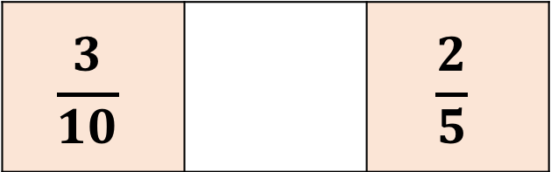
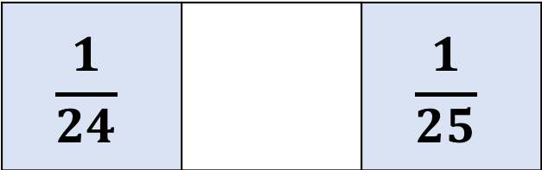
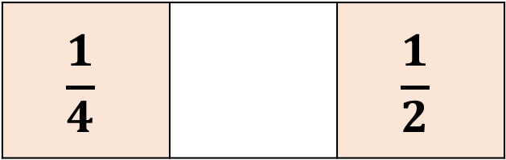
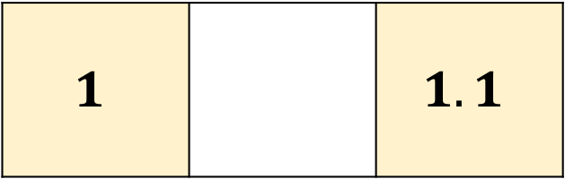
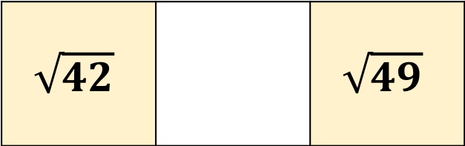
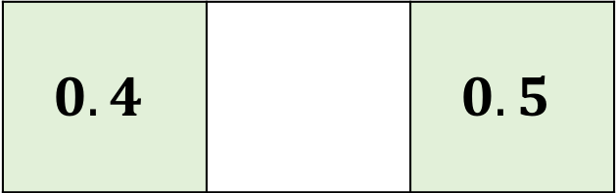
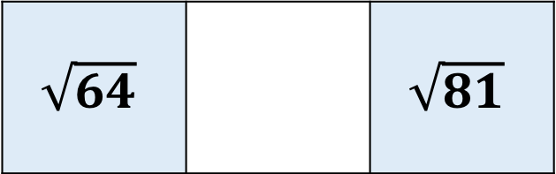
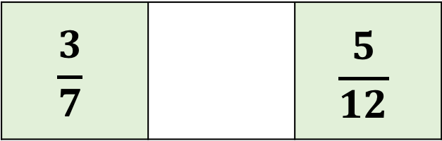
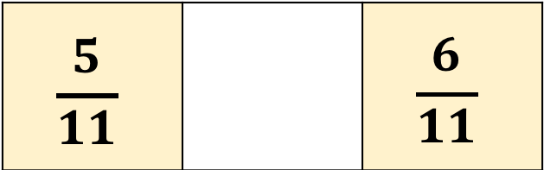
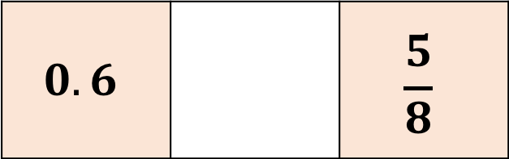
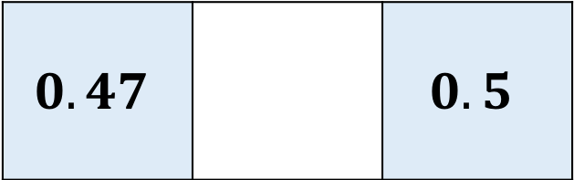
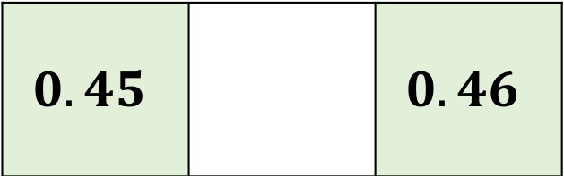
Find a value that lies somewhere between each pair of numbers
$$0.4$$ |  | $$0.5$$
$$\sqrt{64}$$ |  | $$\sqrt{81}$$
$$0.6$$ |  | $$\frac{5}{8}$$
$$\frac{1}{4}$$ |  | $$\frac{1}{2}$$
$$1$$ |  | $$1.1$$
$$\frac{3}{7}$$ |  | $$\frac{5}{12}$$
$$0.47$$ |  | $$0.5$$
$$\frac{3}{10}$$ |  | $$\frac{2}{5}$$
$$\sqrt{42}$$ |  | $$\sqrt{49}$$
$$\frac{5}{11}$$ |  | $$\frac{6}{11}$$
$$0.45$$ |  | $$0.46$$
$$\frac{1}{24}$$ |  | $$\frac{1}{25}$$

