Slide 1
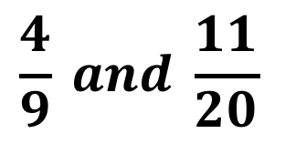


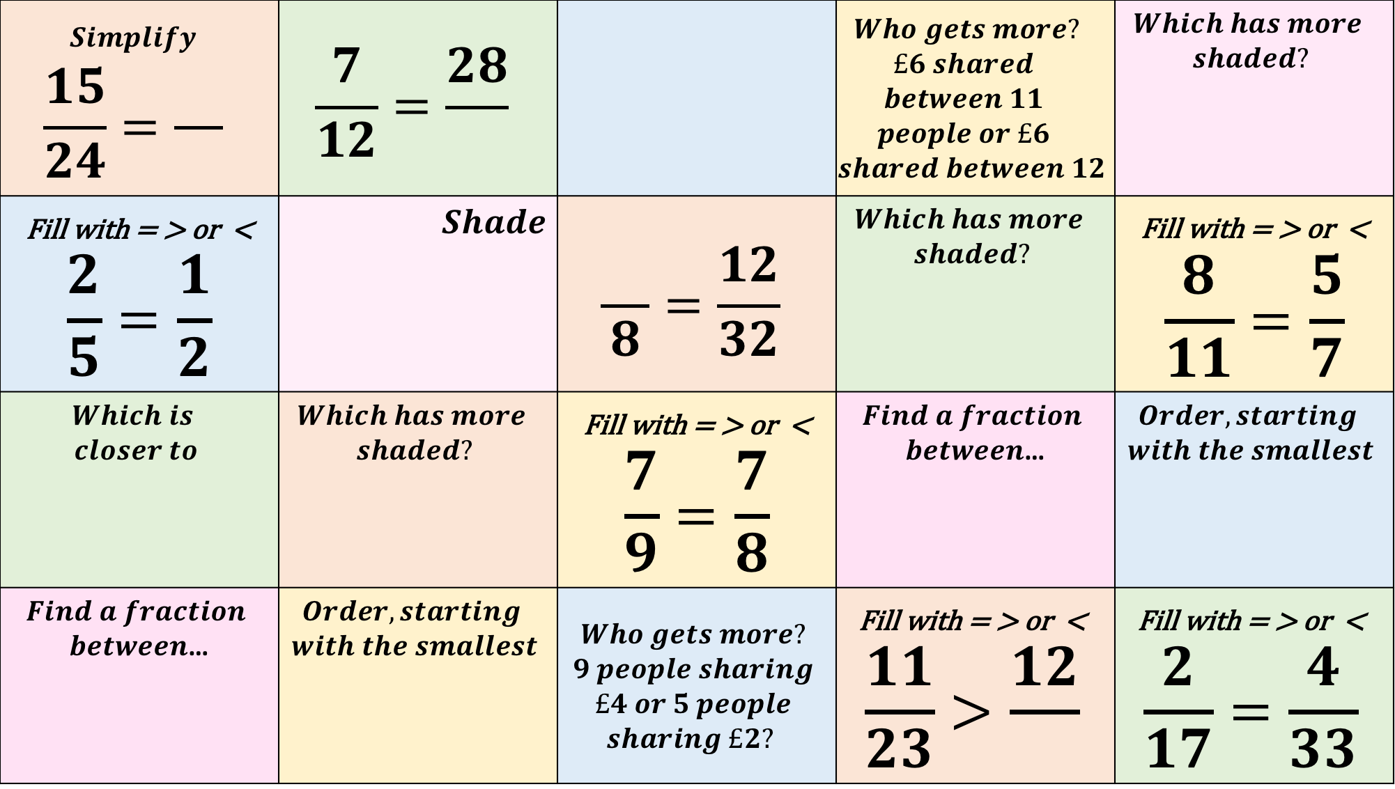
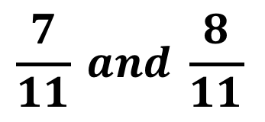
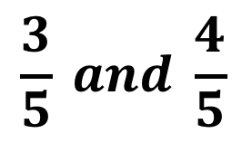
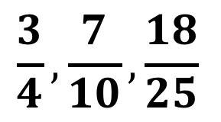
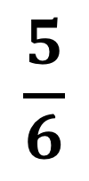
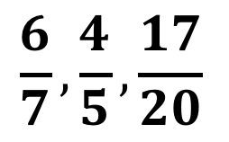
$$Simplify$$ $$\frac{15}{24}=\frac{}{}$$ | $$\frac{7}{12}=\frac{28}{}$$ |  | $$Who gets more?$$ $$£6 shared$$ $$between 11$$ $$people or £6$$ $$shared between 12$$ | $$Which has more$$ $$shaded?$$
Fill with = > or < $$\frac{2}{5}=\frac{1}{2}$$ | $$Shade$$ | $$\frac{}{8}=\frac{12}{32}$$ | $$Which has more$$ $$shaded?$$ | Fill with = > or < $$\frac{8}{11}=\frac{5}{7}$$
$$Which is$$ $closer to$ | $$Which has more$$ $$shaded?$$ | Fill with = > or < $$\frac{7}{9}=\frac{7}{8}$$ | $$Find a fraction$$ $between$… | $$Order, starting$$ $$with the smallest$$
$$Find a fraction$$ $between$… | $$Order, starting$$ $$with the smallest$$ | $$Who gets more?$$ $$9 people sharing$$ $$£4 or 5 people$$ $$sharing £2?$$ | Fill with = > or < $$\frac{11}{23}>\frac{12}{}$$ | Fill with = > or < $$\frac{2}{17}=\frac{4}{33}$$
$$\frac{5}{6}$$
$\frac{1}{2}$ ?
$$\frac{4}{9} and \frac{11}{20}$$
$$\frac{3}{5} and \frac{4}{5}$$
$$\frac{3}{4}, \frac{7}{10}, \frac{18}{25}$$
$$\frac{7}{11} and \frac{8}{11}$$
$$\frac{6}{7}, \frac{4}{5}, \frac{17}{20}$$

Slide 2
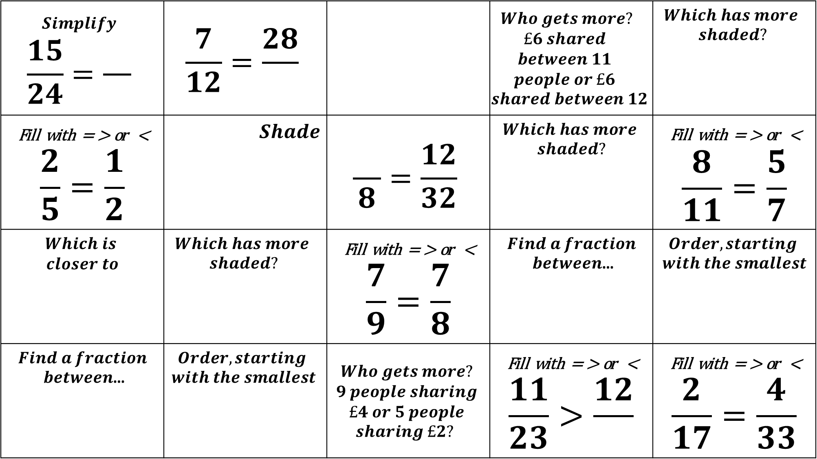
$$Simplify$$ $$\frac{15}{24}=\frac{}{}$$ | $$\frac{7}{12}=\frac{28}{}$$ |  | $$Who gets more?$$ $$£6 shared$$ $$between 11$$ $$people or £6$$ $$shared between 12$$ | $$Which has more$$ $$shaded?$$
Fill with = > or < $$\frac{2}{5}=\frac{1}{2}$$ | $$Shade$$ | $$\frac{}{8}=\frac{12}{32}$$ | $$Which has more$$ $$shaded?$$ | Fill with = > or < $$\frac{8}{11}=\frac{5}{7}$$
$$Which is$$ $closer to$ | $$Which has more$$ $$shaded?$$ | Fill with = > or < $$\frac{7}{9}=\frac{7}{8}$$ | $$Find a fraction$$ $between$… | $$Order, starting$$ $$with the smallest$$
$$Find a fraction$$ $between$… | $$Order, starting$$ $$with the smallest$$ | $$Who gets more?$$ $$9 people sharing$$ $$£4 or 5 people$$ $$sharing £2?$$ | Fill with = > or < $$\frac{11}{23}>\frac{12}{}$$ | Fill with = > or < $$\frac{2}{17}=\frac{4}{33}$$
$$\frac{5}{6}$$
$\frac{1}{2}$ ?
$$\frac{4}{9} and \frac{11}{20}$$
$$\frac{3}{5} and \frac{4}{5}$$
$$\frac{3}{4}, \frac{7}{10}, \frac{18}{25}$$
$$\frac{7}{11} and \frac{8}{11}$$
$$\frac{6}{7}, \frac{4}{5}, \frac{17}{20}$$

Slide 3
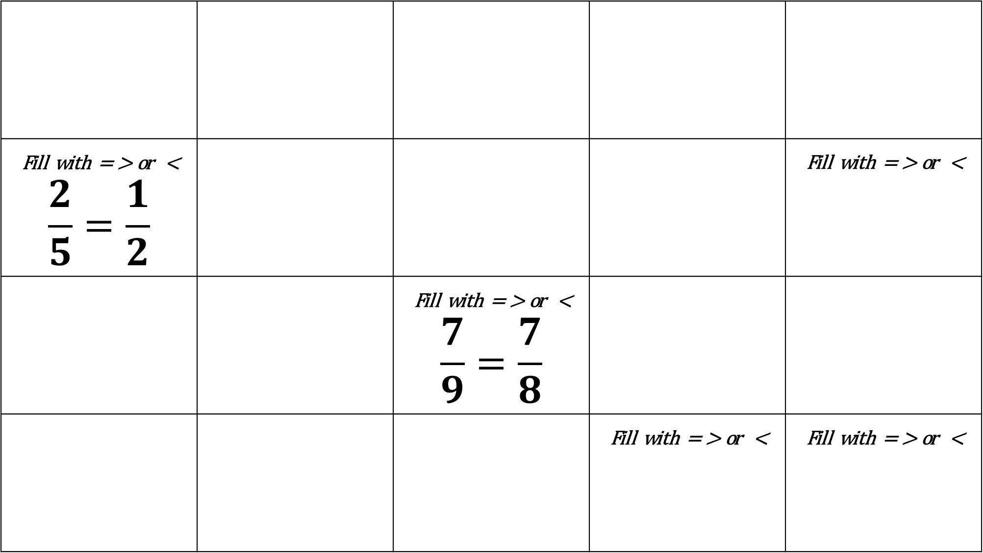
$$Simplify$$ $$\frac{15}{24}=\frac{}{}$$ | $$\frac{7}{12}=\frac{28}{}$$ |  | $$Who gets more?$$ $$£6 shared$$ $$between 11$$ $$people or £6$$ $$shared between 12$$ | $$Which has more$$ $$shaded?$$
Fill with = > or < $$\frac{2}{5}=\frac{1}{2}$$ | $$Shade$$ | $$\frac{}{8}=\frac{12}{32}$$ | $$Which has more$$ $$shaded?$$ | Fill with = > or < $$\frac{8}{11}=\frac{5}{7}$$
$$Which is$$ $closer to$ | $$Which has more$$ $$shaded?$$ | Fill with = > or < $$\frac{7}{9}=\frac{7}{8}$$ | $$Find a fraction$$ $between$… | $$Order, starting$$ $$with the smallest$$
$$Find a fraction$$ $between$… | $$Order, starting$$ $$with the smallest$$ | $$Who gets more?$$ $$9 people sharing$$ $$£4 or 5 people$$ $$sharing £2?$$ | Fill with = > or < $$\frac{11}{23}>\frac{12}{}$$ | Fill with = > or < $$\frac{2}{17}=\frac{4}{33}$$
$$\frac{5}{6}$$
$\frac{1}{2}$ ?
$$\frac{4}{9} and \frac{11}{20}$$
$$\frac{3}{5} and \frac{4}{5}$$
$$\frac{3}{4}, \frac{7}{10}, \frac{18}{25}$$
$$\frac{7}{11} and \frac{8}{11}$$
$$\frac{6}{7}, \frac{4}{5}, \frac{17}{20}$$

Slide 4
$$Simplify$$ $$\frac{15}{24}=\frac{}{}$$ | $$\frac{7}{12}=\frac{28}{}$$ |  | $$Who gets more?$$ $$£6 shared$$ $$between 11$$ $$people or £6$$ $$shared between 12$$ | $$Which has more$$ $$shaded?$$
Fill with = > or < $$\frac{2}{5}=\frac{1}{2}$$ | $$Shade$$ | $$\frac{}{8}=\frac{12}{32}$$ | $$Which has more$$ $$shaded?$$ | Fill with = > or < $$\frac{8}{11}=\frac{5}{7}$$
$$Which is$$ $closer to$ | $$Which has more$$ $$shaded?$$ | Fill with = > or < $$\frac{7}{9}=\frac{7}{8}$$ | $$Find a fraction$$ $between$… | $$Order, starting$$ $$with the smallest$$
$$Find a fraction$$ $between$… | $$Order, starting$$ $$with the smallest$$ | $$Who gets more?$$ $$9 people sharing$$ $$£4 or 5 people$$ $$sharing £2?$$ | Fill with = > or < $$\frac{11}{23}>\frac{12}{}$$ | Fill with = > or < $$\frac{2}{17}=\frac{4}{33}$$
$$\frac{5}{6}$$
$\frac{1}{2}$ ?
$$\frac{4}{9} and \frac{11}{20}$$
$$\frac{3}{5} and \frac{4}{5}$$
$$\frac{3}{4}, \frac{7}{10}, \frac{18}{25}$$
$$\frac{7}{11} and \frac{8}{11}$$
$$\frac{6}{7}, \frac{4}{5}, \frac{17}{20}$$

Slide 5
$$Simplify$$ $$\frac{15}{24}=\frac{}{}$$ | $$\frac{7}{12}=\frac{28}{}$$ |  | $$Who gets more?$$ $$£6 shared$$ $$between 11$$ $$people or £6$$ $$shared between 12$$ | $$Which has more$$ $$shaded?$$
Fill with = > or < $$\frac{2}{5}=\frac{1}{2}$$ | $$Shade$$ | $$\frac{}{8}=\frac{12}{32}$$ | $$Which has more$$ $$shaded?$$ | Fill with = > or < $$\frac{8}{11}=\frac{5}{7}$$
$$Which is$$ $closer to$ | $$Which has more$$ $$shaded?$$ | Fill with = > or < $$\frac{7}{9}=\frac{7}{8}$$ | $$Find a fraction$$ $between$… | $$Order, starting$$ $$with the smallest$$
$$Find a fraction$$ $between$… | $$Order, starting$$ $$with the smallest$$ | $$Who gets more?$$ $$9 people sharing$$ $$£4 or 5 people$$ $$sharing £2?$$ | Fill with = > or < $$\frac{11}{23}>\frac{12}{}$$ | Fill with = > or < $$\frac{2}{17}=\frac{4}{33}$$
$$\frac{5}{6}$$
$\frac{1}{2}$ ?
$$\frac{4}{9} and \frac{11}{20}$$
$$\frac{3}{5} and \frac{4}{5}$$
$$\frac{3}{4}, \frac{7}{10}, \frac{18}{25}$$
$$\frac{7}{11} and \frac{8}{11}$$
$$\frac{6}{7}, \frac{4}{5}, \frac{17}{20}$$

