Slide 1
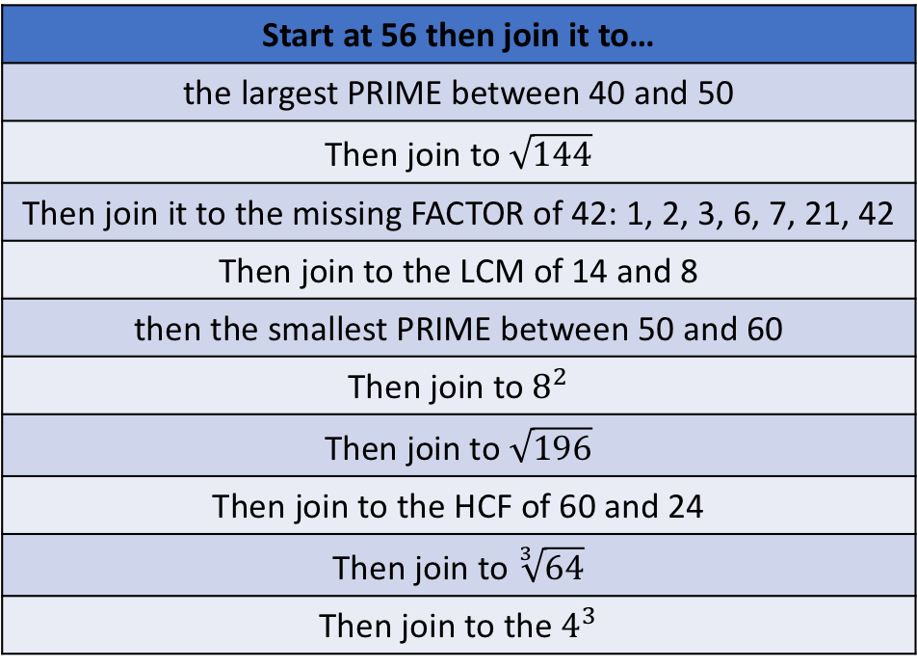
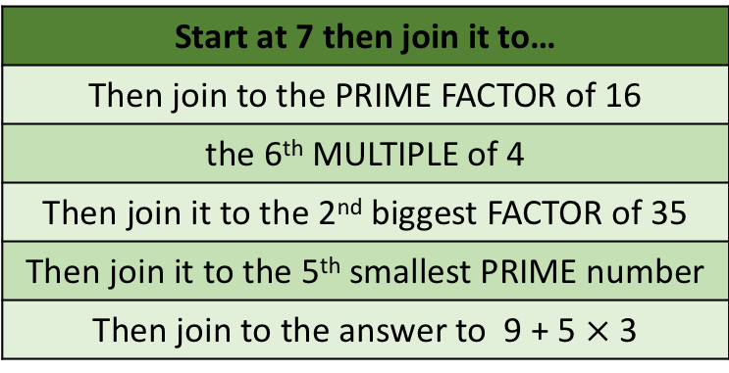
24
Start at 7 then join it to…
Then join to the PRIME FACTOR of 16
the 6th MULTIPLE of 4
Then join it to the 2nd biggest FACTOR of 35
Then join it to the 5th smallest PRIME number
Then join to the answer to 9 + 5$×$ 3
DOT
TO
DOT
8
9
15
11
2
7
48
Start at 56 then join it to…
the largest PRIME between 40 and 50
Then join to$\sqrt{144}$
Then join it to the missing FACTOR of 42: 1, 2, 3, 6, 7, 21, 42
Then join to the LCM of 14 and 8
then the smallest PRIME between 50 and 60
Then join to $8^{2}$
Then join to $\sqrt{196}$
Then join to the HCF of 60 and 24
Then join to $\sqrt[3]{64}$
Then join to the $4^{3}$
8
20
51
4
12
64
14
49
98
47
53
56
70
6
16
Name the shapes

Slide 2
Dot-to-Dot
Start at 150
160 | Increase by 25% | 200
200 | Increase by 300%
 | Decrease by 20%
 | Decrease by 95%
 | Increase by 100%
 | Increase by 25%
 | Decrease by 80%
 | Increase by 25%
 | Increase by 25%
 | Increase by 60%
 | Increase by 150%
 | Increase by 300%
 | Decrease by 20%
 | Decrease by 50%
Start at 150 then for each question find the percentage of the previous answer
240
160
180
300
400
320
200
800
220
106
100
600
900
640
40
30
32
25
64
60
16
50
20
80

Slide 3
Start at 150
160 | Increase by 25% | 200
200 | Increase by 300% | 800
800 | Decrease by 20% | 640
640 | Decrease by 95% | 32
32 | Increase by 100% | 64
64 | Increase by 25% | 80
80 | Decrease by 80% | 16
16 | Increase by 25% | 20
20 | Increase by 25% | 25
25 | Increase by 60% | 40
40 | Increase by 150% | 100
100 | Increase by 300% | 400
400 | Decrease by 20% | 320
320 | Decrease by 50% | 160
Start at 150 then for each question find the percentage of the previous answer
160
400
320
200
800
100
640
40
32
25
64
16
20
80

