Slide 1
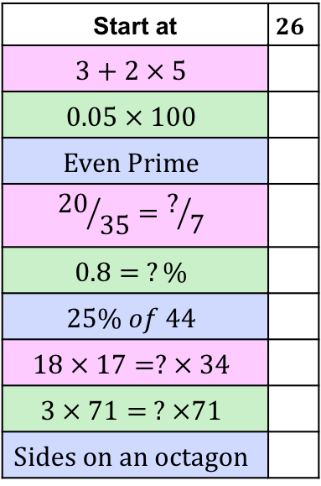
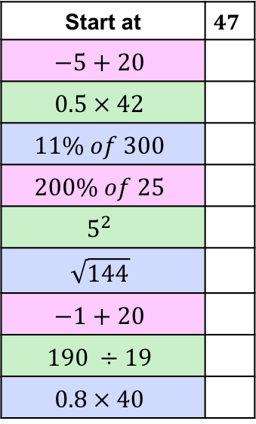
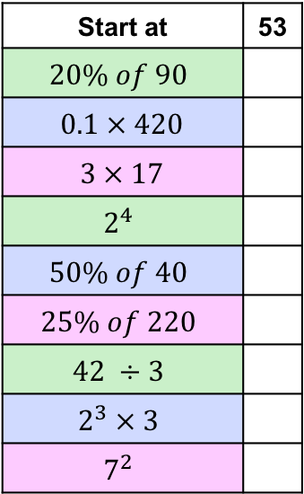
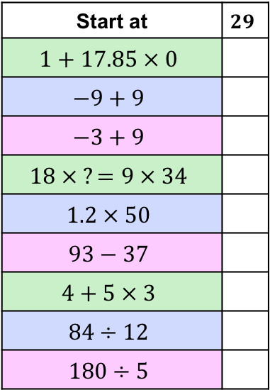
Start at
Start at
5
13
24
14
9
3
18
42
26
80
16
11
8
51
2
36
29
4
20
55
6
17
32
49
53
10
Start at
Start at | 53
19
7
47
25
50
15
60
56
33
21
0
1
12
19

Slide 2
Start at
Start at
5
13
24
14
9
3
18
42
26
80
16
11
8
51
2
36
29
4
20
55
6
17
32
49
53
10
Start at
Start at | 53
19
7
47
25
50
15
60
56
33
21
0
1
12
19

Slide 3
Start at
Start at
5
13
24
14
9
3
18
42
26
80
16
11
8
51
2
36
29
4
20
55
6
17
32
49
53
10
Start at
Start at | 53
19
7
47
25
50
15
60
56
33
21
0
1
12
19

