Slide 1
Which Multipack weighed more??
Both bags NOW have the same number of grams per packet but they had a 30g difference BEFORE the changes.
Which multipack weighed the most before the change in size?
Hops Crisps are sold in multipacks of 17
Ramblers Crisps are sold in multipacks of 13
10% Extra per bag
20% less
per bag
Hops Crisps are sold in bags that are NOW 10% MORE
Ramblers Crisps are sold in bags that are NOW 20% LESS
Notes:
17x90=1530
120x13=1560
108x17=1836
108x13=1404 → 427

Slide 2
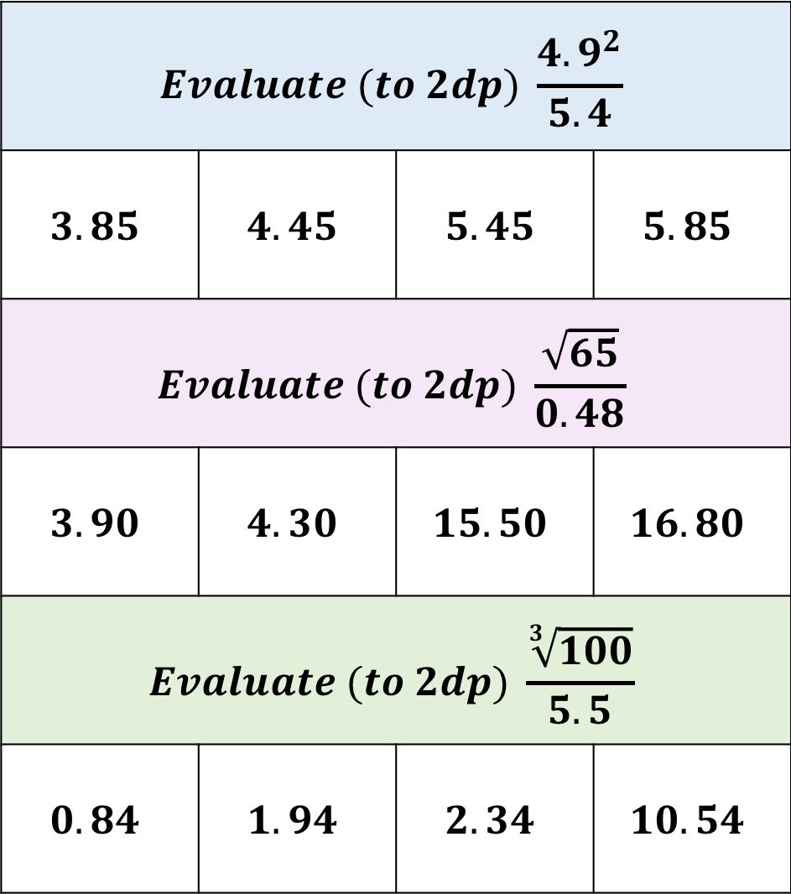
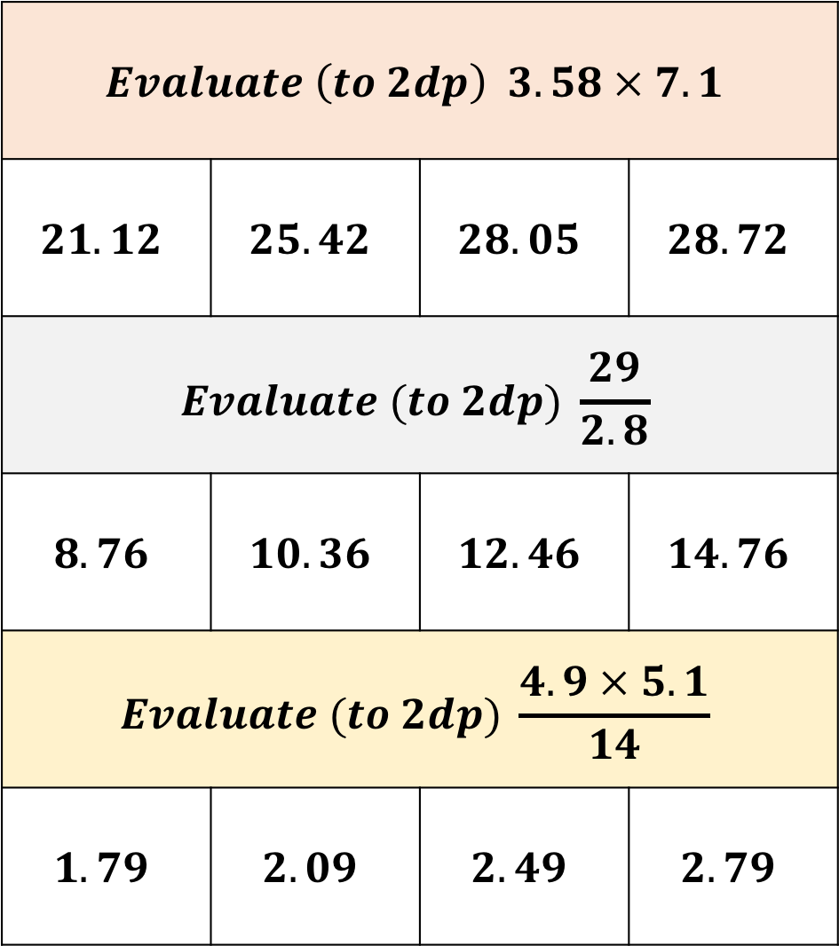
$$Evaluate \left(to 2dp\right) 3.58 × 7.1$$
$$21.12$$ | $$25.42$$ | $$28.05$$ | $$28.72$$
$$Evaluate (to 2dp) \frac{29}{2.8}$$
$$8.76$$ | $$10.36$$ | $$12.46$$ | $$14.76$$
$$Evaluate (to 2dp) \frac{4.9 × 5.1}{14}$$
$$1.79$$ | $$2.09$$ | $$2.49$$ | $$2.79$$
$$Evaluate (to 2dp) \frac{{4.9}^{2}}{5.4}$$
$$3.85$$ | $$4.45$$ | $$5.45$$ | $$5.85$$
$$Evaluate (to 2dp) \frac{\sqrt{65}}{0.48}$$
$$3.90$$ | $$4.30$$ | $$15.50$$ | $$16.80$$
$$Evaluate (to 2dp) \frac{\sqrt[3]{100}}{5.5}$$
$$0.84$$ | $$1.94$$ | $$2.34$$ | $$10.54$$

Slide 3
Do I have enough?
I have forgotten my PIN number but I can use my
cards contactless feature if spend under £30
Which of the following can I buy using contactless?
Use Estimation to determine your answer.
6 books at £4.99 each
99 pencils for 32p each
45 chocolate bars for 60p each

Slide 4
Round each value and then join each tables answers to form a shape
Round to 1 decimal place
8.03
8.43
8.05
8.947
8.809
8.552
7.939
8.15
8.952
8.30
7.96
Round to 1 Significant Figure
8.4
83
9.4
89
0.82
27
14
18
0.87
1.85
7.85
Round to nearest whole number
26.61
26.1
18.8
88.947
13.7
29.15
17.44
17.99
0.42
3.5
27.06
Round to 2 Significant Figures
8.65
8.472
7.79
20.8
70.45
87.5
87.49
0.791
0.865
0.803
8.726
8.4
8.1
9.0
8.2
8.0
8.3
0.75
42
0.22
55
8
2
7.5
0.7
9
2.9
43
80
8.9
8.8
8.5
7.8
20
0.9
7.9
8.6
8.7
0.80
10
30
27
4
0.79
15
8.00
0.87
90
0.8
26
19
70
90.0
26.5
21
0.2
19.5
87
88
12
3
17
29
0
18
89
14

Slide 5
Round each value and then join each tables answers to form a shape
Round to 1 decimal place
8.03 | 8.0
8.43 | 8.4
8.05 | 8.1
8.947 | 8.9
8.809 | 8.8
8.552 | 8.6
7.939 | 7.9
8.15 | 8.2
8.952 | 9.0
8.30 | 8.3
7.96 | 8.0
Round to 1 Significant Figure
8.4 | 8
83 | 80
9.4 | 9
89 | 90
0.82 | 0.8
27 | 30
14 | 10
18 | 20
0.87 | 0.9
1.85 | 2
7.85 | 8
Round to nearest whole number
26.61 | 27
26.1 | 26
18.8 | 19
88.947 | 89
13.7 | 14
29.15 | 29
17.44 | 17
17.99 | 18
0.42 | 0
3.5 | 4
27.06 | 27
Round to 2 Significant Figures
8.65 | 8.7
8.472 | 8.5
7.79 | 7.8
20.8 | 21
70.45 | 70
87.5 | 88
87.49 | 87
0.791 | 0.79
0.865 | 0.87
0.803 | 0.80
8.726 | 8.7
8.4
8.1
9.0
8.2
8.0
8.3
0.75
42
0.22
55
8
2
7.5
0.7
9
2.9
43
80
8.9
8.8
8.5
7.8
20
0.9
7.9
8.6
8.7
0.80
10
30
27
4
0.79
15
8.00
0.87
90
0.8
26
19
70
90.0
26.5
21
0.2
19.5
87
88
12
3
17
29
0
18
89
14

