Slide 1
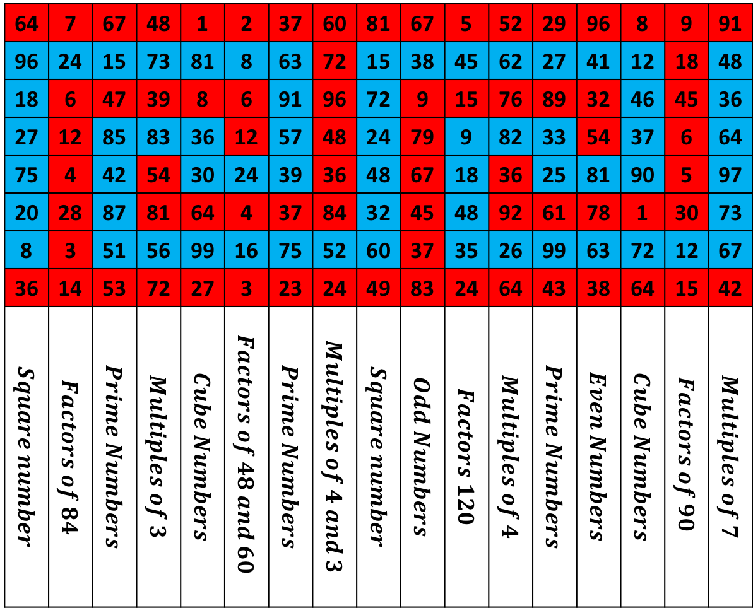
64 | 7 | 67 | 48 | 1 | 2 | 37 | 60 | 81 | 67 | 5 | 52 | 29 | 96 | 8 | 9 | 91
96 | 24 | 15 | 73 | 81 | 8 | 63 | 72 | 15 | 38 | 45 | 62 | 27 | 41 | 12 | 18 | 48
18 | 6 | 47 | 39 | 8 | 6 | 91 | 96 | 72 | 9 | 15 | 76 | 89 | 32 | 46 | 45 | 36
27 | 12 | 85 | 83 | 36 | 12 | 57 | 48 | 24 | 79 | 9 | 82 | 33 | 54 | 37 | 6 | 64
75 | 4 | 42 | 54 | 30 | 24 | 39 | 36 | 48 | 67 | 18 | 36 | 25 | 81 | 90 | 5 | 97
20 | 28 | 87 | 81 | 64 | 4 | 37 | 84 | 32 | 45 | 48 | 92 | 61 | 78 | 1 | 30 | 73
8 | 3 | 51 | 56 | 99 | 16 | 75 | 52 | 60 | 37 | 35 | 26 | 99 | 63 | 72 | 12 | 67
36 | 14 | 53 | 72 | 27 | 3 | 23 | 24 | 49 | 83 | 24 | 64 | 43 | 38 | 64 | 15 | 42
$$Square number$$ | $$Factors of 84$$ | $$Prime Numbers$$ | $$Multiples of 3$$ | $$Cube Numbers$$ | $$Factors of 48 and 60$$ | $$Prime Numbers$$ | $$Multiples of 4 and 3$$ | $$Square number$$ | $$Odd Numbers$$ | $$Factors 120$$ | $$Multiples of 4$$ | $$Prime Numbers$$ | $$Even Numbers$$ | $$Cube Numbers$$ | $$Factors of 90$$ | $$Multiples of 7$$

Slide 2
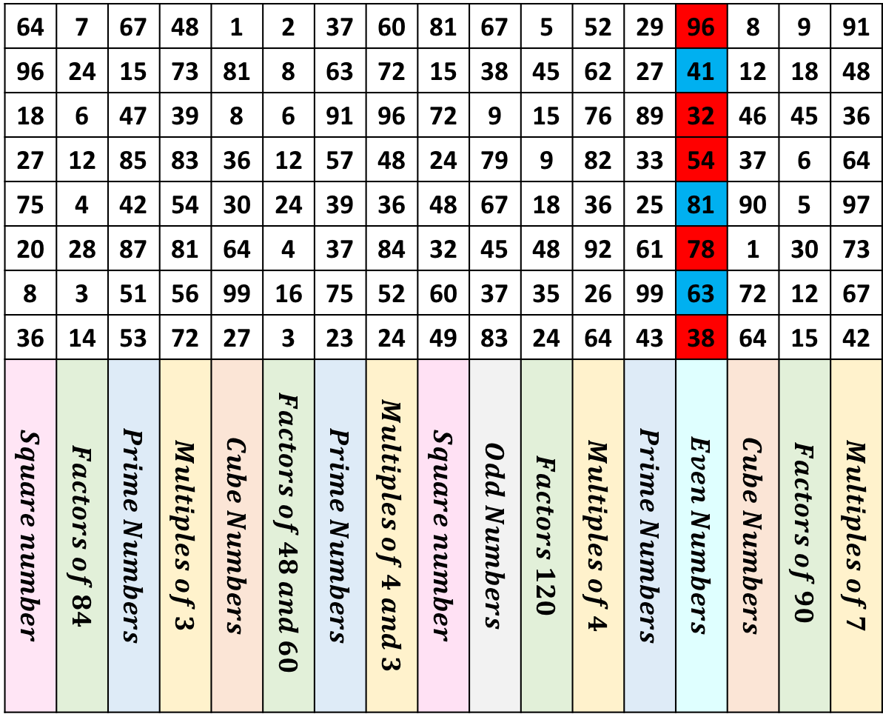
Colour the Numbers Puzzle
Colour the numbers in each column that match the description with RED
Colour the ones that don’t match the description with BLUE
EVEN Numbers has been done for you.
64 | 7 | 67 | 48 | 1 | 2 | 37 | 60 | 81 | 67 | 5 | 52 | 29 | 96 | 8 | 9 | 91
96 | 24 | 15 | 73 | 81 | 8 | 63 | 72 | 15 | 38 | 45 | 62 | 27 | 41 | 12 | 18 | 48
18 | 6 | 47 | 39 | 8 | 6 | 91 | 96 | 72 | 9 | 15 | 76 | 89 | 32 | 46 | 45 | 36
27 | 12 | 85 | 83 | 36 | 12 | 57 | 48 | 24 | 79 | 9 | 82 | 33 | 54 | 37 | 6 | 64
75 | 4 | 42 | 54 | 30 | 24 | 39 | 36 | 48 | 67 | 18 | 36 | 25 | 81 | 90 | 5 | 97
20 | 28 | 87 | 81 | 64 | 4 | 37 | 84 | 32 | 45 | 48 | 92 | 61 | 78 | 1 | 30 | 73
8 | 3 | 51 | 56 | 99 | 16 | 75 | 52 | 60 | 37 | 35 | 26 | 99 | 63 | 72 | 12 | 67
36 | 14 | 53 | 72 | 27 | 3 | 23 | 24 | 49 | 83 | 24 | 64 | 43 | 38 | 64 | 15 | 42
$$Square number$$ | $$Factors of 84$$ | $$Prime Numbers$$ | $$Multiples of 3$$ | $$Cube Numbers$$ | $$Factors of 48 and 60$$ | $$Prime Numbers$$ | $$Multiples of 4 and 3$$ | $$Square number$$ | $$Odd Numbers$$ | $$Factors 120$$ | $$Multiples of 4$$ | $$Prime Numbers$$ | $$Even Numbers$$ | $$Cube Numbers$$ | $$Factors of 90$$ | $$Multiples of 7$$

Slide 3
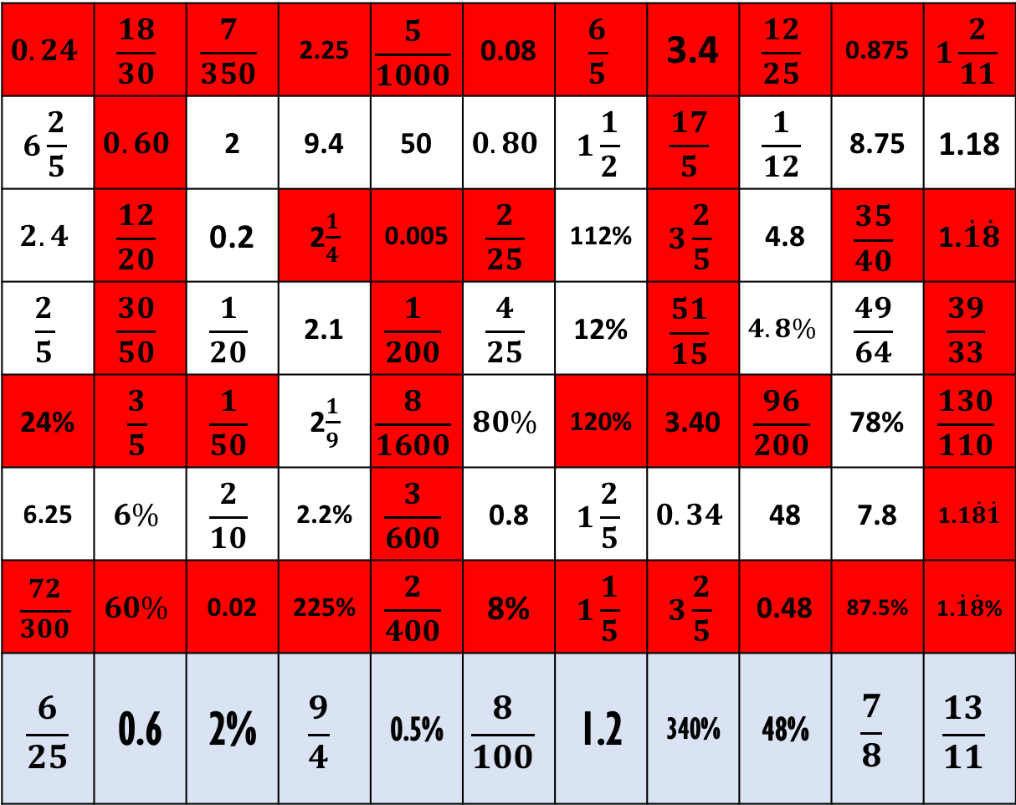
Colour the Numbers Puzzle
$$0.24$$ | $$\frac{18}{30}$$ | $$\frac{7}{350}$$ | 2.25 | $$\frac{5}{1000}$$ | 0.08 | $$\frac{6}{5}$$ | 3.4 | $$\frac{12}{25}$$ | 0.875 | $$1\frac{2}{11}$$
$$6\frac{2}{5}$$ | $$0.60$$ | 2 | 9.4 | 50 | $$0.80$$ | $$1\frac{1}{2}$$ | $$\frac{17}{5}$$ | $$\frac{1}{12}$$ | 8.75 | 1.18
$$2.4$$ | $$\frac{12}{20}$$ | 0.2 | 2$\frac{1}{4}$ | 0.005 | $$\frac{2}{25}$$ | 112% | $$3\frac{2}{5}$$ | 4.8 | $$\frac{35}{40}$$ | 1.$\dot{1}\dot{8}$
$$\frac{2}{5}$$ | $$\frac{30}{50}$$ | $$\frac{1}{20}$$ | 2.1 | $$\frac{1}{200}$$ | $$\frac{4}{25}$$ | 12% | $$\frac{51}{15}$$ | $$4.8\%$$ | $$\frac{49}{64}$$ | $$\frac{39}{33}$$
24% | $$\frac{3}{5}$$ | $$\frac{1}{50}$$ | 2$\frac{1}{9}$ | $$\frac{8}{1600}$$ | $$80\%$$ | 120% | 3.40 | $$\frac{96}{200}$$ | 78% | $$\frac{130}{110}$$
6.25 | $$6\%$$ | $$\frac{2}{10}$$ | 2.2% | $$\frac{3}{600}$$ | 0.8 | $$1\frac{2}{5}$$ | $$0.34$$ | 48 | 7.8 | 1.$1\dot{8}\dot{1}$
$$\frac{72}{300}$$ | $$60\%$$ | 0.02 | 225% | $$\frac{2}{400}$$ | 8% | $$1\frac{1}{5}$$ | $$3\frac{2}{5}$$ | 0.48 | 87.5% | 1.$\dot{1}\dot{8}$%
$$\frac{6}{25}$$ | 0.6 | 2% | $$\frac{9}{4}$$ | 0.5% | $$\frac{8}{100}$$ | 1.2 | 340% | 48% | $$\frac{7}{8}$$ | $$\frac{13}{11}$$
Look at each column and colour the equivalent fraction, decimal and percentage.
You can choose what colour you use
Leave the rest blank

Slide 4
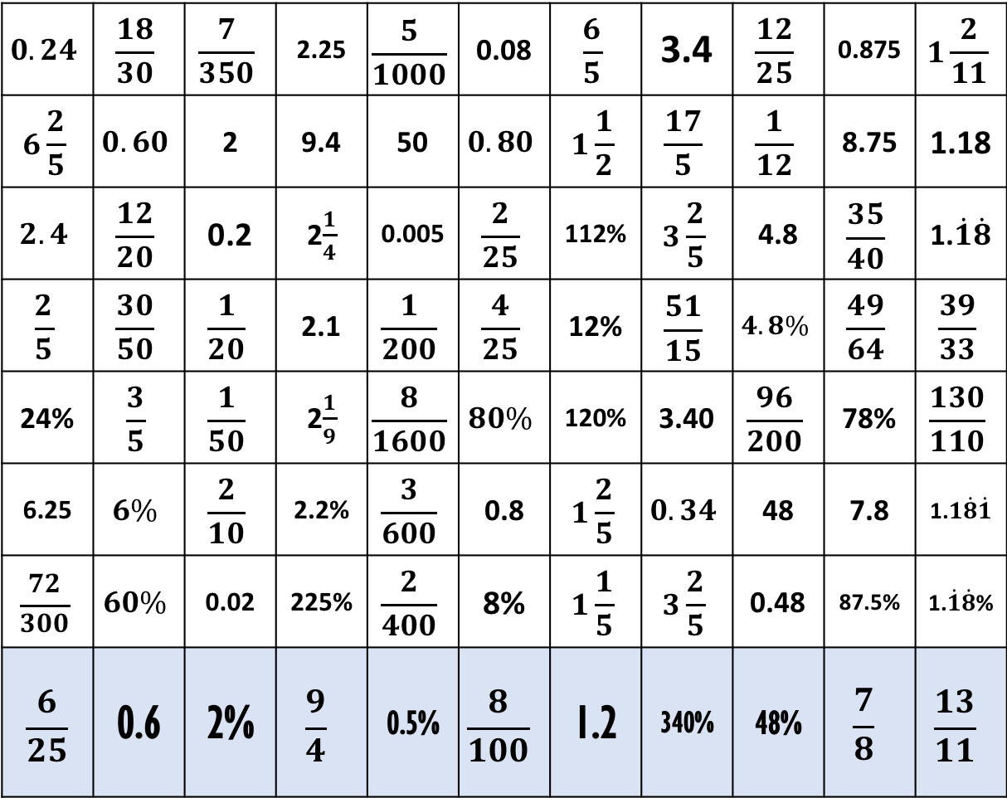
Colour the Numbers Puzzle
$$0.24$$ | $$\frac{18}{30}$$ | $$\frac{7}{350}$$ | 2.25 | $$\frac{5}{1000}$$ | 0.08 | $$\frac{6}{5}$$ | 3.4 | $$\frac{12}{25}$$ | 0.875 | $$1\frac{2}{11}$$
$$6\frac{2}{5}$$ | $$0.60$$ | 2 | 9.4 | 50 | $$0.80$$ | $$1\frac{1}{2}$$ | $$\frac{17}{5}$$ | $$\frac{1}{12}$$ | 8.75 | 1.18
$$2.4$$ | $$\frac{12}{20}$$ | 0.2 | 2$\frac{1}{4}$ | 0.005 | $$\frac{2}{25}$$ | 112% | $$3\frac{2}{5}$$ | 4.8 | $$\frac{35}{40}$$ | 1.$\dot{1}\dot{8}$
$$\frac{2}{5}$$ | $$\frac{30}{50}$$ | $$\frac{1}{20}$$ | 2.1 | $$\frac{1}{200}$$ | $$\frac{4}{25}$$ | 12% | $$\frac{51}{15}$$ | $$4.8\%$$ | $$\frac{49}{64}$$ | $$\frac{39}{33}$$
24% | $$\frac{3}{5}$$ | $$\frac{1}{50}$$ | 2$\frac{1}{9}$ | $$\frac{8}{1600}$$ | $$80\%$$ | 120% | 3.40 | $$\frac{96}{200}$$ | 78% | $$\frac{130}{110}$$
6.25 | $$6\%$$ | $$\frac{2}{10}$$ | 2.2% | $$\frac{3}{600}$$ | 0.8 | $$1\frac{2}{5}$$ | $$0.34$$ | 48 | 7.8 | 1.$1\dot{8}\dot{1}$
$$\frac{72}{300}$$ | $$60\%$$ | 0.02 | 225% | $$\frac{2}{400}$$ | 8% | $$1\frac{1}{5}$$ | $$3\frac{2}{5}$$ | 0.48 | 87.5% | 1.$\dot{1}\dot{8}$%
$$\frac{6}{25}$$ | 0.6 | 2% | $$\frac{9}{4}$$ | 0.5% | $$\frac{8}{100}$$ | 1.2 | 340% | 48% | $$\frac{7}{8}$$ | $$\frac{13}{11}$$
Look at each column and colour the equivalent fraction, decimal and percentage.
You can choose what colour you use
Leave the rest blank

Slide 5
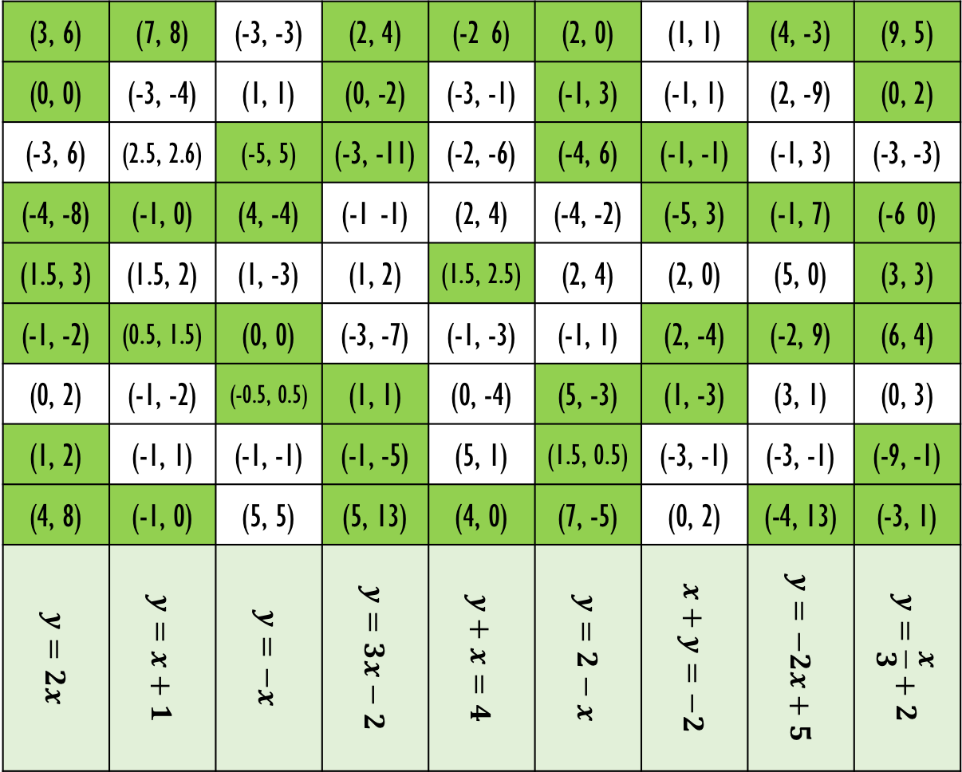
Look at each column and colour the co-ordinates that satisfy the equation at the bottom of each column.
You can choose which colour to use for this work.
Leave the rest blank
Colour the Numbers Puzzle
(3, 6) | (7, 8) | (-3, -3) | (2, 4) | (-2 6) | (2, 0) | (1, 1) | (4, -3) | (9, 5)
(0, 0) | (-3, -4) | (1, 1) | (0, -2) | (-3, -1) | (-1, 3) | (-1, 1) | (2, -9) | (0, 2)
(-3, 6) | (2.5, 2.6) | (-5, 5) | (-3, -11) | (-2, -6) | (-4, 6) | (-1, -1) | (-1, 3) | (-3, -3)
(-4, -8) | (-1, 0) | (4, -4) | (-1 -1) | (2, 4) | (-4, -2) | (-5, 3) | (-1, 7) | (-6 0)
(1.5, 3) | (1.5, 2) | (1, -3) | (1, 2) | (1.5, 2.5) | (2, 4) | (2, 0) | (5, 0) | (3, 3)
(-1, -2) | (0.5, 1.5) | (0, 0) | (-3, -7) | (-1, -3) | (-1, 1) | (2, -4) | (-2, 9) | (6, 4)
(0, 2) | (-1, -2) | (-0.5, 0.5) | (1, 1) | (0, -4) | (5, -3) | (1, -3) | (3, 1) | (0, 3)
(1, 2) | (-1, 1) | (-1, -1) | (-1, -5) | (5, 1) | (1.5, 0.5) | (-3, -1) | (-3, -1) | (-9, -1)
(4, 8) | (-1, 0) | (5, 5) | (5, 13) | (4, 0) | (7, -5) | (0, 2) | (-4, 13) | (-3, 1)
$$y=2x$$ | $$y=x+1$$ | $$y=−x$$ | $$y=3x−2$$ | $$y+x=4$$ | $$y=2−x$$ | $$x+y=−2$$ | $$y=−2x+5$$ | $$y=\frac{x}{3}+2$$

Slide 6
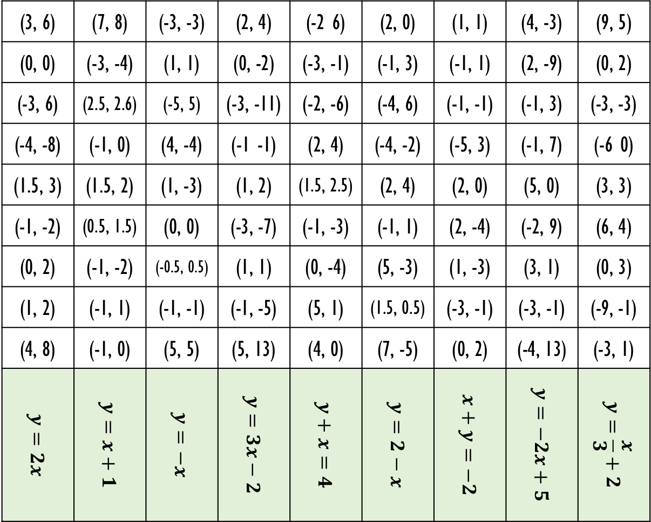
Look at each column and colour the co-ordinates that satisfy the equation at the bottom of each column.
You can choose which colour to use for this work.
Leave the rest blank
Colour the Numbers Puzzle
(3, 6) | (7, 8) | (-3, -3) | (2, 4) | (-2 6) | (2, 0) | (1, 1) | (4, -3) | (9, 5)
(0, 0) | (-3, -4) | (1, 1) | (0, -2) | (-3, -1) | (-1, 3) | (-1, 1) | (2, -9) | (0, 2)
(-3, 6) | (2.5, 2.6) | (-5, 5) | (-3, -11) | (-2, -6) | (-4, 6) | (-1, -1) | (-1, 3) | (-3, -3)
(-4, -8) | (-1, 0) | (4, -4) | (-1 -1) | (2, 4) | (-4, -2) | (-5, 3) | (-1, 7) | (-6 0)
(1.5, 3) | (1.5, 2) | (1, -3) | (1, 2) | (1.5, 2.5) | (2, 4) | (2, 0) | (5, 0) | (3, 3)
(-1, -2) | (0.5, 1.5) | (0, 0) | (-3, -7) | (-1, -3) | (-1, 1) | (2, -4) | (-2, 9) | (6, 4)
(0, 2) | (-1, -2) | (-0.5, 0.5) | (1, 1) | (0, -4) | (5, -3) | (1, -3) | (3, 1) | (0, 3)
(1, 2) | (-1, 1) | (-1, -1) | (-1, -5) | (5, 1) | (1.5, 0.5) | (-3, -1) | (-3, -1) | (-9, -1)
(4, 8) | (-1, 0) | (5, 5) | (5, 13) | (4, 0) | (7, -5) | (0, 2) | (-4, 13) | (-3, 1)
$$y=2x$$ | $$y=x+1$$ | $$y=−x$$ | $$y=3x−2$$ | $$y+x=4$$ | $$y=2−x$$ | $$x+y=−2$$ | $$y=−2x+5$$ | $$y=\frac{x}{3}+2$$

Slide 7
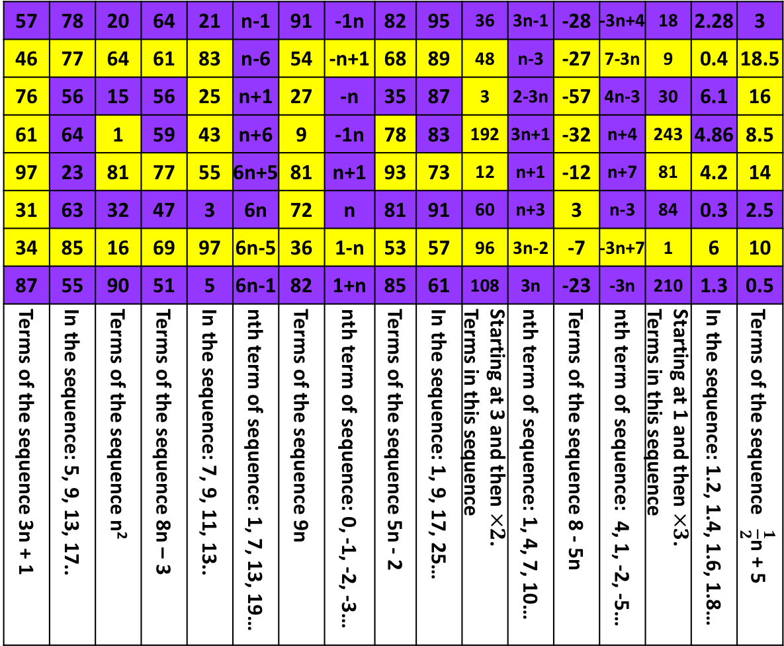
Colour the Numbers Puzzle
57 | 78 | 20 | 64 | 21 | n-1 | 91 | -1n | 82 | 95 | 36 | 3n-1 | -28 | -3n+4 | 18 | 2.28 | 3
46 | 77 | 64 | 61 | 83 | n-6 | 54 | -n+1 | 68 | 89 | 48 | n-3 | -27 | 7-3n | 9 | 0.4 | 18.5
76 | 56 | 15 | 56 | 25 | n+1 | 27 | -n | 35 | 87 | 3 | 2-3n | -57 | 4n-3 | 30 | 6.1 | 16
61 | 64 | 1 | 59 | 43 | n+6 | 9 | -1n | 78 | 83 | 192 | 3n+1 | -32 | n+4 | 243 | 4.86 | 8.5
97 | 23 | 81 | 77 | 55 | 6n+5 | 81 | n+1 | 93 | 73 | 12 | n+1 | -12 | n+7 | 81 | 4.2 | 14
31 | 63 | 32 | 47 | 3 | 6n | 72 | n | 81 | 91 | 60 | n+3 | 3 | n-3 | 84 | 0.3 | 2.5
34 | 85 | 16 | 69 | 97 | 6n-5 | 36 | 1-n | 53 | 57 | 96 | 3n-2 | -7 | -3n+7 | 1 | 6 | 10
87 | 55 | 90 | 51 | 5 | 6n-1 | 82 | 1+n | 85 | 61 | 108 | 3n | -23 | -3n | 210 | 1.3 | 0.5
Terms of the sequence 3n + 1 | In the sequence: 5, 9, 13, 17.. | Terms of the sequence n² | Terms of the sequence 8n – 3 | In the sequence: 7, 9, 11, 13.. | nth term of sequence: 1, 7, 13, 19… | Terms of the sequence 9n | nth term of sequence: 0, -1, -2, -3… | Terms of the sequence 5n - 2 | In the sequence: 1, 9, 17, 25… | Starting at 3 and then $×2$. Terms in this sequence | nth term of sequence: 1, 4, 7, 10… | Terms of the sequence 8 - 5n | nth term of sequence: 4, 1, -2, -5… | Starting at 1 and then $×3$. Terms in this sequence | In the sequence: 1.2, 1.4, 1.6, 1.8… | Terms of the sequence $\frac{1}{2}$n + 5
Look at each column and colour in YELLOW ALL the answers for the question at the bottom of each column.
Colour the rest in PURPLE

Slide 8
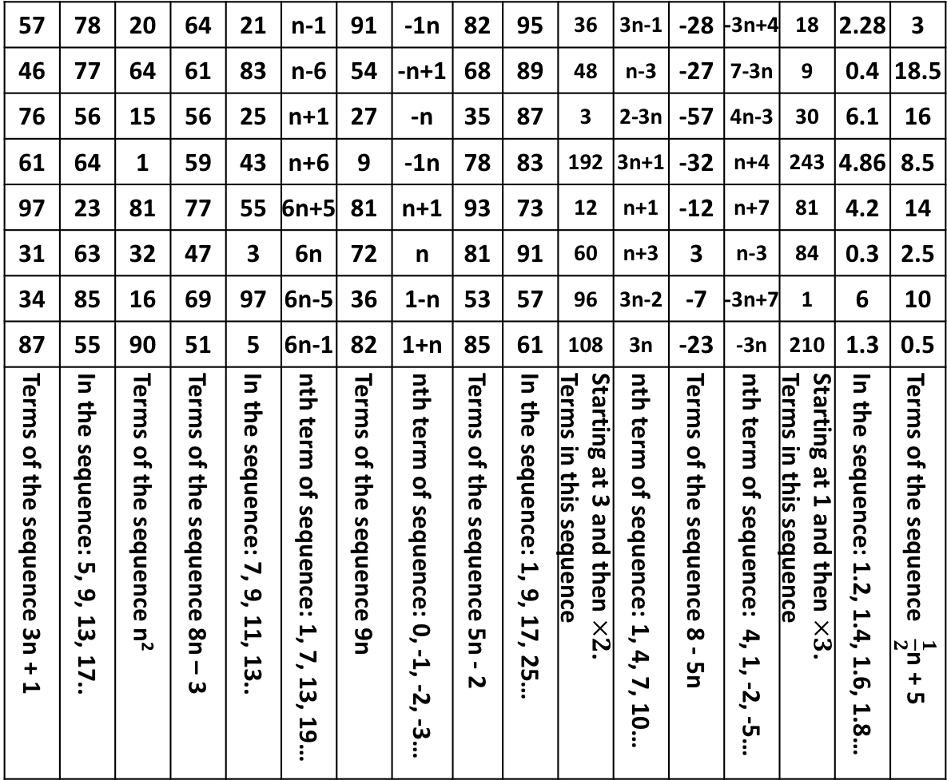
Colour the Numbers Puzzle
57 | 78 | 20 | 64 | 21 | n-1 | 91 | -1n | 82 | 95 | 36 | 3n-1 | -28 | -3n+4 | 18 | 2.28 | 3
46 | 77 | 64 | 61 | 83 | n-6 | 54 | -n+1 | 68 | 89 | 48 | n-3 | -27 | 7-3n | 9 | 0.4 | 18.5
76 | 56 | 15 | 56 | 25 | n+1 | 27 | -n | 35 | 87 | 3 | 2-3n | -57 | 4n-3 | 30 | 6.1 | 16
61 | 64 | 1 | 59 | 43 | n+6 | 9 | -1n | 78 | 83 | 192 | 3n+1 | -32 | n+4 | 243 | 4.86 | 8.5
97 | 23 | 81 | 77 | 55 | 6n+5 | 81 | n+1 | 93 | 73 | 12 | n+1 | -12 | n+7 | 81 | 4.2 | 14
31 | 63 | 32 | 47 | 3 | 6n | 72 | n | 81 | 91 | 60 | n+3 | 3 | n-3 | 84 | 0.3 | 2.5
34 | 85 | 16 | 69 | 97 | 6n-5 | 36 | 1-n | 53 | 57 | 96 | 3n-2 | -7 | -3n+7 | 1 | 6 | 10
87 | 55 | 90 | 51 | 5 | 6n-1 | 82 | 1+n | 85 | 61 | 108 | 3n | -23 | -3n | 210 | 1.3 | 0.5
Terms of the sequence 3n + 1 | In the sequence: 5, 9, 13, 17.. | Terms of the sequence n² | Terms of the sequence 8n – 3 | In the sequence: 7, 9, 11, 13.. | nth term of sequence: 1, 7, 13, 19… | Terms of the sequence 9n | nth term of sequence: 0, -1, -2, -3… | Terms of the sequence 5n - 2 | In the sequence: 1, 9, 17, 25… | Starting at 3 and then $×2$. Terms in this sequence | nth term of sequence: 1, 4, 7, 10… | Terms of the sequence 8 - 5n | nth term of sequence: 4, 1, -2, -5… | Starting at 1 and then $×3$. Terms in this sequence | In the sequence: 1.2, 1.4, 1.6, 1.8… | Terms of the sequence $\frac{1}{2}$n + 5
Look at each column and colour in YELLOW ALL the answers for the question at the bottom of each column.
Colour the rest in PURPLE

