Slide 1
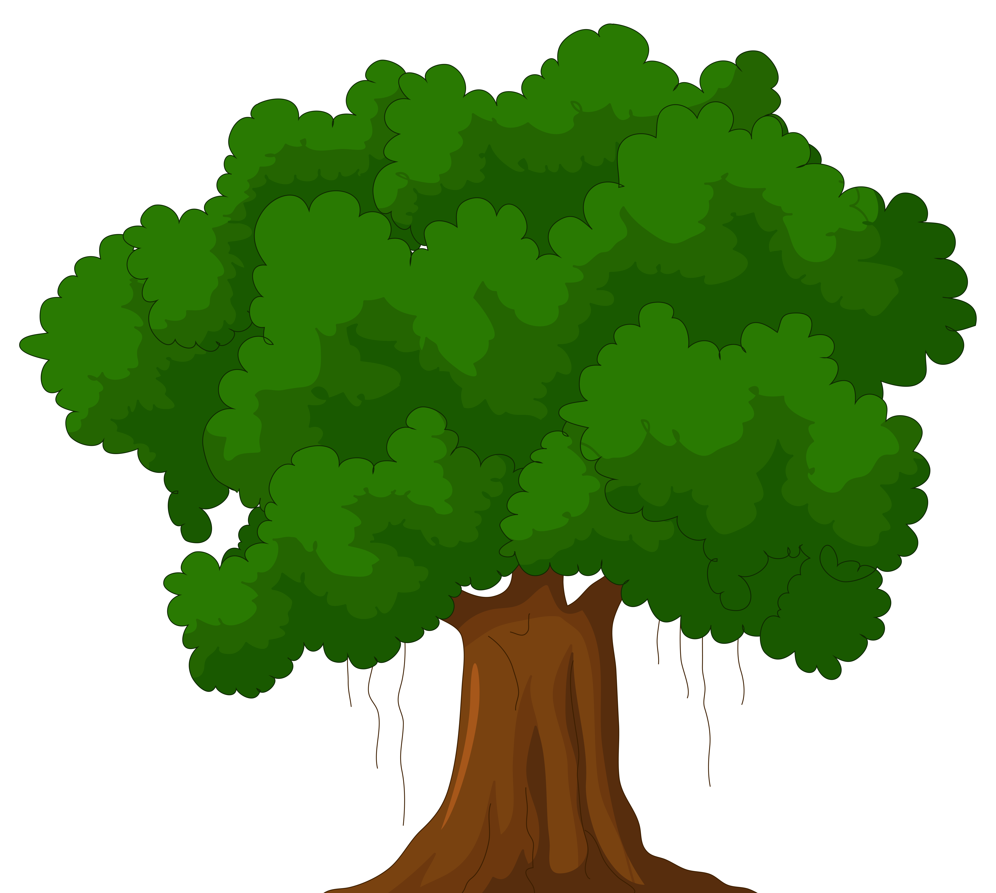

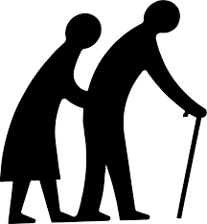
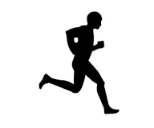


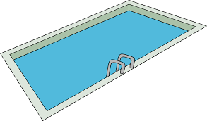
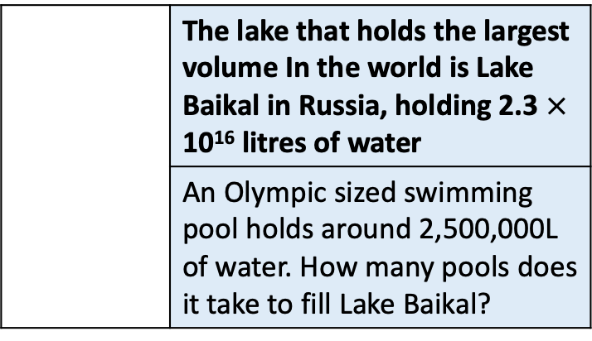
 | The heaviest animal in the world (Blue Whale) can weigh up to 199680kg
 | The average apple weighs 80g. How many apples would you need to have a total weight equal to the weight of the whale?
 | The tallest tree in the world is a 115.7m tall Redwood
 | The average length of an unsharpened pencil is 19cm. Estimate how many you would need to place, end to end to be as tall as the tree?
 | The oldest person to ever live, Jeanne Calment died at 122 years 164 days old.
 | The average life expectancy of a cat is 15 years. Approximately what fraction of Jeanne’s life is equal to a cats?
 | The fastest man to run 100m is Usain Bolt taking 9.58 seconds.
 | The averages butterfly flaps its wings 20 times a second. Estimate how many times it flap it’s wings in 9.58s?
 | The largest capacity stadium in the world is in North Korea and holds 114,000 people
 | The country with the smallest population is the Vatican City with 825 people. How many times does this population fit into the stadium?
 | The lake that holds the largest volume In the world is Lake Baikal in Russia, holding 2.3 $×$ 10¹⁶ litres of water
 | An Olympic sized swimming pool holds around 2,500,000L of water. How many pools does it take to fill Lake Baikal?

