Slide 1


1.)
$$x$$
$$62o$$

Slide 2


2.)
$$x$$
$$x$$
$$138o$$

Slide 3

3.)
$$138o$$
$$x$$

Slide 4


4.)
$$57o$$
$$x$$

Slide 5


5.)
$$117o$$
$$x$$

Slide 6


6.)
$$x$$
$$138o$$
$$29o$$

Slide 7


7.)
$$x$$
$$x$$
$$x$$
$$118o$$

Slide 8


8.)
$$67o$$
$$x$$
$$x$$

Slide 9



9.)
$$x$$
$$146o$$
$$x$$

Slide 10

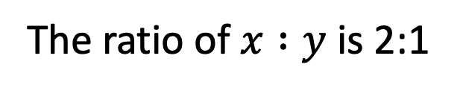

10.)
The ratio of $x :y$ is 2:1
$$z$$
$$x$$
$$138o$$
$$y$$

Slide 11
Circle Theorems

Slide 12
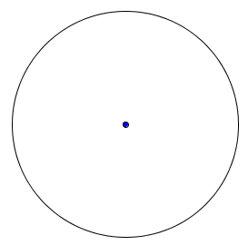
A tangent meets the radius at 90º | The angle in a semicircle is a right angle.
Any triangle with two points at the circumference and one in the centre is isosceles. | The angle subtended by an arc at the centre of a circle is twice the angle subtended at the circumference.
The sum of the opposite angles of a cyclic quadrilateral is 180. | Angles in the same segment are equal
The angle between a chord and the tangent at the point of contact is equal to the angle in the alternate segment. | Any triangle created by two crossing tangents and the line joining their point of contact is isosceles.
A tangent meets the radius at 90º | The angle in a semicircle is a right angle.
Any triangle with two points at the circumference and one in the centre is isosceles. | The angle subtended by an arc at the centre of a circle is twice the angle subtended at the circumference.
The sum of the opposite angles of a cyclic quadrilateral is 180. | Angles in the same segment are equal
The angle between a chord and the tangent at the point of contact is equal to the angle in the alternate segment. | Any triangle created by two crossing tangents and the line joining their point of contact is isosceles.

Slide 13
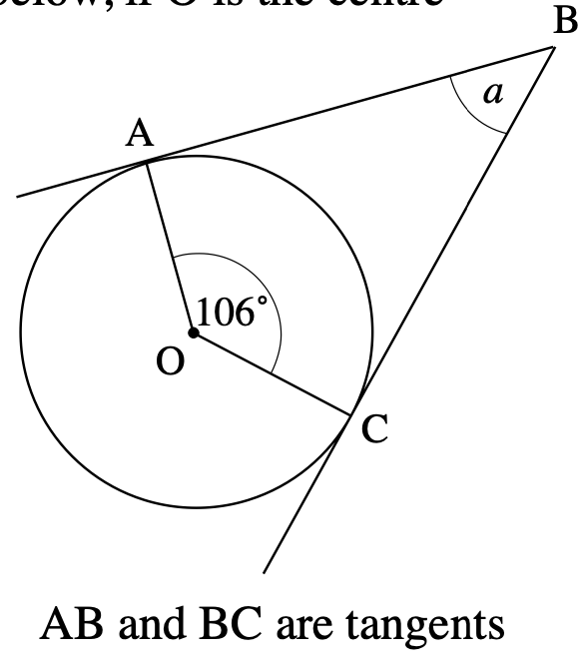
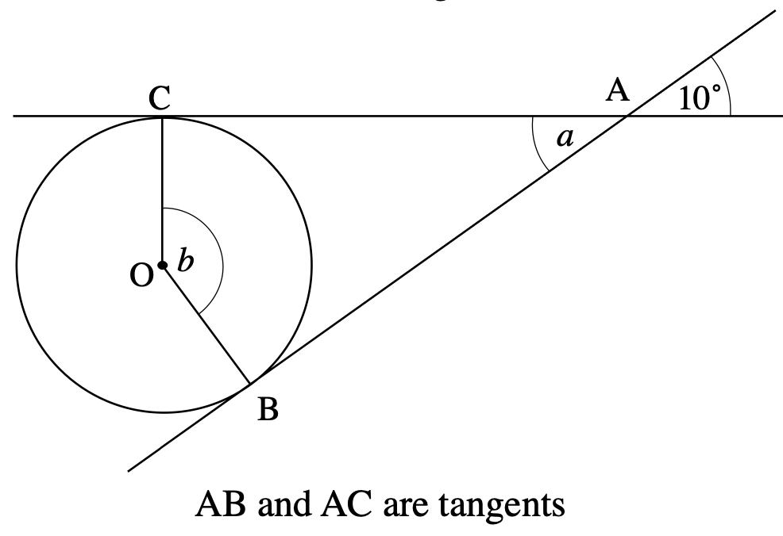
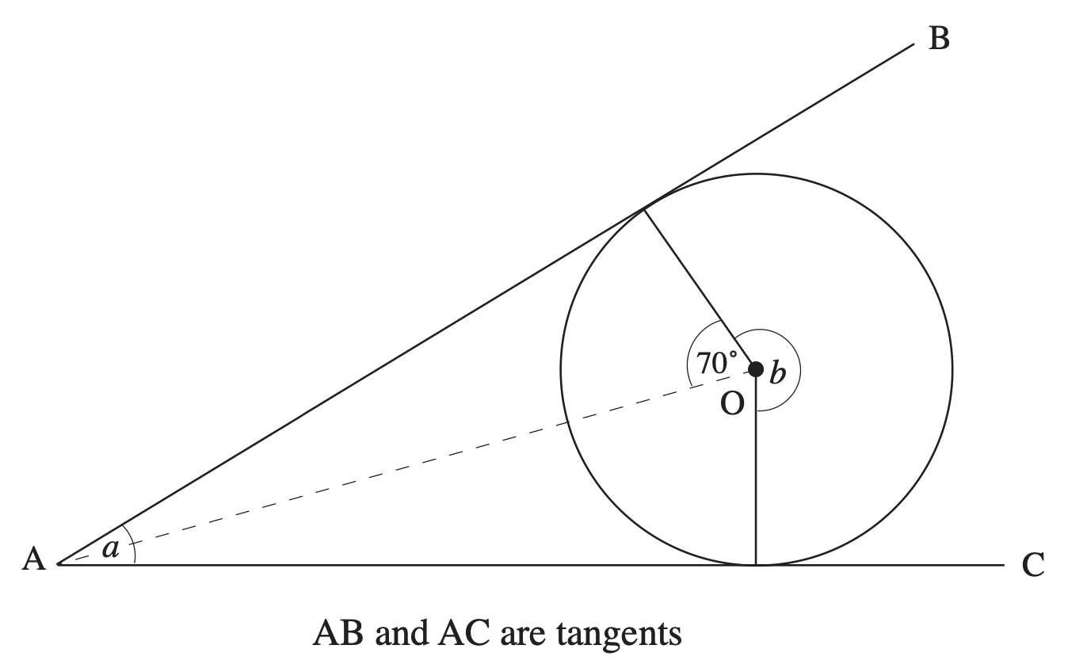
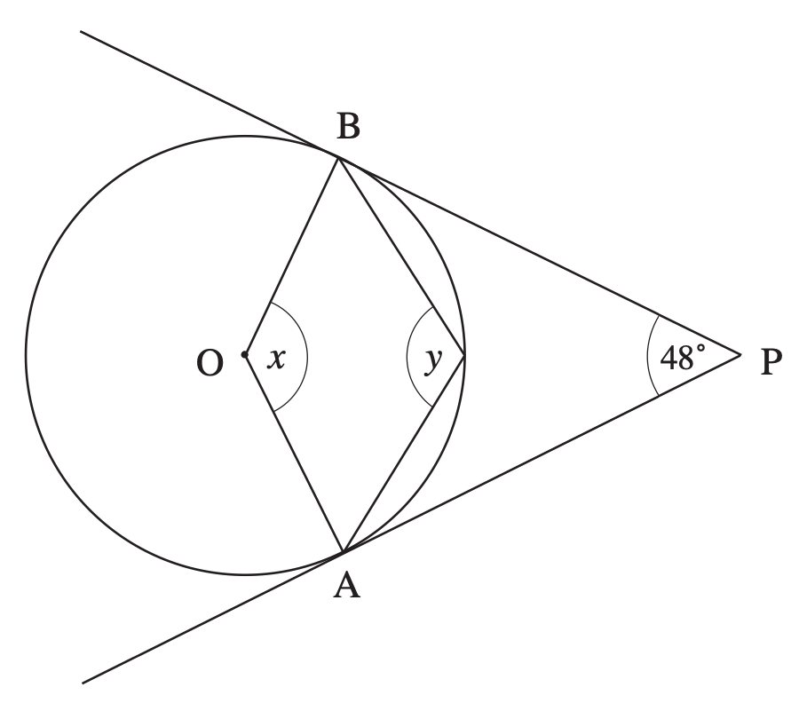

Slide 14
