Slide 1





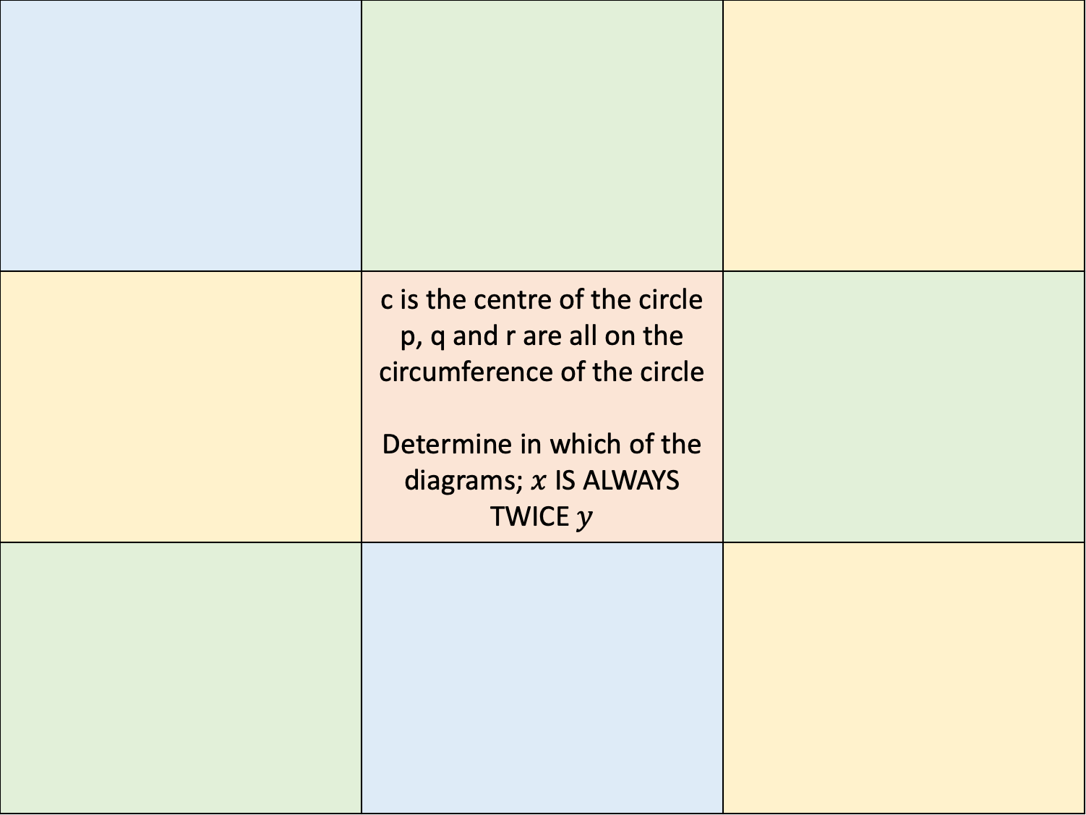







 | c is the centre of the circle p, q and r are all on the circumference of the circle Determine in which of the diagrams; $x$ IS ALWAYS TWICE $y$
(1)
q
(2)
(3)
r
p
$$y$$
$$y$$
p
$$x$$
$$x$$
c
c
$$y$$
p
$$x$$
r
q
q
(4)
q
(5)
p
q
$$y$$
$$x$$
$$y$$
$$x$$
c
c
r
r
(6)
q
(7)
(8)
q
r
$$y$$
$$y$$
$$x$$
c
c
c
$$x$$
$$y$$
$$x$$
r
p
q
p
p
r

Slide 2




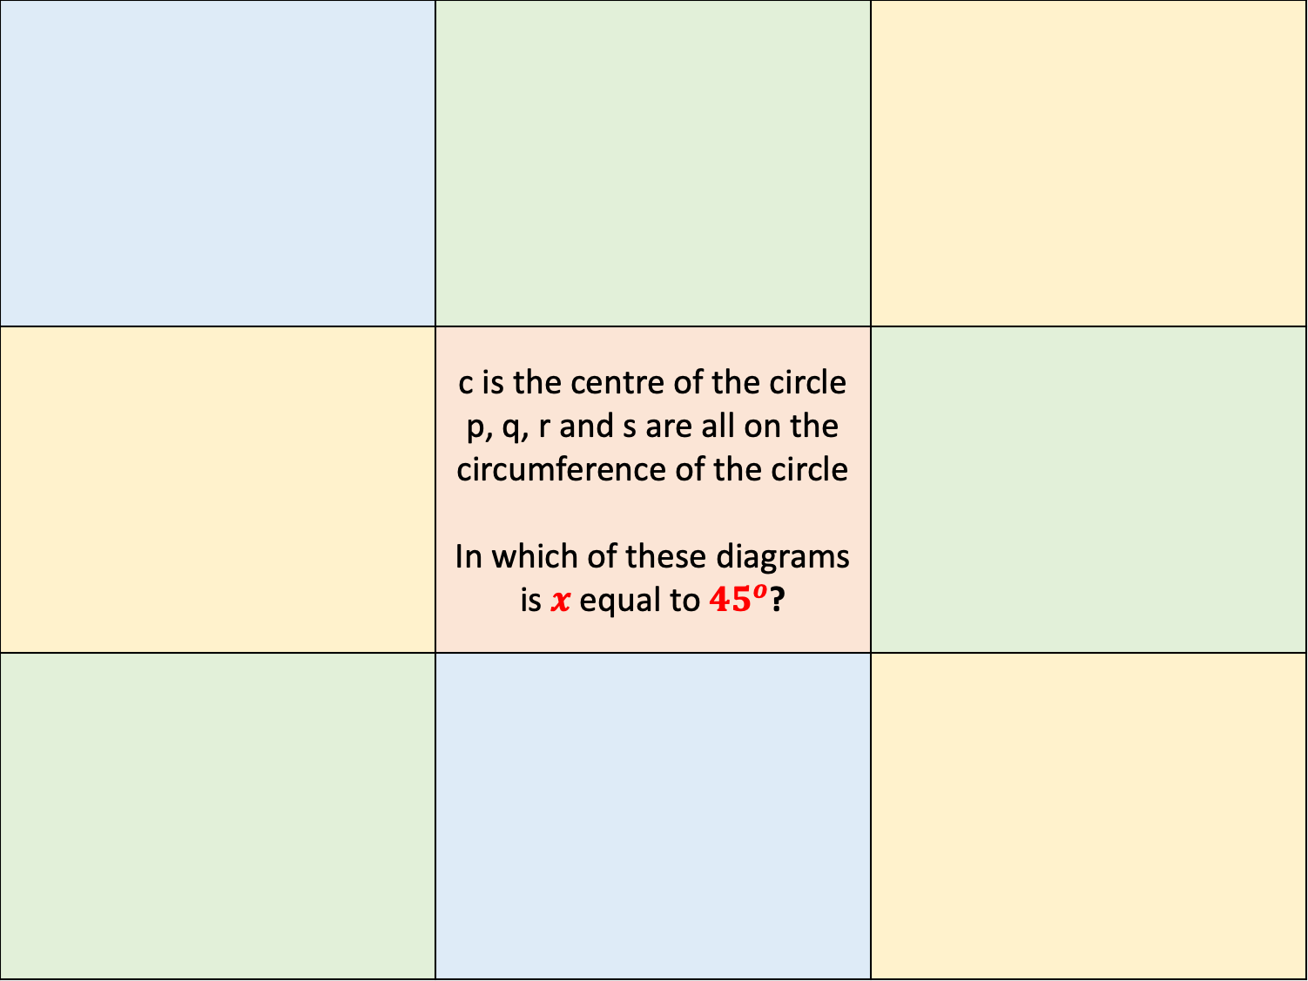









q
p
s
 | c is the centre of the circle p, q, r and s are all on the circumference of the circle In which of these diagrams is $x$ equal to ${45}^{o}$?
(1)
(2)
(3)
$$x$$
$$x$$
p
$${135}^{o}$$
c
c
$${60}^{o}$$
q
q
c
s
$$x$$
$${85}^{o}$$
$${135}^{o}$$
r
p
r
r
(4)
(5)
q
p
$$x$$
c
c
$$x$$
r
q
p
r
(6)
q
(7)
s
(8)
q
$${135}^{o}$$
r
c
c
$${145}^{o}$$
$${25}^{o}$$
$$x$$
c
p
p
$${160}^{o}$$
r
$$x$$
q
p
r

