Slide 1
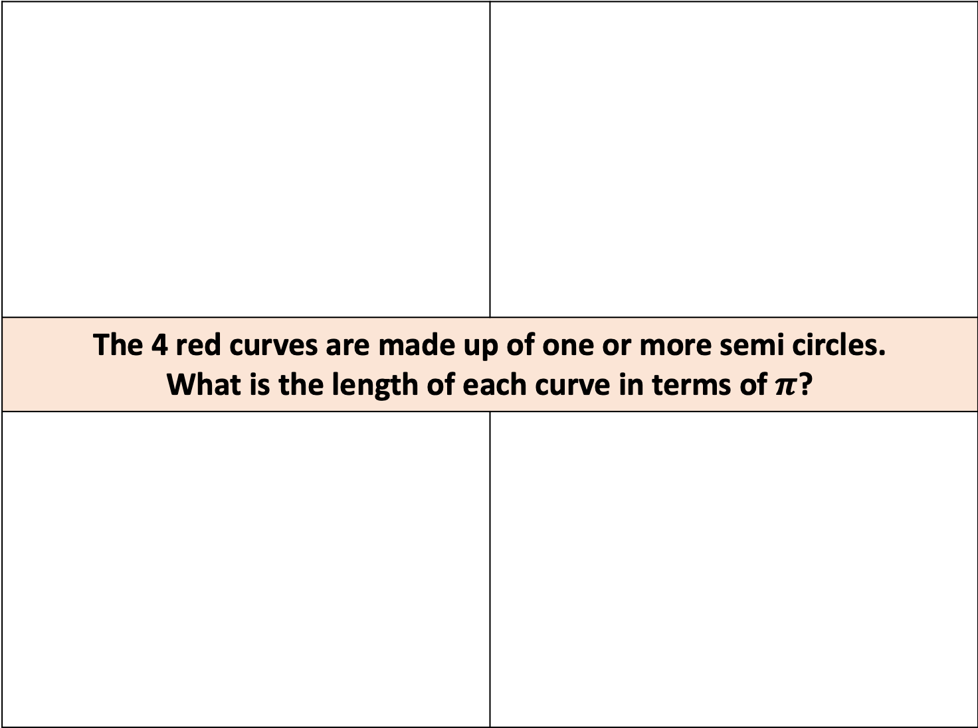
The 4 red curves are made up of one or more semi circles. What is the length of each curve in terms of $π$?
8cm
8cm
16cm
12cm
4cm
4cm
4cm
4cm
4cm

Slide 2
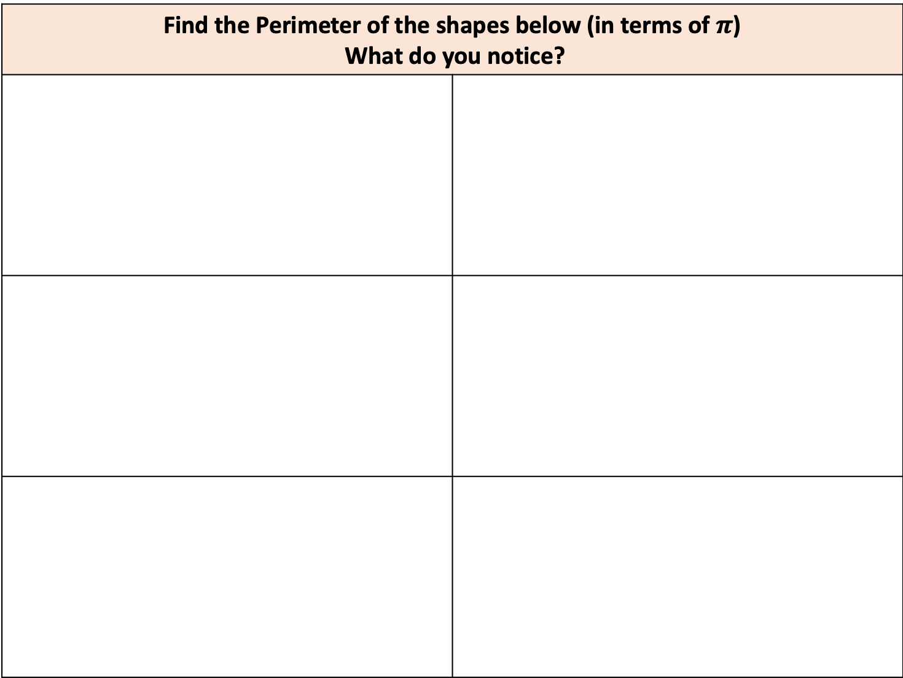
Find the Perimeter of the shapes below (in terms of $π$) What do you notice?
6cm
6cm
12cm
4cm
4cm
4cm
3cm
3cm
3cm
3cm
1cm
1cm
1cm
1cm
1cm
1cm
1cm
1cm
1cm
1cm
2cm
2cm
2cm
2cm
2cm
2cm
1cm
1cm

Slide 3
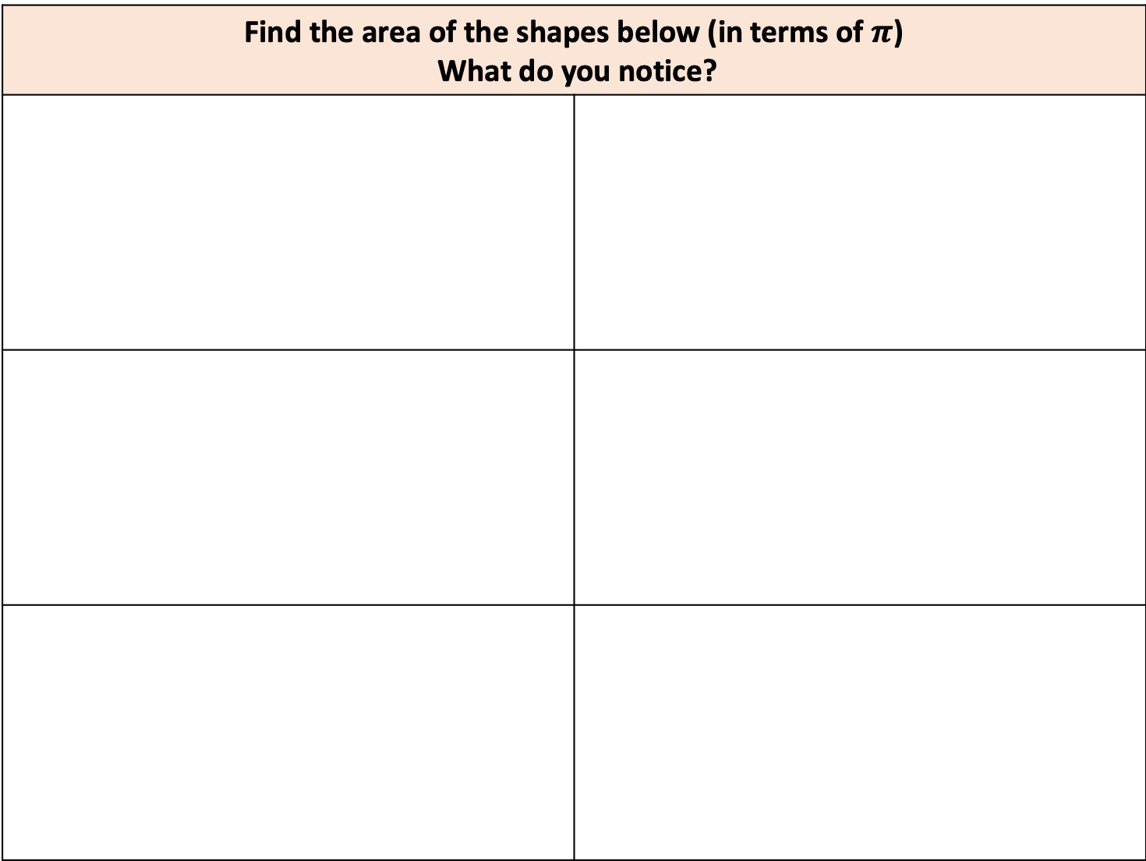
Find the area of the shapes below (in terms of $π$) What do you notice?
6cm
6cm
12cm
4cm
4cm
4cm
3cm
3cm
3cm
3cm
1cm
1cm
1cm
1cm
1cm
1cm
1cm
1cm
1cm
1cm
2cm
2cm
2cm
2cm
2cm
2cm
1cm
1cm
Notes:
18. 9. 6. 4.5. 3. 1.5

Slide 4
I bend lengths of wire to create the 6 designs below. All 6 designs are made up of semi-circles. Find the length of the 6 pieces of wire needed to make the designs
6cm
6cm
12cm
4cm
4cm
4cm
3cm
3cm
3cm
3cm
1cm
1cm
1cm
1cm
1cm
1cm
1cm
1cm
1cm
1cm
2cm
2cm
2cm
2cm
2cm
2cm
1cm
1cm

