Slide 1
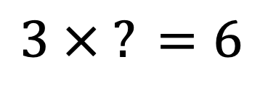
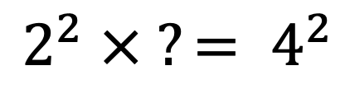
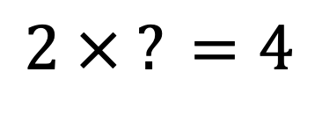
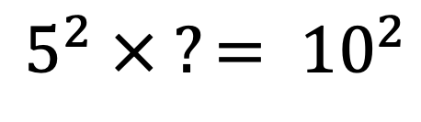
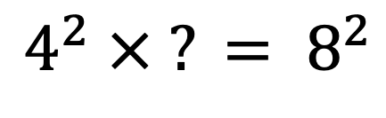
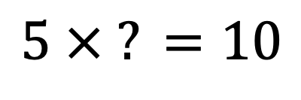
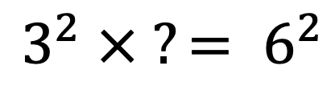
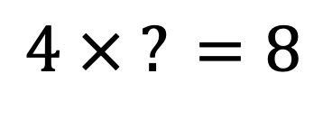
What do you notice?
$$2 × ? =4$$
$$2^{2} × ?= 4^{2}$$
$$3 × ? =6$$
$$3^{2} × ?= 6^{2}$$
$$4 × ? =8$$
$$4^{2} × ? = 8^{2}$$
$$5 × ? =10$$
$$5^{2} × ?= {10}^{2}$$
Notes:
1 - 1
2 - 4
3 - 9
4 - 16
5 - 25
6 - 36
7 - 49
8 - 64
9 - 81
10 - 100
11 - 121
12 -
13
14
15
16
17
18
19
20

Slide 2
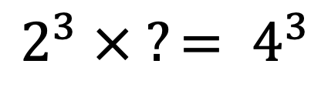
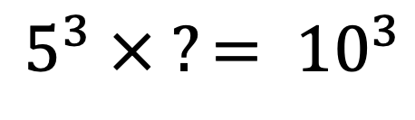
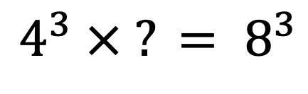
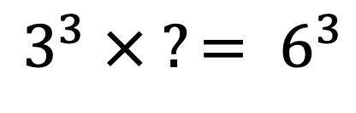
What do you notice?
$$2 × ? =4$$
$$2^{3} × ?= 4^{3}$$
$$3 × ? =6$$
$$3^{3} × ?= 6^{3}$$
$$4 × ? =8$$
$$4^{3} × ? = 8^{3}$$
$$5 × ? =10$$
$$5^{3} × ?= {10}^{3}$$
Notes:
1 - 1
2 - 4
3 - 9
4 - 16
5 - 25
6 - 36
7 - 49
8 - 64
9 - 81
10 - 100
11 - 121
12 -
13
14
15
16
17
18
19
20

Slide 3
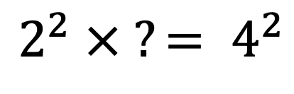
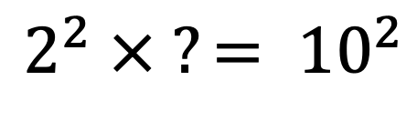
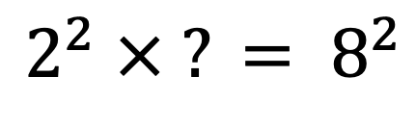
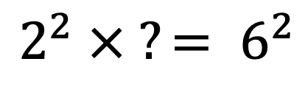
What do you notice?
$$2^{2} × ?= 4^{2}$$
$$2^{2} × ?= 6^{2}$$
$$2^{2} × ? = 8^{2}$$
$$2^{2} × ?= {10}^{2}$$
Notes:
1 - 1
2 - 4
3 - 9
4 - 16
5 - 25
6 - 36
7 - 49
8 - 64
9 - 81
10 - 100
11 - 121
12 -
13
14
15
16
17
18
19
20

Slide 4
















$$2 × ...=4$$
$$2^{2} × ... = 4^{2}$$
$$2^{3} × ... = 4^{3}$$
$$3 × ...=6$$
$$3^{2} × ... = 6^{2}$$
$$3^{3} × ... = 6^{3}$$
$$4 × ...=8$$
$$4^{2} × ... = 8^{2}$$
$$4^{3} × ... = 8^{3}$$
$$5 × ...=10$$
$$5^{2} × ... = {10}^{2}$$
$$5^{3} × ... = {10}^{3}$$
$$2^{2} × ... = 4^{2}$$
$$2^{2} × ... = 6^{2}$$
$$2^{2} × ... = 8^{2}$$
$$2^{2} × ... = {10}^{2}$$
Notes:
1 - 1
2 - 4
3 - 9
4 - 16
5 - 25
6 - 36
7 - 49
8 - 64
9 - 81
10 - 100
11 - 121
12 -
13
14
15
16
17
18
19
20

