Slide 1
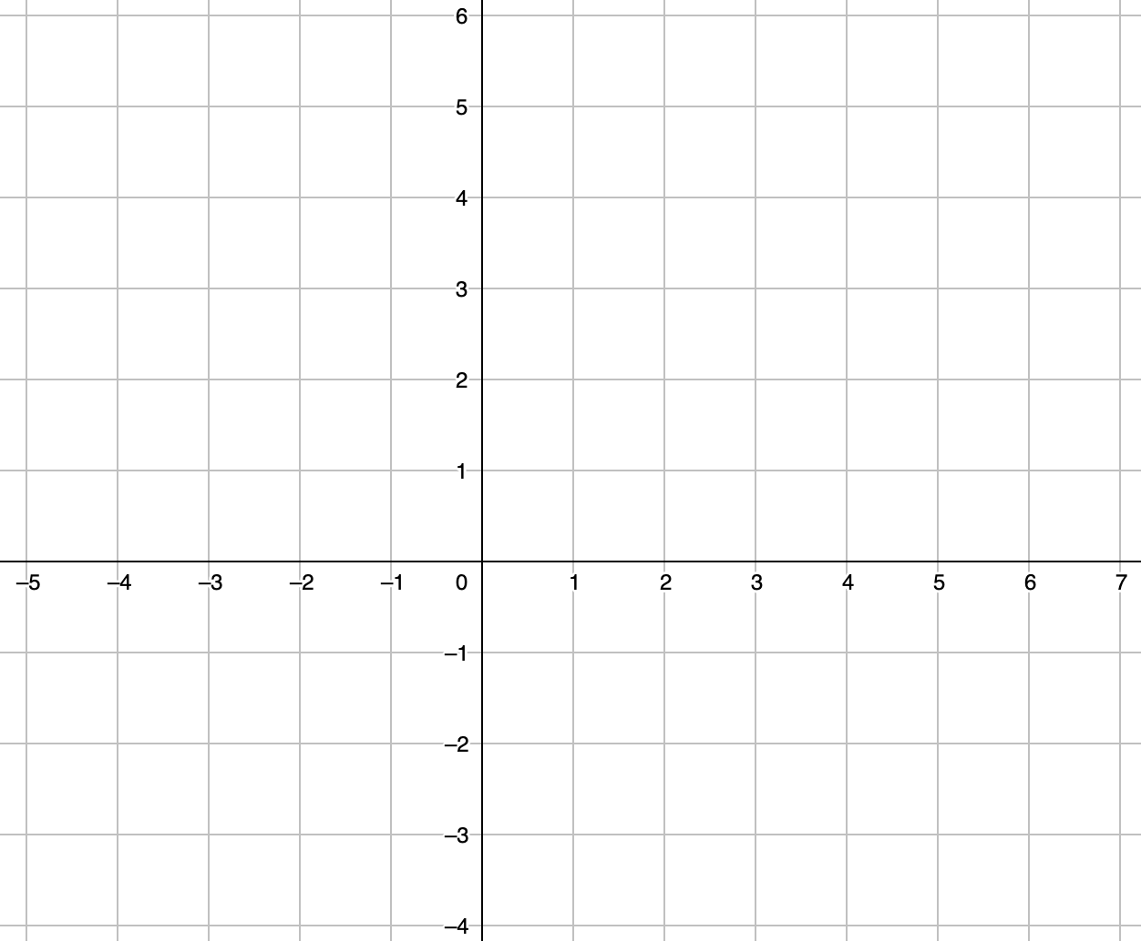
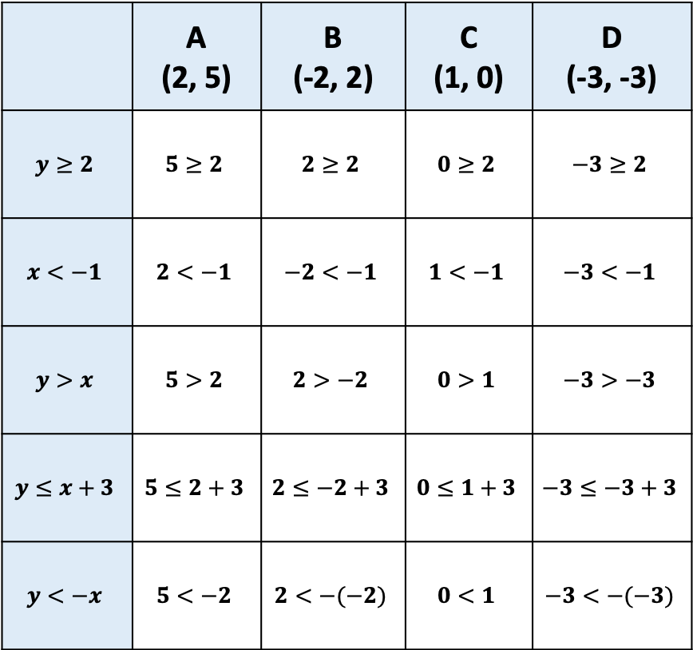
Circle the correct inequalities
The first row has been done for you
A
 | A (2, 5) | B (-2, 2) | C (1, 0) | D (-3, -3)
$$y≥2$$ | $$5≥2$$ | $$2≥2$$ | $$0≥2$$ | $$−3≥2$$
$$x<−1$$ | $$2<−1$$ | $$−2<−1$$ | $$1<−1$$ | $$−3<−1$$
$$y>x$$ | $$5>2$$ | $$2>−2$$ | $$0>1$$ | $$−3>−3$$
$$y≤x+3$$ | $$5≤2+3$$ | $$2≤−2+3$$ | $$0≤1+3$$ | $$−3≤−3+3$$
$$y<−x$$ | $$5<−2$$ | $$2<−(−2)$$ | $$0<1$$ | $$−3<−(−3)$$
B
C
D

Slide 2
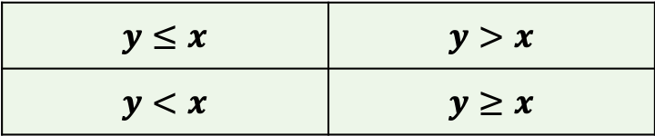
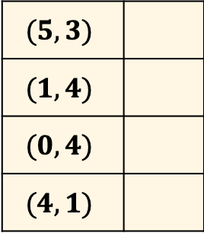
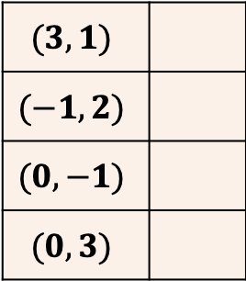
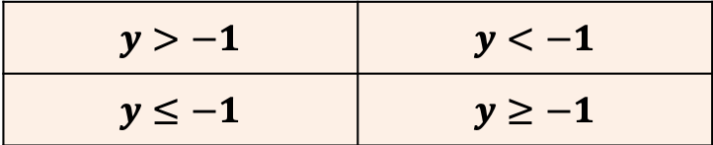
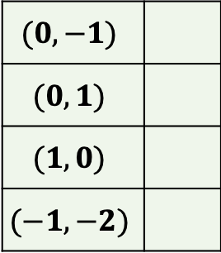
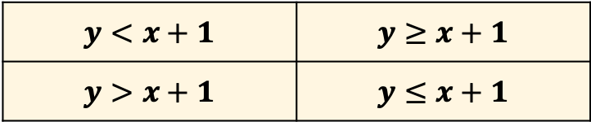
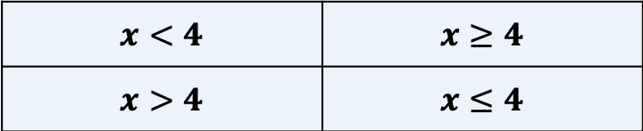
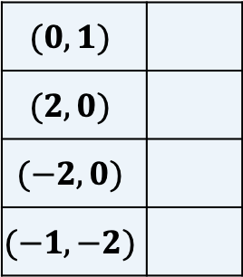
For each question; Tick the co-ordinates and then the equation that represents the shaded region
$$(5, 3)$$
$$(1, 4)$$
$$(0, 4)$$
$$(4, 1)$$
$$(0, −1)$$
$$(0, 1)$$
$$(1, 0)$$
$$(−1, −2)$$
$$x<4$$ | $$x≥4$$
$$x>4$$ | $$x≤4$$
$$y>−1$$ | $$y<−1$$
$$y≤−1$$ | $$y≥−1$$
$$(3, 1)$$
$$(−1,2)$$
$$(0, −1)$$
$$(0, 3)$$
$$(0, 1)$$
$$(2, 0)$$
$$(−2,0)$$
$$(−1, −2)$$
$$y≤x$$ | $$y>x$$
$$y<x$$ | $$y≥x$$
$$y<x+1$$ | $$y≥x+1$$
$$y>x+1$$ | $$y≤x+1$$

Slide 3
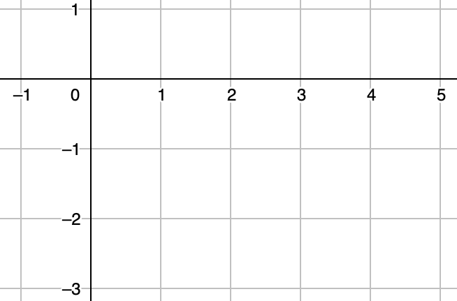
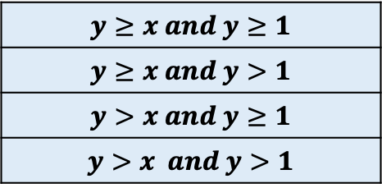
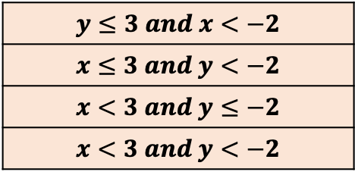
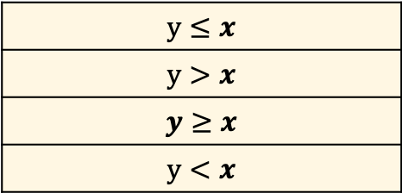
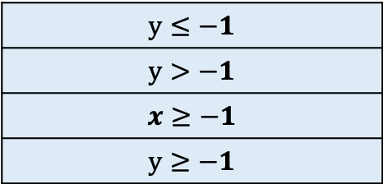
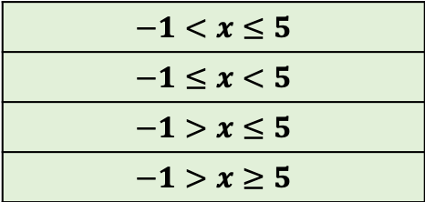
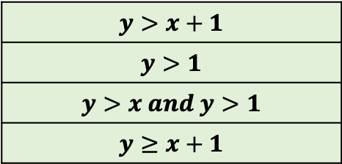
$$y≤−1$$
$$y>−1$$
$$x≥−1$$
$$y≥−1$$
$$−1<x≤5$$
$$−1≤x<5$$
$$−1>x≤5$$
$$−1>x≥5$$
$$y≤3 and x<−2$$
$$x≤3 and y<−2$$
$$x<3 and y≤−2$$
$$x<3 and y<−2$$
$$y≤x$$
$$y>x$$
$$y≥x$$
$$y<x$$
$$y≥x and y≥1$$
$$y≥x and y>1$$
$$y>x and y≥1$$
$$y>x and y>1$$
$$y>x+1$$
$$y>1$$
$$y>x and y>1$$
$$y≥x+1$$

