Slide 1
1. 2 3 4 5 6 7 8
A
C
D
E
F
G
A
B
A pattern has 3 shapes: Square, Triangle, Circle
and 7 letters: A, B, C, D, E, F, G
The 3rd shape has the letter that the shape starts with: C (Circle)
For which pattern number does this happen again?

Slide 2
0. 1 2 3 4 5 6 7 8
A RED pattern is drawn at the top of a line and a BLUE pattern is drawn on the bottom of a line.
The patterns touch at 0, at what number do they touch again?

Slide 3
42cm
A
8cm
A GREEN circle with diameter 42cm rolls along a line
A PURPLE circle with diameter 8cm also rolls along the line
They have a point A marked on BOTH circumferences
If they both start with A touching, how many revolutions of each circle are needed so that A touches again?

Slide 4
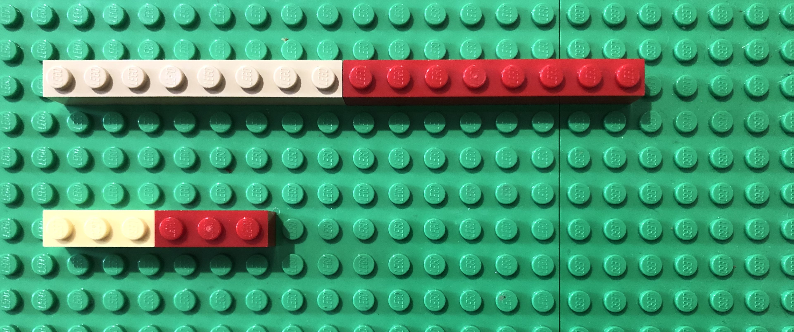
I place a row of 8 stud bricks in a line.
Underneath I place a row of 3 stud bricks in a line
If the two lines are equal in length, how many of each type of brick will I need?

