Slide 1
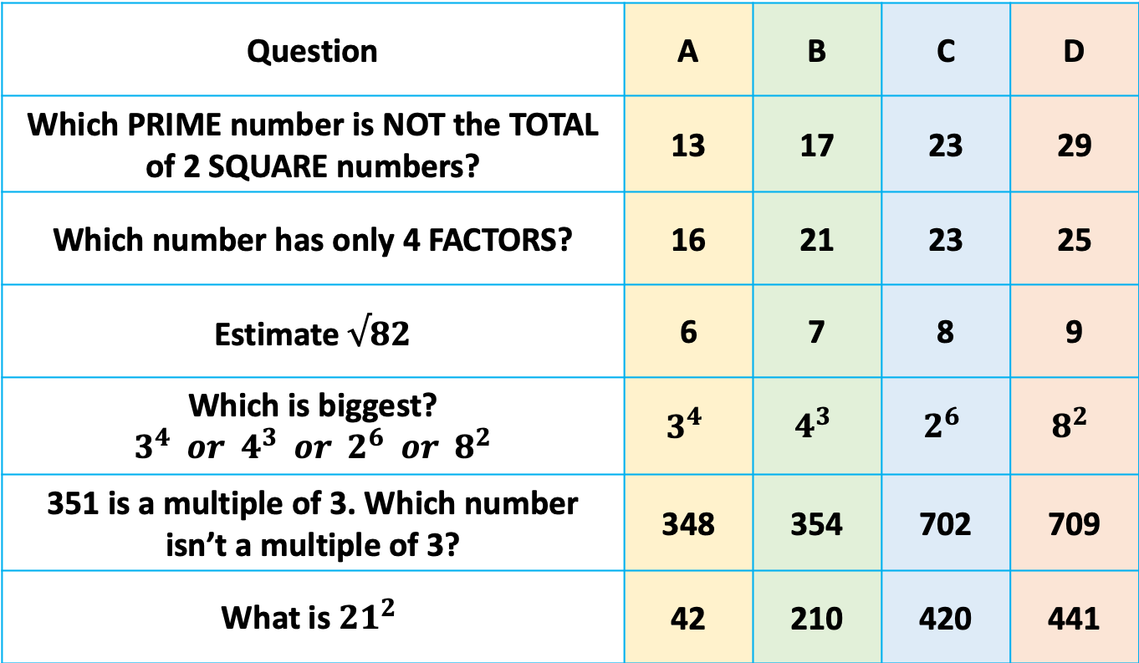
Multiple Choice
Question | A | B | C | D
Which PRIME number is NOT the TOTAL of 2 SQUARE numbers? | 13 | 17 | 23 | 29
Which number has only 4 FACTORS? | 16 | 21 | 23 | 25
Estimate $√82$ | 6 | 7 | 8 | 9
Which is biggest? $3^{4} or 4^{3} or 2^{6} or 8^{2}$ | $$3^{4}$$ | $$4^{3}$$ | $$2^{6}$$ | $$8^{2}$$
351 is a multiple of 3. Which number isn’t a multiple of 3? | 348 | 354 | 702 | 709
What is ${21}^{2}$ | 42 | 210 | 420 | 441
Notes:
1 4 9 16 25 36 49

Slide 2
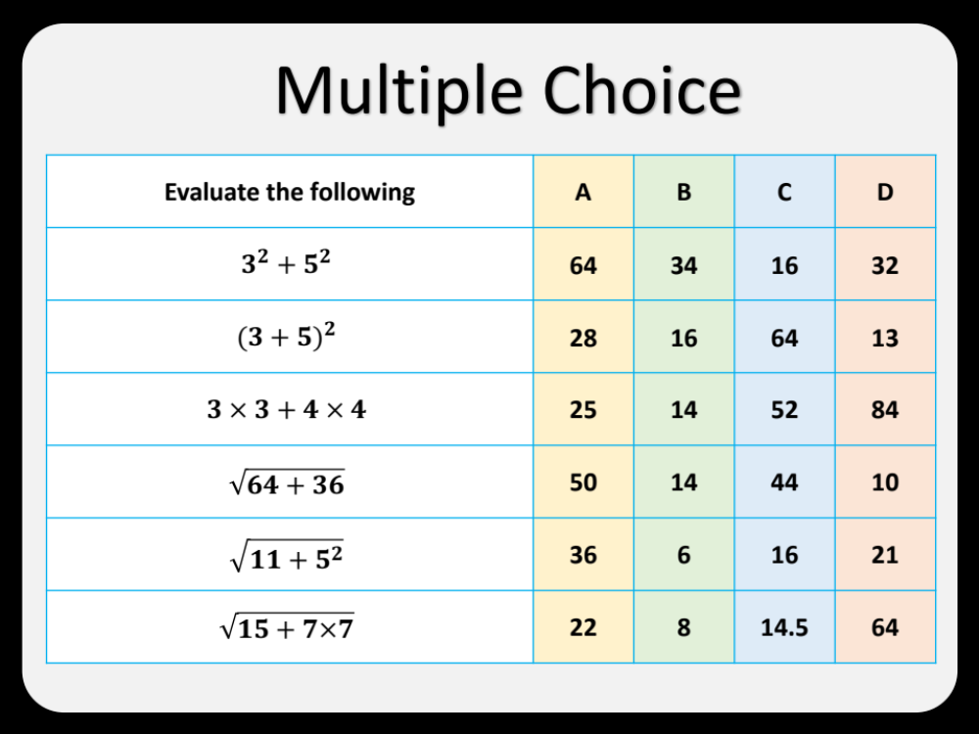
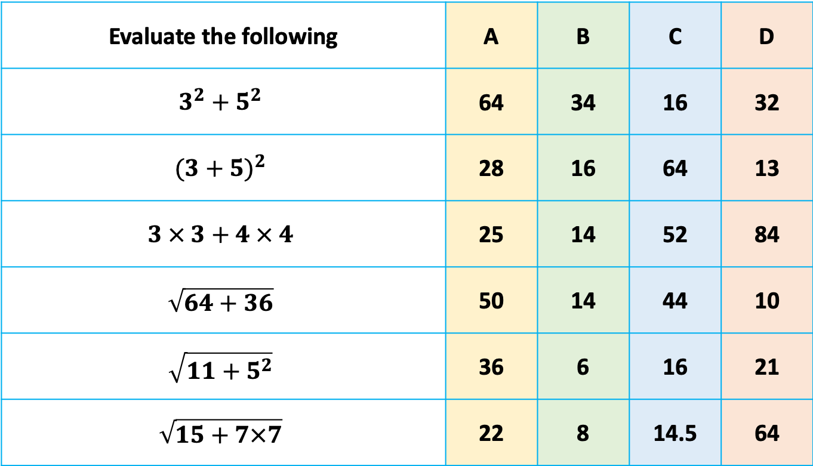
Multiple Choice
Evaluate the following | A | B | C | D
$$3^{2}+5^{2}$$ | 64 | 34 | 16 | 32
$${(3+5)}^{2}$$ | 28 | 16 | 64 | 13
$$3 × 3+4 × 4$$ | 25 | 14 | 52 | 84
$$\sqrt{64+36}$$ | 50 | 14 | 44 | 10
$$\sqrt{{11+5}^{2}}$$ | 36 | 6 | 16 | 21
$$\sqrt{15+7×7}$$ | 22 | 8 | 14.5 | 64
Notes:
1 4 9 16 25 36 49

Slide 3
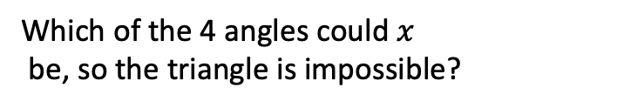
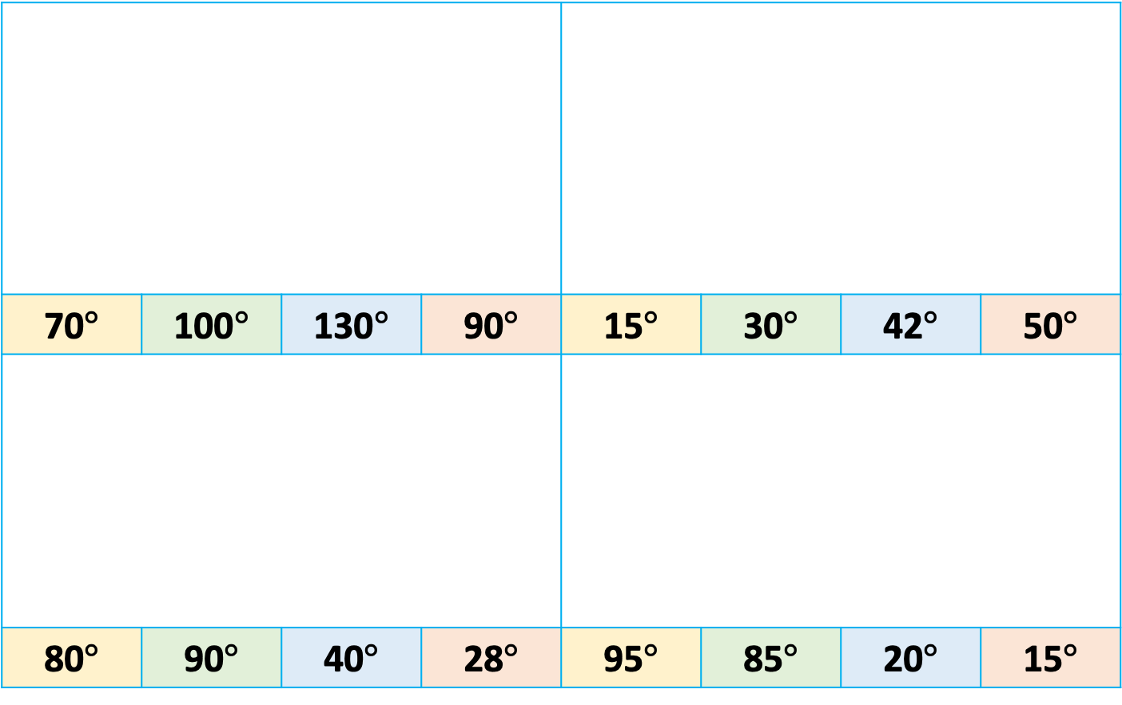


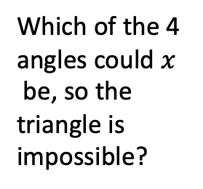

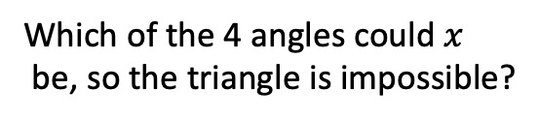

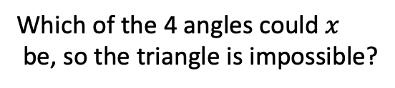
Multiple Choice
Which of the 4 angles could $x$
be, so the triangle is impossible?
70$°$ | 100$°$ | 130$°$ | 90$°$ | 15$°$ | 30$°$ | 42$°$ | 50$°$
80$°$ | 90$°$ | 40$°$ | 28$°$ | 95$°$ | 85$°$ | 20$°$ | 15$°$
Which of the 4 angles could $x$
be, so the triangle is impossible?
$$x$$
$$130°$$
$$x$$
$$50°$$
Which of the 4 angles could $x$
be, so the triangle is impossible?
Which of the 4 angles could $x$
be, so the triangle is impossible?
$$x$$
$$x$$
Notes:
1 4 9 16 25 36 49

Slide 4
Multiple Choice
Questions | A | B | C | D
Which term isn’t in this linear sequence: 10, 14, 18, 22, 26… | 174 | 210 | 243 | 258
Find the missing term in the linear sequence: 83, ….. , 91 | 84 | 85 | 86 | 87
Which isn’t a multiple of 6? | 432 | 363 | 246 | 138
Which term is in the linear sequence: 7, 12, 17, 22... | 327 | 371 | 273 | 725
Find the missing term in the linear sequence: 165, ….. ,187 | 175 | 176 | 177 | 178
Notes:
1 4 9 16 25 36 49

Slide 5
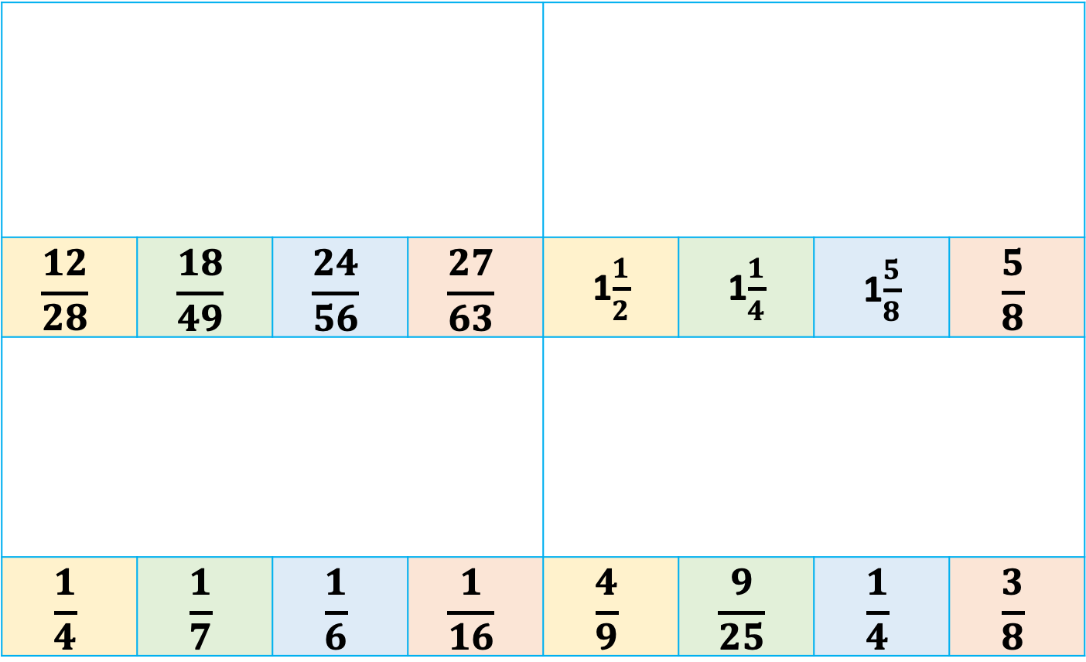




Multiple Choice
$$\frac{12}{28}$$ | $$\frac{18}{49}$$ | $$\frac{24}{56}$$ | $$\frac{27}{63}$$ | 1$\frac{1}{2}$ | 1$\frac{1}{4}$ | 1$\frac{5}{8}$ | $$\frac{5}{8}$$
$$\frac{1}{4}$$ | $$\frac{1}{7}$$ | $$\frac{1}{6}$$ | $$\frac{1}{16}$$ | $$\frac{4}{9}$$ | $$\frac{9}{25}$$ | $$\frac{1}{4}$$ | $$\frac{3}{8}$$
Find the fraction that isn’t equivalent to…
Find the fraction in the middle of 1 and 2$\frac{1}{4}$
$$\frac{3}{7}$$
$$1$$
2$\frac{1}{4}$
Find the fraction shaded
Which fraction is closest to 0.4?
Notes:
1 4 9 16 25 36 49

Slide 6
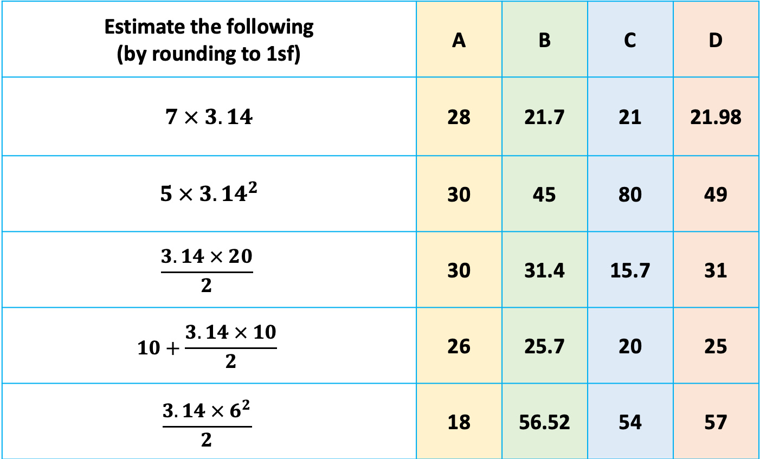
Multiple Choice
Estimate the following (by rounding to 1sf) | A | B | C | D
$$7 × 3.14$$ | 28 | 21.7 | 21 | 21.98
$$5 × {3.14}^{2}$$ | 30 | 45 | 80 | 49
$$\frac{3.14 × 20}{2}$$ | 30 | 31.4 | 15.7 | 31
$$10+\frac{3.14 × 10}{2}$$ | 26 | 25.7 | 20 | 25
$$\frac{3.14 × 6^{2}}{2}$$ | 18 | 56.52 | 54 | 57
Notes:
1 4 9 16 25 36 49

Slide 7
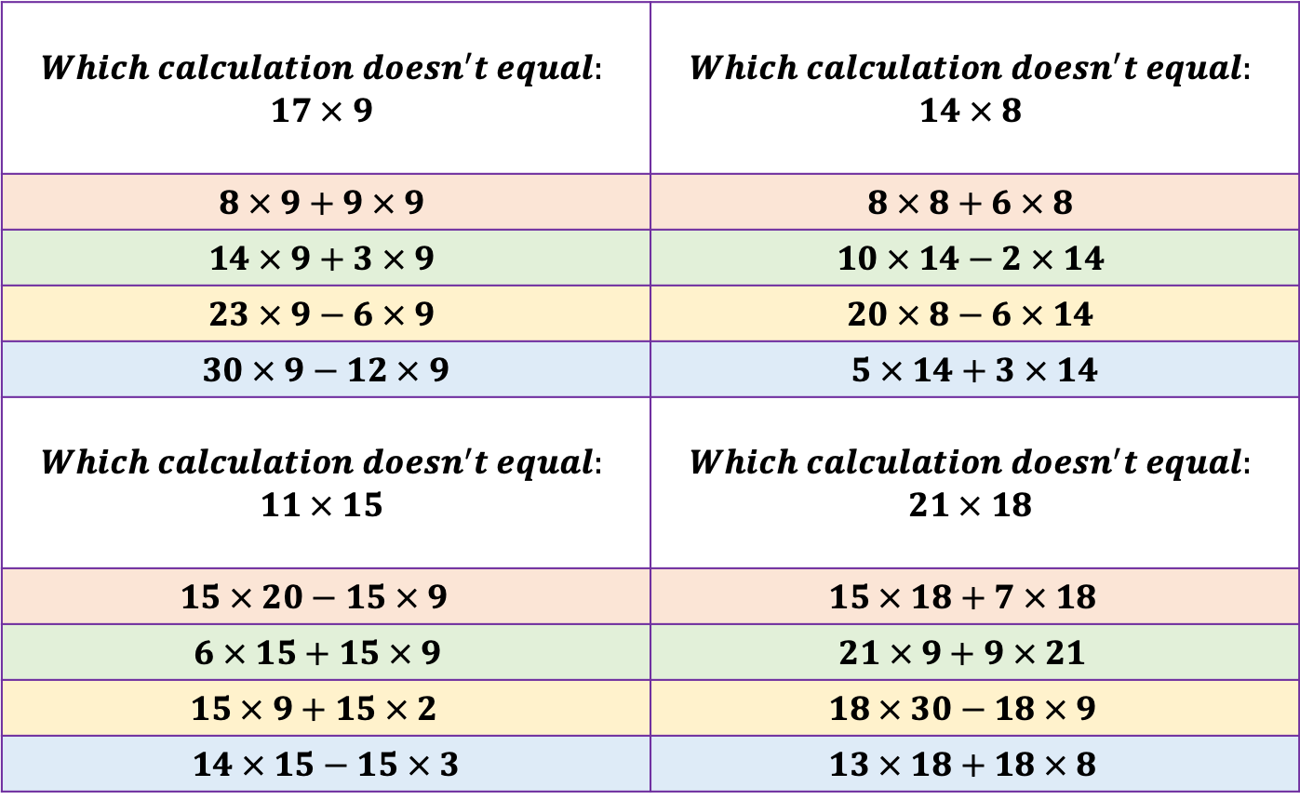
Multiple Choice
$$Which calculation doesn^{′}t equal:$$ $$17 × 9$$ | $$Which calculation doesn^{′}t equal:$$ $$14 × 8$$
$$8 × 9+9 × 9$$ | $$8 × 8+6 × 8$$
$$14 × 9+3 × 9$$ | $$10 × 14−2 × 14$$
$$23 × 9−6 × 9$$ | $$20 × 8−6 × 14$$
$$30 × 9−12 × 9$$ | $$5 × 14+3 × 14$$
$$Which calculation doesn^{′}t equal:$$ $$11 × 15$$ | $$Which calculation doesn^{′}t equal:$$ $$21 × 18$$
$$15 × 20−15 × 9$$ | $$15 × 18+7 × 18$$
$$6 × 15+15 × 9$$ | $$21 × 9+9 × 21$$
$$15 × 9+15 × 2$$ | $$18 × 30−18 × 9$$
$$14 × 15−15 × 3$$ | $$13 × 18+18 × 8$$
Notes:
1 4 9 16 25 36 49

Slide 8
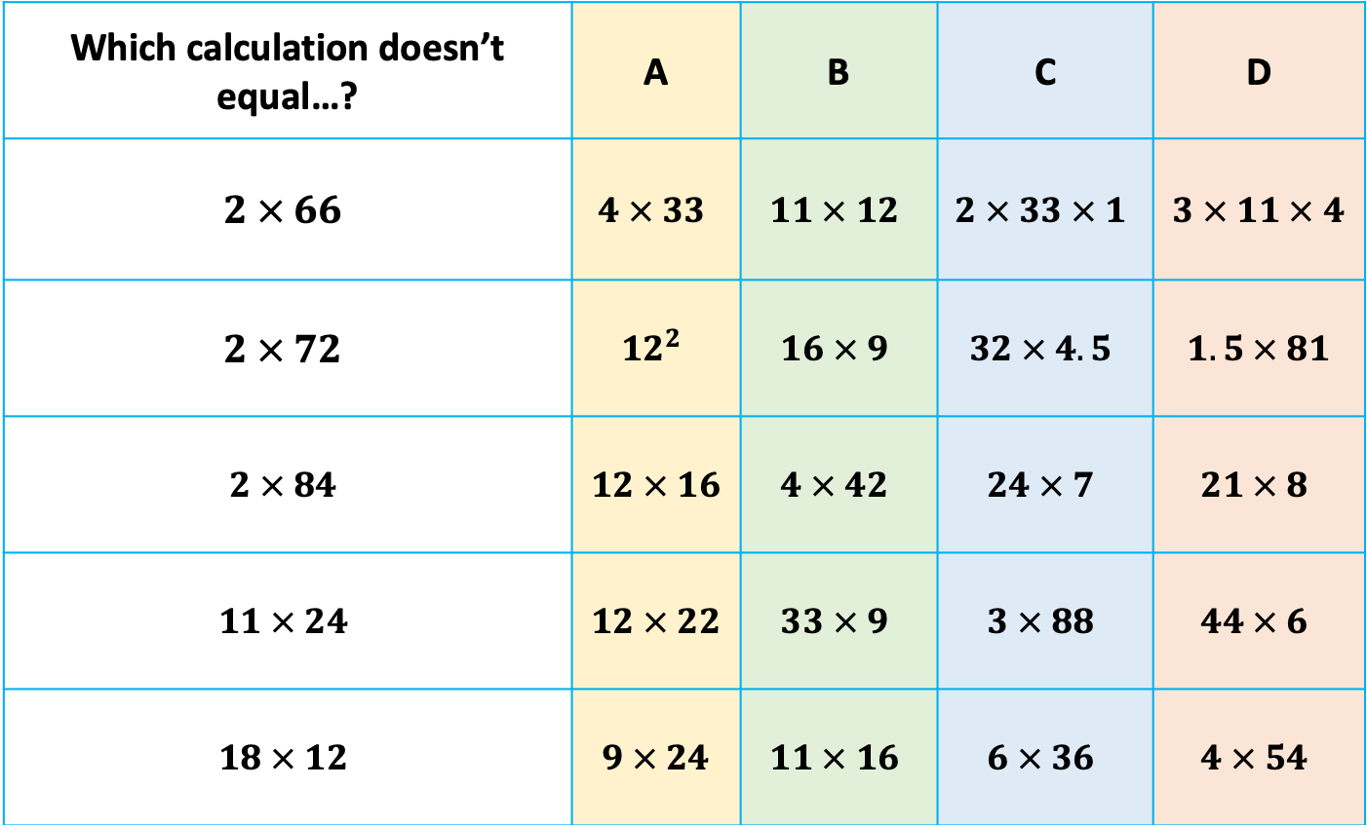
Multiple Choice
Which calculation doesn’t equal…? | A | B | C | D
$$2 × 66$$ | $$4 × 33$$ | $$11 × 12$$ | $$2 × 33 × 1$$ | $$3 × 11 × 4$$
$$2 × 72$$ | $${12}^{2}$$ | $$16 × 9$$ | $$32 × 4.5$$ | $$1.5 × 81$$
$$2 × 84$$ | $$12 × 16$$ | $$4 × 42$$ | $$24 × 7$$ | $$21 × 8$$
$$11 × 24$$ | $$12 × 22$$ | $$33 × 9$$ | $$3 × 88$$ | $$44 × 6$$
$$18 × 12$$ | $$9 × 24$$ | $$11 × 16$$ | $$6 × 36$$ | $$4 × 54$$
Notes:
1 4 9 16 25 36 49

Slide 9
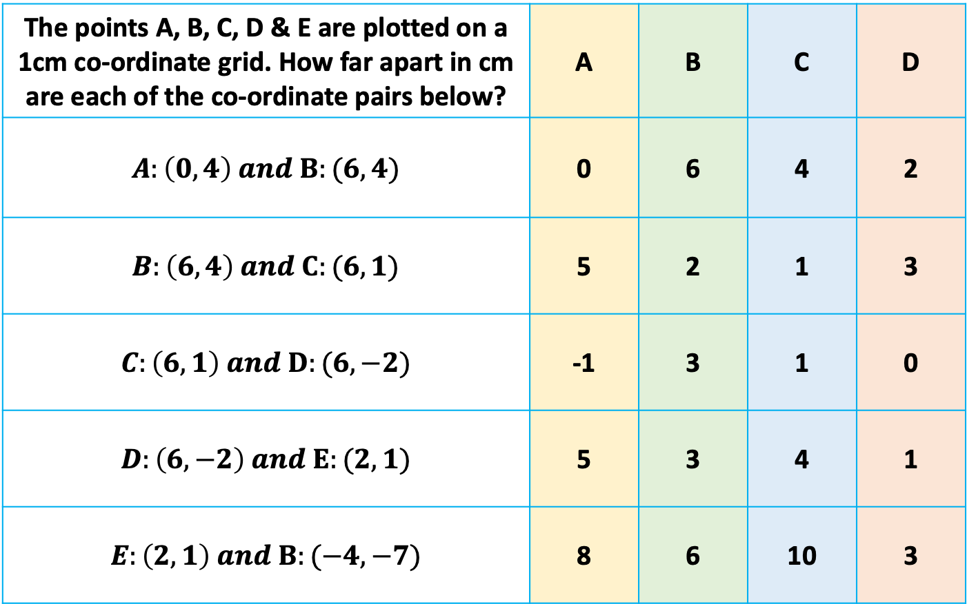
Multiple Choice
The points A, B, C, D & E are plotted on a 1cm co-ordinate grid. How far apart in cm are each of the co-ordinate pairs below? | A | B | C | D
$$A:\left(0, 4\right) and B:(6, 4)$$ | 0 | 6 | 4 | 2
$$B:\left(6, 4\right) and C:(6, 1)$$ | 5 | 2 | 1 | 3
$$C:\left(6, 1\right) and D:(6, −2)$$ | -1 | 3 | 1 | 0
$$D:\left(6, −2\right) and E:(2, 1)$$ | 5 | 3 | 4 | 1
$$E:\left(2, 1\right) and B:(−4, −7)$$ | 8 | 6 | 10 | 3
Notes:
1 4 9 16 25 36 49

Slide 10
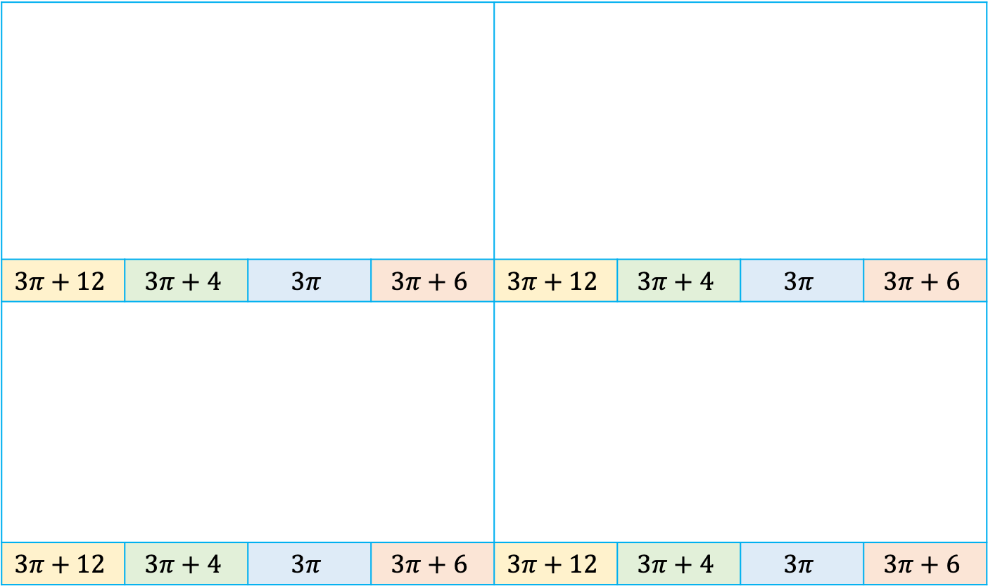




Multiple Choice
$$3π+12$$ | $$3π+4$$ | $$3π$$ | $$3π+6$$ | $$3π+12$$ | $$3π+4$$ | $$3π$$ | $$3π+6$$
$$3π+12$$ | $$3π+4$$ | $$3π$$ | $$3π+6$$ | $$3π+12$$ | $$3π+4$$ | $$3π$$ | $$3π+6$$
Find the Perimeter
Find the Perimeter
$$6cm$$
$$6cm$$
Find the Perimeter
Find the Perimeter
$$2cm$$
$$3cm$$
Notes:
1 4 9 16 25 36 49

Slide 11
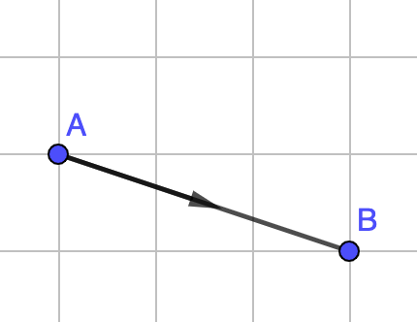
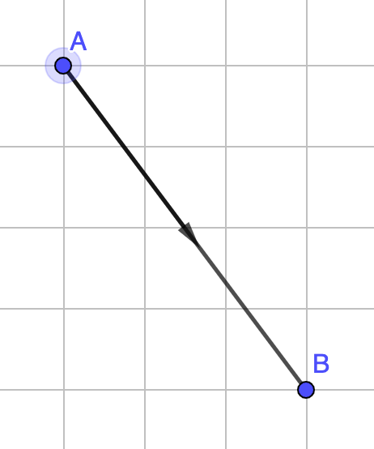
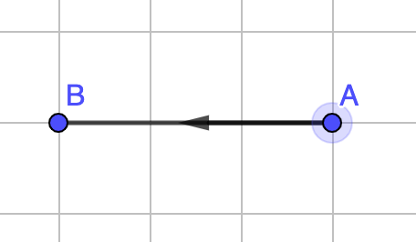
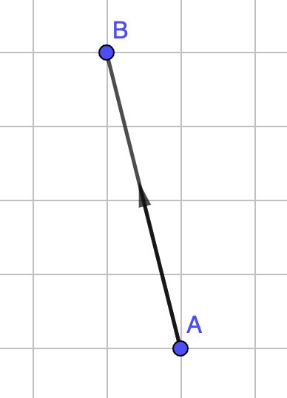
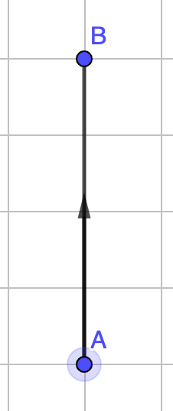
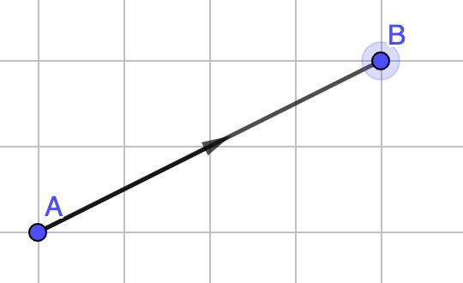
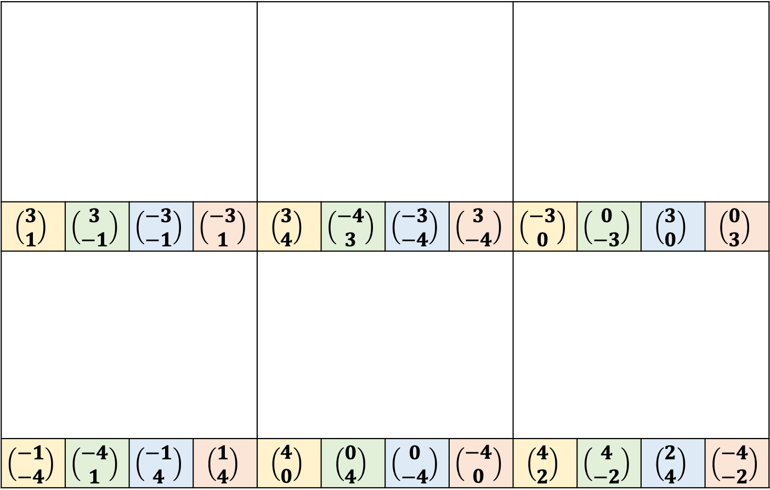

Multiple Choice
Describe the vector $\vec{AB}$
$$\left(\begin{aligned}3 \\ 1\end{aligned}\right)$$ | $$\left(\begin{aligned}3 \\ −1\end{aligned}\right)$$ | $$\left(\begin{aligned}−3 \\ −1\end{aligned}\right)$$ | $$\left(\begin{aligned}−3 \\ 1\end{aligned}\right)$$ | $$\left(\begin{aligned}3 \\ 4\end{aligned}\right)$$ | $$\left(\begin{aligned}−4 \\ 3\end{aligned}\right)$$ | $$\left(\begin{aligned}−3 \\ −4\end{aligned}\right)$$ | $$\left(\begin{aligned}3 \\ −4\end{aligned}\right)$$ | $$\left(\begin{aligned}−3 \\ 0\end{aligned}\right)$$ | $$\left(\begin{aligned}0 \\ −3\end{aligned}\right)$$ | $$\left(\begin{aligned}3 \\ 0\end{aligned}\right)$$ | $$\left(\begin{aligned}0 \\ 3\end{aligned}\right)$$
$$\left(\begin{aligned}−1 \\ −4\end{aligned}\right)$$ | $$\left(\begin{aligned}−4 \\ 1\end{aligned}\right)$$ | $$\left(\begin{aligned}−1 \\ 4\end{aligned}\right)$$ | $$\left(\begin{aligned}1 \\ 4\end{aligned}\right)$$ | $$\left(\begin{aligned}4 \\ 0\end{aligned}\right)$$ | $$\left(\begin{aligned}0 \\ 4\end{aligned}\right)$$ | $$\left(\begin{aligned}0 \\ −4\end{aligned}\right)$$ | $$\left(\begin{aligned}−4 \\ 0\end{aligned}\right)$$ | $$\left(\begin{aligned}4 \\ 2\end{aligned}\right)$$ | $$\left(\begin{aligned}4 \\ −2\end{aligned}\right)$$ | $$\left(\begin{aligned}2 \\ 4\end{aligned}\right)$$ | $$\left(\begin{aligned}−4 \\ −2\end{aligned}\right)$$
Notes:
1 4 9 16 25 36 49

