Slide 1
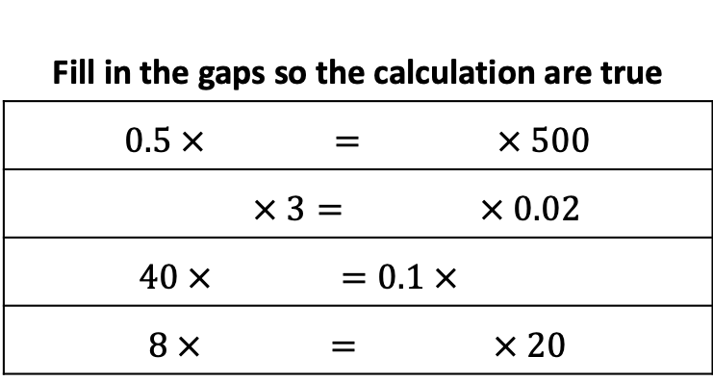
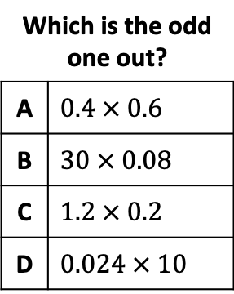
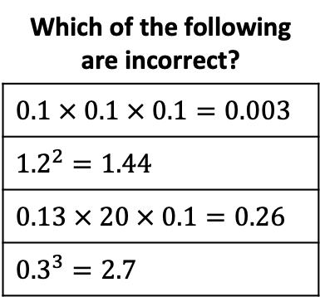
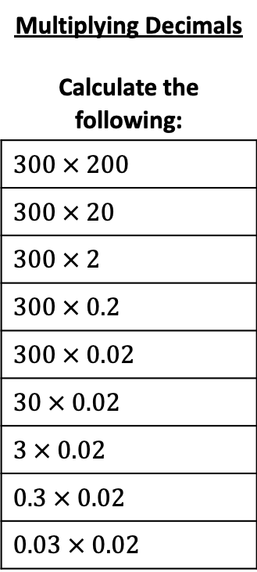
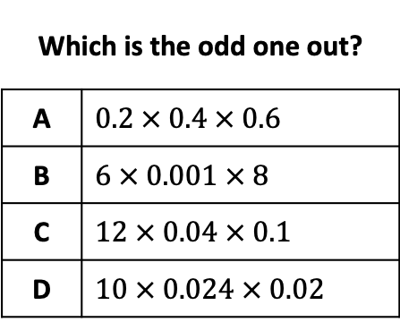
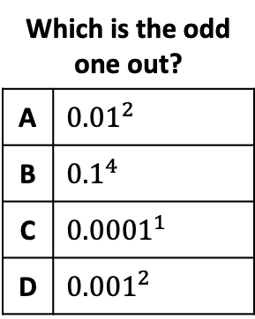
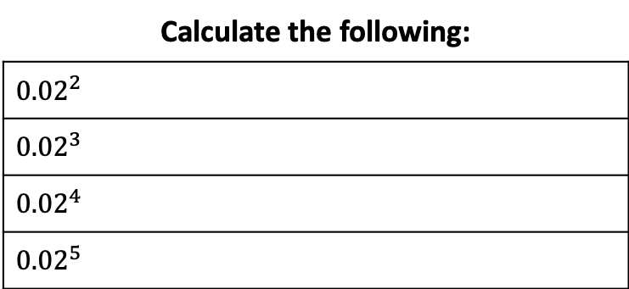
Multiplying Decimals Calculate the following:
$$300 × 200$$
$$300 × 20$$
$$300 × 2$$
$$300 × 0.2$$
$$300 × 0.02$$
$$30 × 0.02$$
$$3 × 0.02$$
$$0.3 × 0.02$$
$$0.03 × 0.02$$
Calculate the following:
$${0.02}^{2}$$
$${0.02}^{3}$$
$${0.02}^{4}$$
$${0.02}^{5}$$
Use the 6 tiles to make 3 equal calculations
0.6
0.04
2
1.8
90
6
Fill in the gaps so the calculation are true
$$0.5 ×{}^{}{}^{}={}^{}{}^{} × 500$$
$${}^{}{}^{}× 3={}^{}{}^{} × 0.02$$
$$40 ×{}^{}{}^{}=0.1 ×{}^{}{}^{}$$
$$8 ×{}^{}{}^{}={}^{}{}^{} × 20$$
Which is the odd one out?
A | $$0.4 × 0.6$$
B | $$30 × 0.08$$
C | $$1.2 × 0.2$$
D | $$0.024 × 10$$
Which is the odd one out?
A | $$0.2 × 0.4 × 0.6$$
B | $6 × 0.001$ $× 8$
C | $12 × 0.04$ $× 0.1$
D | $10 × 0.024$ $× 0.02$
Which of the following are incorrect?
$$0.1 × 0.1 × 0.1=0.003$$
$${1.2}^{2}=1.44$$
$$0.13 × 20 × 0.1=0.26$$
$${0.3}^{3}=2.7$$
Which is the odd one out?
A | $${0.01}^{2}$$
B | $${0.1}^{4}$$
C | $${0.0001}^{1}$$
D | $${0.001}^{2}$$

Slide 2
Multiplying Decimals Calculate the following:
$$300 × 200$$
$$300 × 20$$
$$300 × 2$$
$$300 × 0.2$$
$$300 × 0.02$$
$$30 × 0.02$$
$$3 × 0.02$$
$$0.3 × 0.02$$
$$0.03 × 0.02$$
Calculate the following:
$${0.02}^{2}$$
$${0.02}^{3}$$
$${0.02}^{4}$$
$${0.02}^{5}$$
Use the 6 tiles to make 3 equal calculations
0.6
0.04
2
1.8
90
6
Fill in the gaps so the calculation are true
$$0.5 ×{}^{}{}^{}={}^{}{}^{} × 500$$
$${}^{}{}^{}× 3={}^{}{}^{} × 0.02$$
$$40 ×{}^{}{}^{}=0.1 ×{}^{}{}^{}$$
$$8 ×{}^{}{}^{}={}^{}{}^{} × 20$$
Which is the odd one out?
A | $$0.4 × 0.6$$
B | $$30 × 0.08$$
C | $$1.2 × 0.2$$
D | $$0.024 × 10$$
Which is the odd one out?
A | $$0.2 × 0.4 × 0.6$$
B | $6 × 0.001$ $× 8$
C | $12 × 0.04$ $× 0.1$
D | $10 × 0.024$ $× 0.02$
Which of the following are incorrect?
$$0.1 × 0.1 × 0.1=0.003$$
$${1.2}^{2}=1.44$$
$$0.13 × 20 × 0.1=0.26$$
$${0.3}^{3}=2.7$$
Which is the odd one out?
A | $${0.01}^{2}$$
B | $${0.1}^{4}$$
C | $${0.0001}^{1}$$
D | $${0.001}^{2}$$

