Slide 1
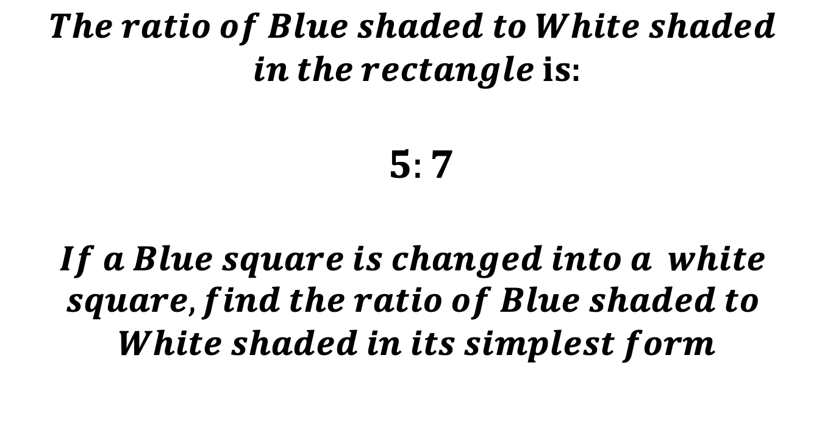
$$The ratio of Blue shaded to White shaded$$
$in the rectangle is$:
$$5:7$$
$$If a Blue square is changed into a white$$
$$square, find the ratio of Blue shaded to$$
$$White shaded in its simplest form$$

Slide 2
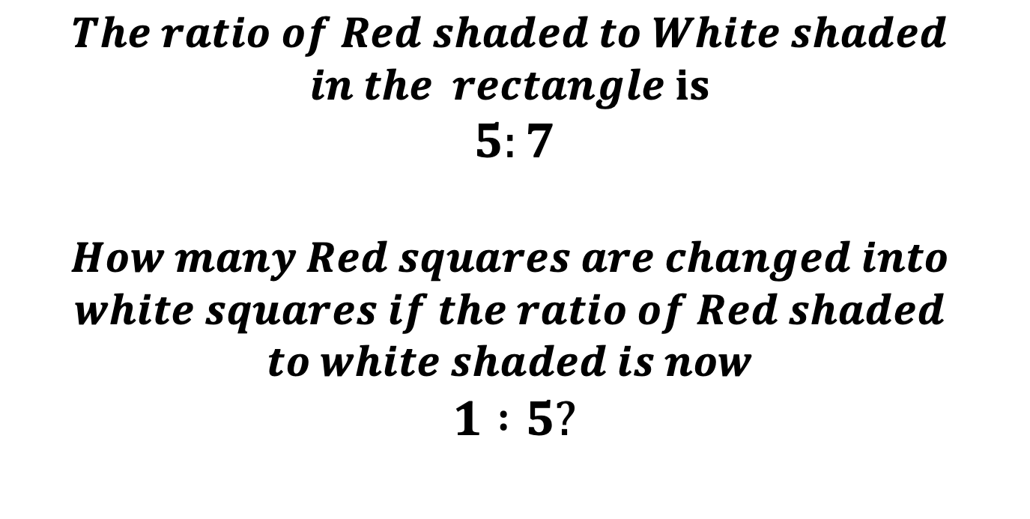
$$The ratio of Red shaded to White shaded$$
$$in the rectangle is$$
$$5:7$$
$$How many Red squares are changed into$$
$$white squares if the ratio of Red shaded$$
$$to white shaded is now$$
$$1 :5?$$

Slide 3
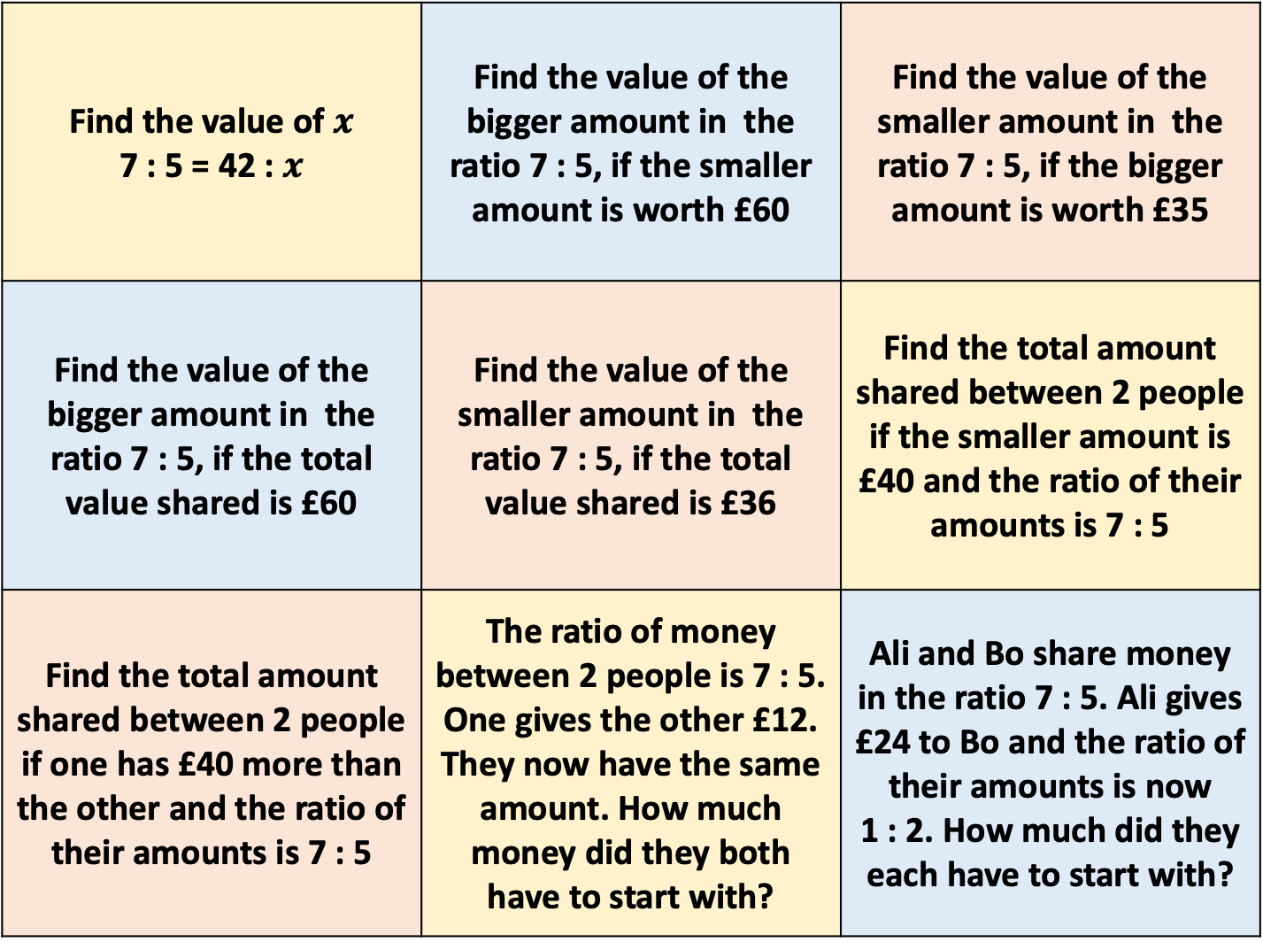
Find the value of $x$ 7 : 5 = 42 : $x$ | Find the value of the bigger amount in the ratio 7 : 5, if the smaller amount is worth £60 | Find the value of the smaller amount in the ratio 7 : 5, if the bigger amount is worth £35
Find the value of the bigger amount in the ratio 7 : 5, if the total value shared is £60 | Find the value of the smaller amount in the ratio 7 : 5, if the total value shared is £36 | Find the total amount shared between 2 people if the smaller amount is £40 and the ratio of their amounts is 7 : 5
Find the total amount shared between 2 people if one has £40 more than the other and the ratio of their amounts is 7 : 5 | The ratio of money between 2 people is 7 : 5. One gives the other £12. They now have the same amount. How much money did they both have to start with? | Ali and Bo share money in the ratio 7 : 5. Ali gives £24 to Bo and the ratio of their amounts is now 1 : 2. How much did they each have to start with?

Slide 4
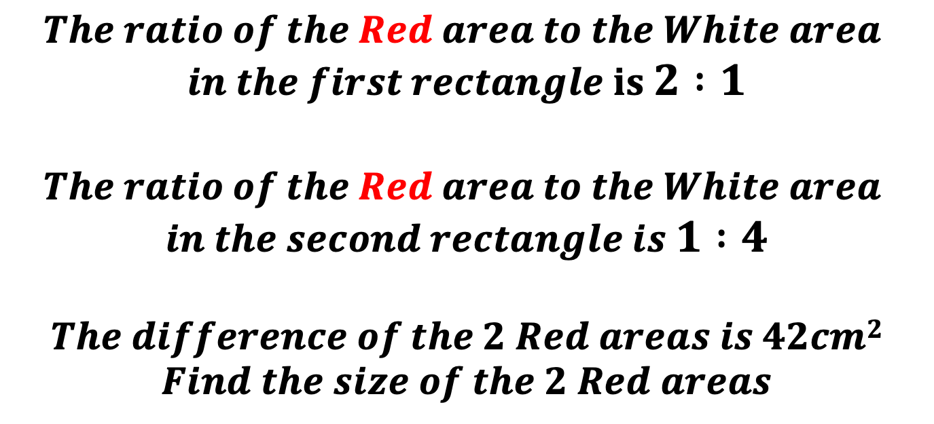
$$The ratio of the Red area to the White area$$
$$in the first rectangle is 2 :1$$
$$The ratio of the Red area to the White area$$
$$in the second rectangle is 1 :4$$
$$The difference of the 2 Red areas is 42cm2$$
$$Find the size of the 2 Red areas$$
Notes:
2:1 = 10:5
1:4 = 3:12
90….
60 and 18

