Slide 1
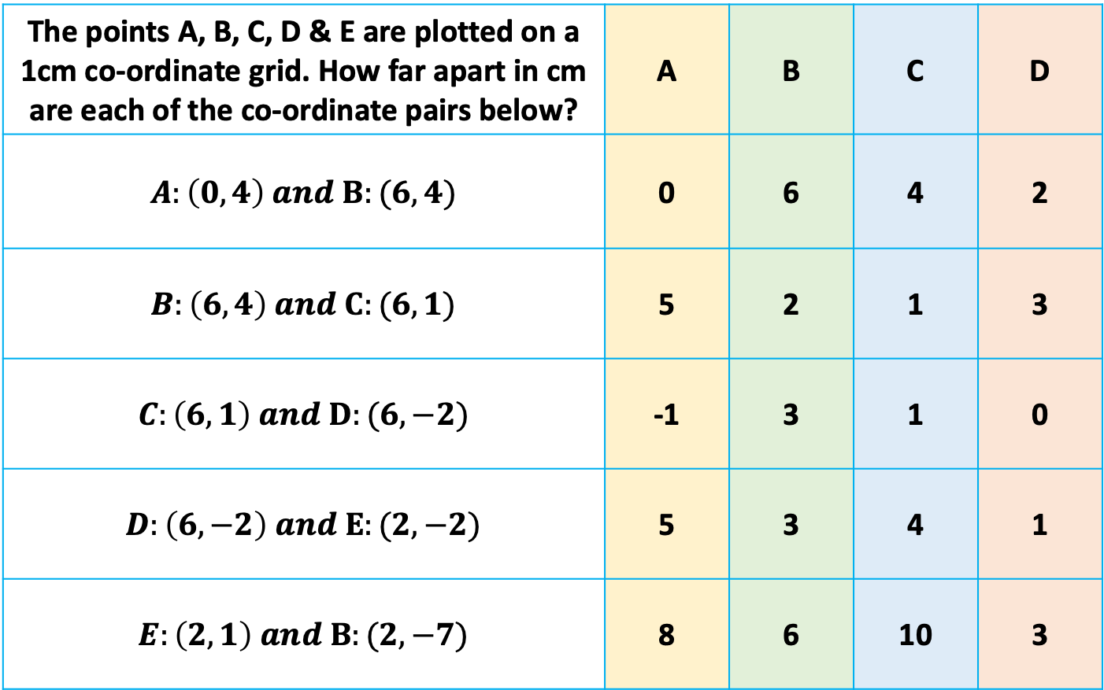
Multiple Choice
The points A, B, C, D & E are plotted on a 1cm co-ordinate grid. How far apart in cm are each of the co-ordinate pairs below? | A | B | C | D
$$A:\left(0, 4\right) and B:(6, 4)$$ | 0 | 6 | 4 | 2
$$B:\left(6, 4\right) and C:(6, 1)$$ | 5 | 2 | 1 | 3
$$C:\left(6, 1\right) and D:(6, −2)$$ | -1 | 3 | 1 | 0
$$D:\left(6, −2\right) and E:(2, −2)$$ | 5 | 3 | 4 | 1
$$E:\left(2, 1\right) and B:(2, −7)$$ | 8 | 6 | 10 | 3
Notes:
1 4 9 16 25 36 49

Slide 2
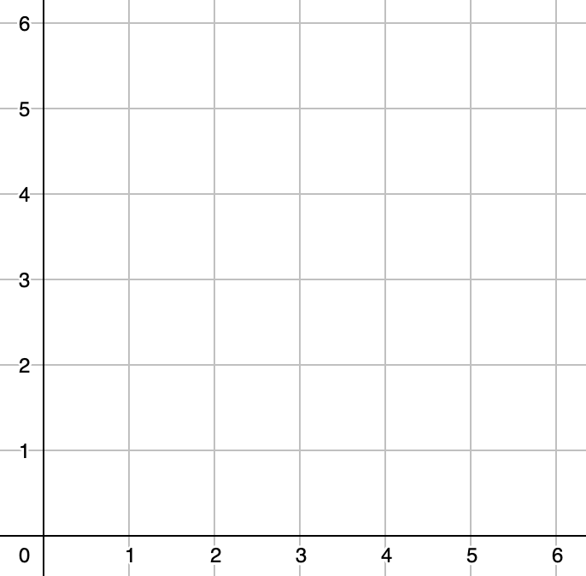
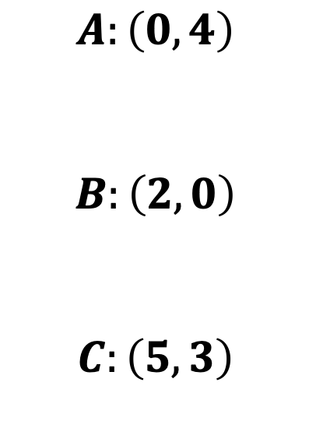
$$Which two of the points:A, B, and C are the closest?$$
$$A:\left(0, 4\right)$$
$$B:\left(2, 0\right)$$
$$C:\left(5, 3\right)$$

Slide 3
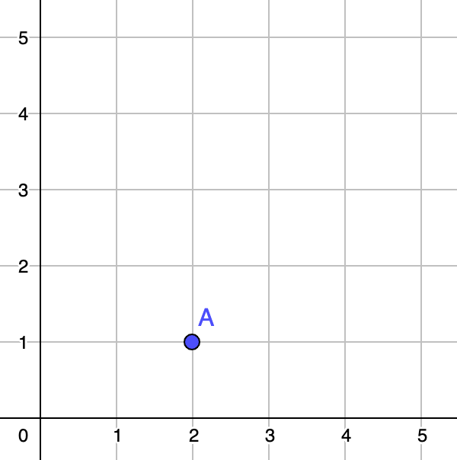
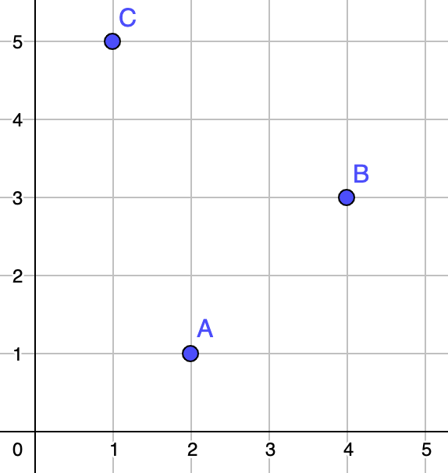
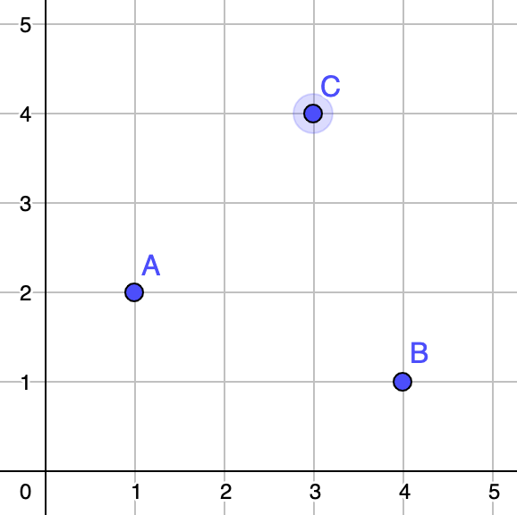
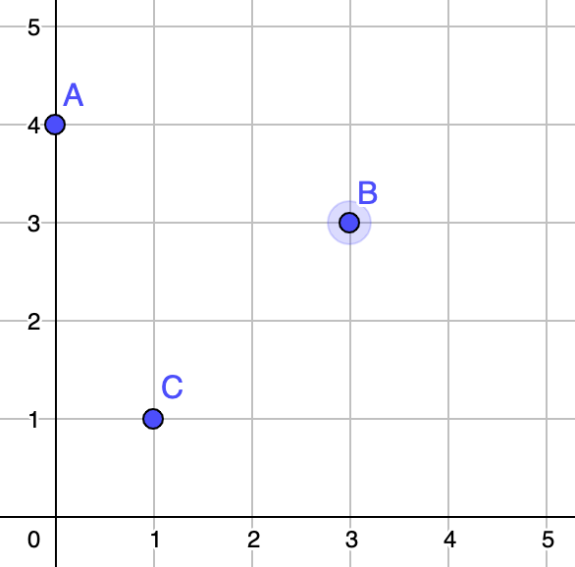
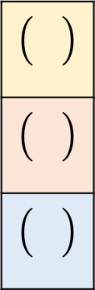
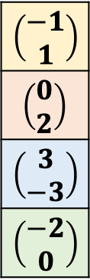
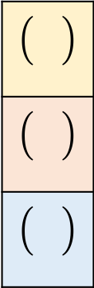
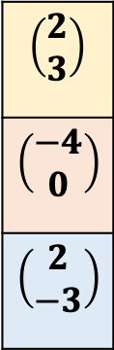
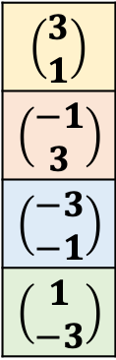
Vectors
$$\left(\begin{aligned}−1 \\ 1\end{aligned}\right)$$
$$\left(\begin{aligned}0 \\ 2\end{aligned}\right)$$
$$\left(\begin{aligned}3 \\ −3\end{aligned}\right)$$
$$\left(\begin{aligned}−2 \\ 0\end{aligned}\right)$$
1.)
$$\left(\begin{aligned}3 \\ 1\end{aligned}\right)$$
$$\left(\begin{aligned}−1 \\ 3\end{aligned}\right)$$
$$\left(\begin{aligned}−3 \\ −1\end{aligned}\right)$$
$$\left(\begin{aligned}1 \\ −3\end{aligned}\right)$$
2.)
1 – 3: Draw in the vectors starting from A
4 – 5: Write in the vectors A→B, B→C, A→C
6 – 8: Write in the vectors
$$\left(\begin{aligned}2 \\ 3\end{aligned}\right)$$
$$\left(\begin{aligned}−4 \\ 0\end{aligned}\right)$$
$$\left(\begin{aligned}2 \\ −3\end{aligned}\right)$$
3.)
4.)
5.)
C
C
B
B
A→B
B→C
A→C
6.)
A→B
B→C
A→C
7.)
A→B
B→C
A→C
8.)

Slide 4
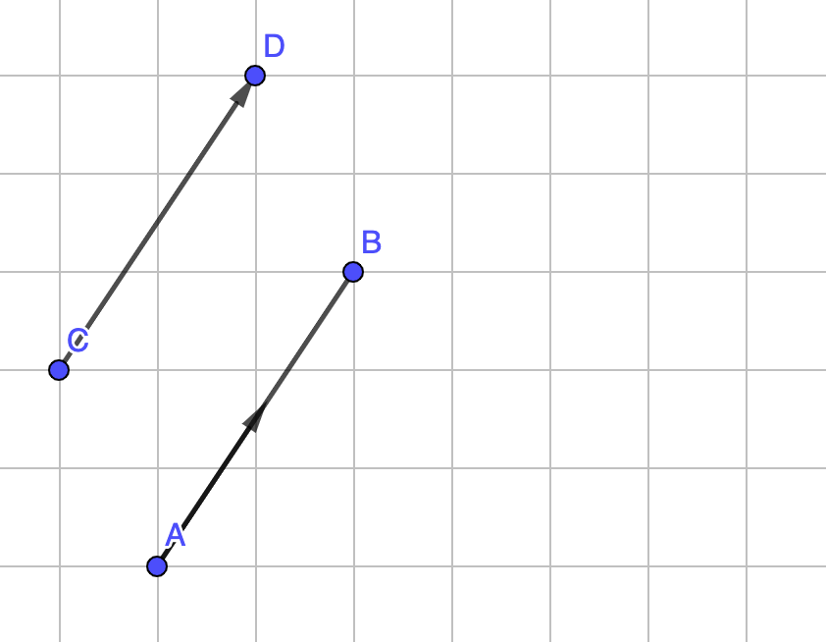
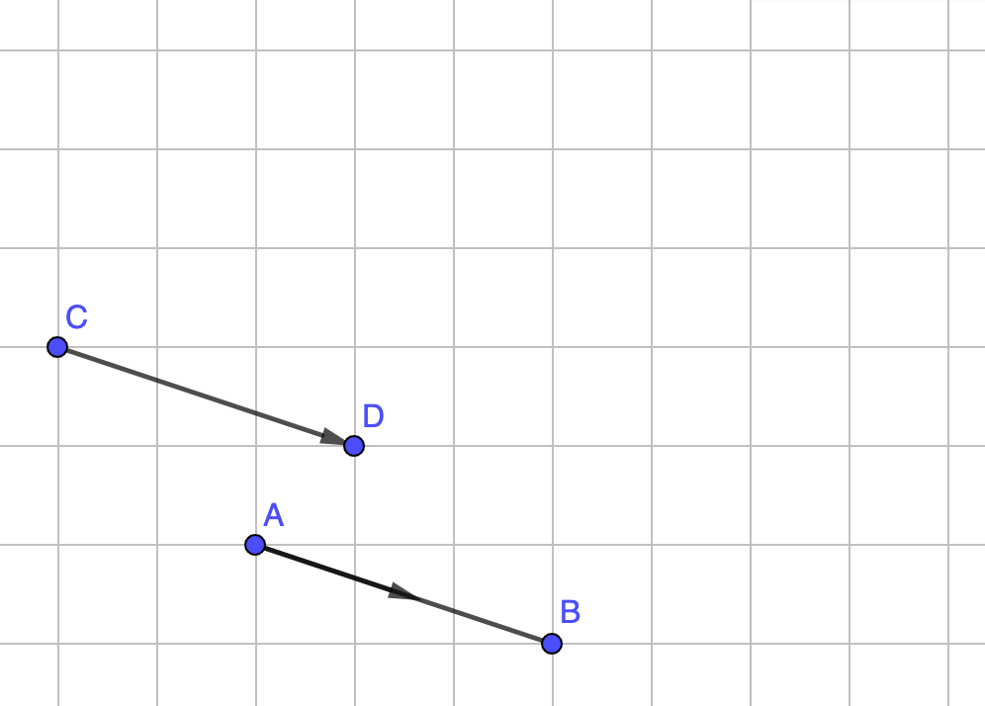
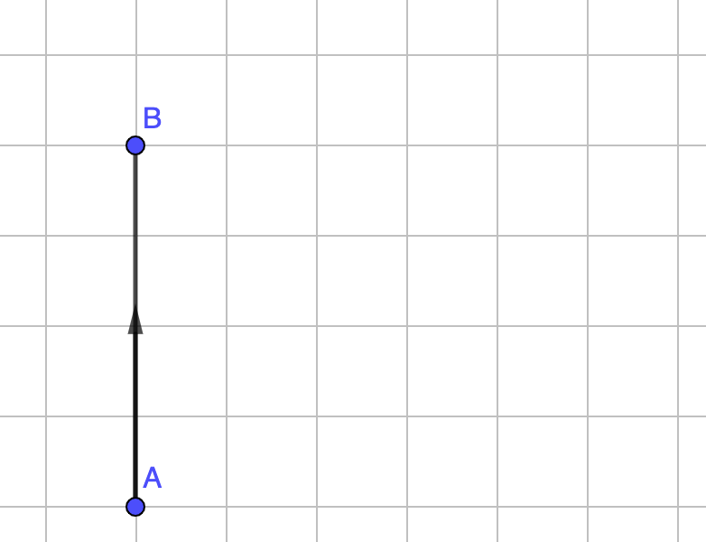
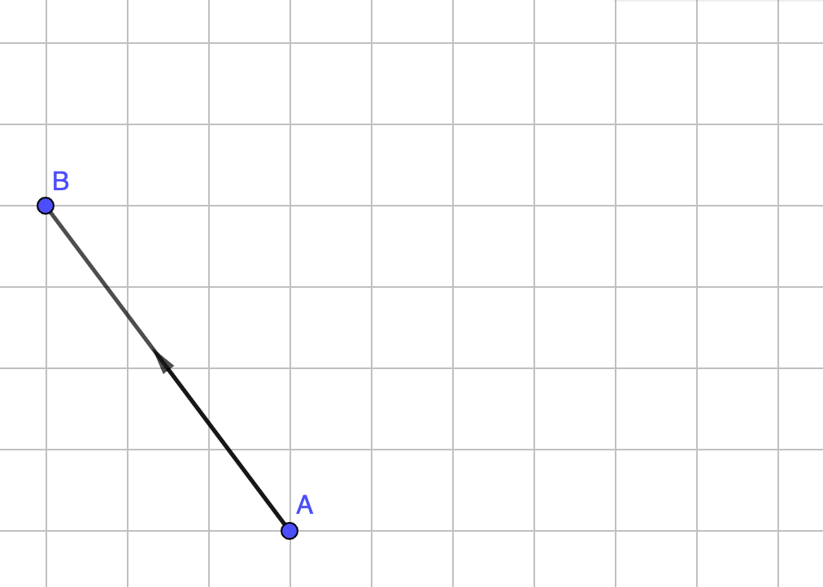
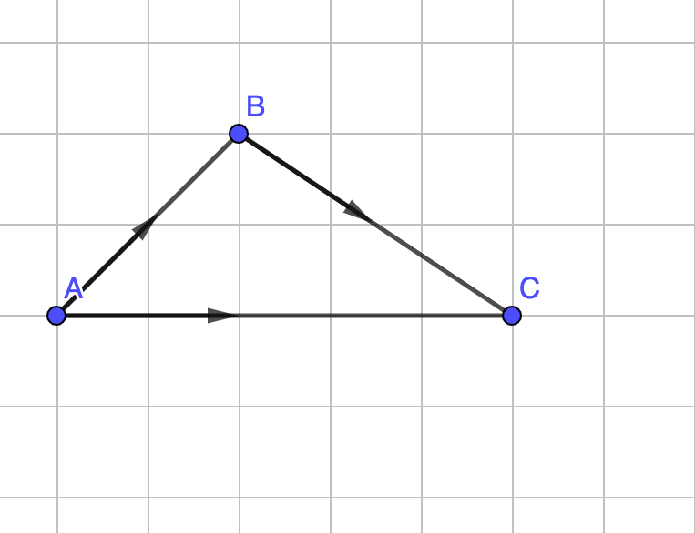
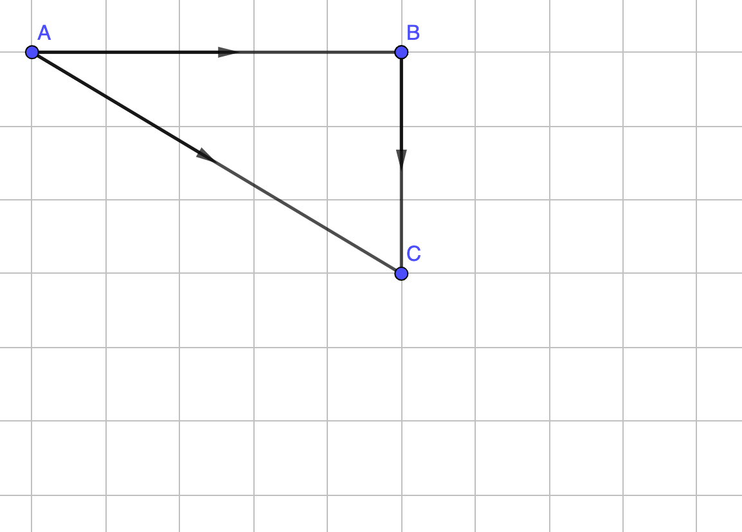
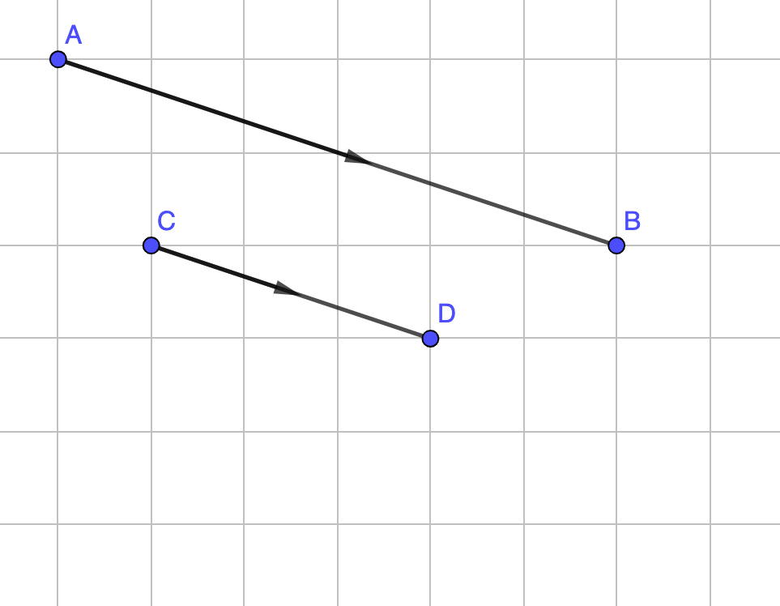
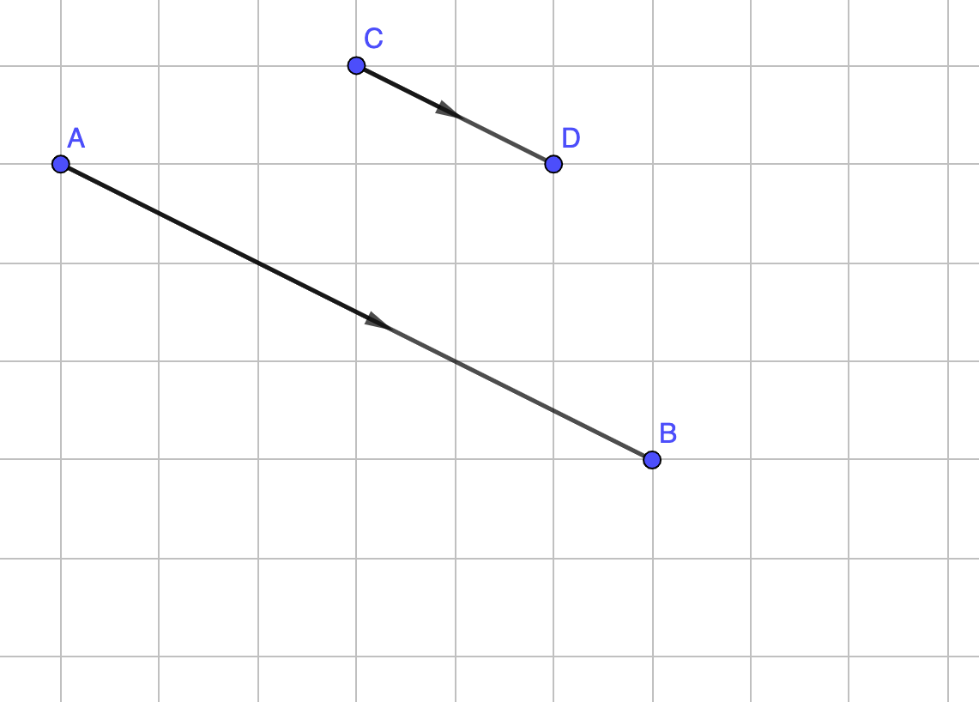
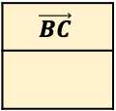
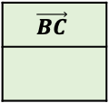
Vectors
For each question, make a note of anything you notice
1.)
$$\vec{AB}$$
$$\vec{CD}$$
2.)
$$\vec{AB}$$
$$\vec{CD}$$
$$\left(\begin{aligned}2 \\ 3\end{aligned}\right)$$
$$\left(\begin{aligned}−4 \\ 0\end{aligned}\right)$$
$$\left(\begin{aligned}2 \\ −3\end{aligned}\right)$$
4.)
3.)
5.)
6.)
$$\vec{AB}$$
$$\vec{BA}$$
$$\vec{AB}$$
$$\vec{BA}$$
A→B
B→C
A→C
$$\vec{AB}$$
$$\vec{BC}$$
$$\vec{AC}$$
+ =
7.)
8.)
6.)
$$\vec{AB}$$
$$\vec{BC}$$
$$\vec{AC}$$
$$\vec{CD}$$
$$\vec{AB}$$
$$\vec{CD}$$
$$\vec{AB}$$
+ =
$×$ =
$×$ =

