Slide 1
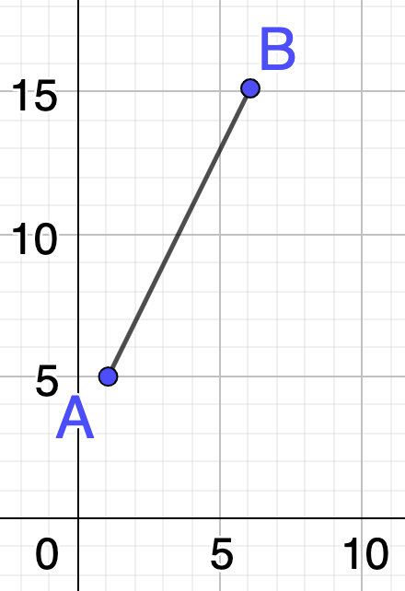
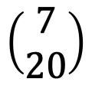
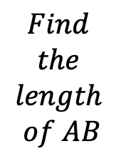
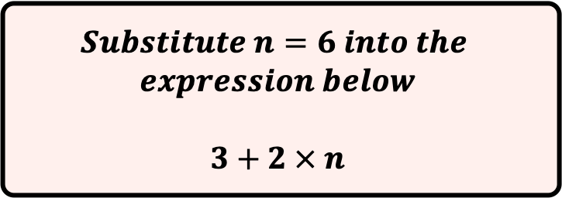
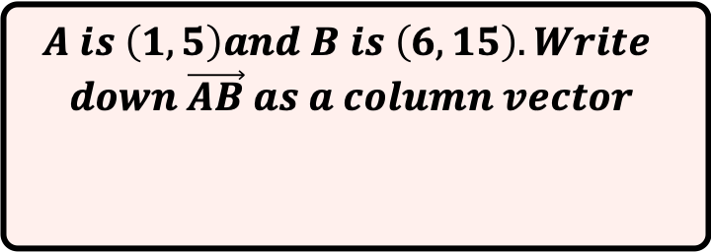
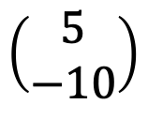
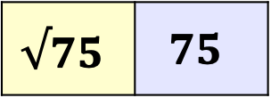
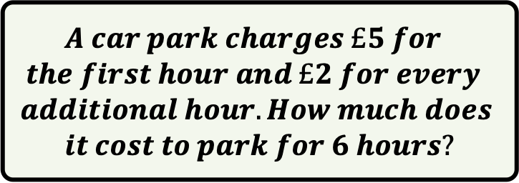
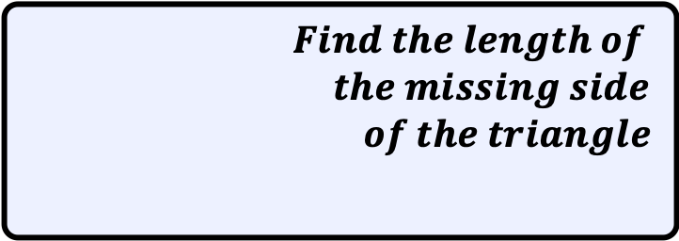

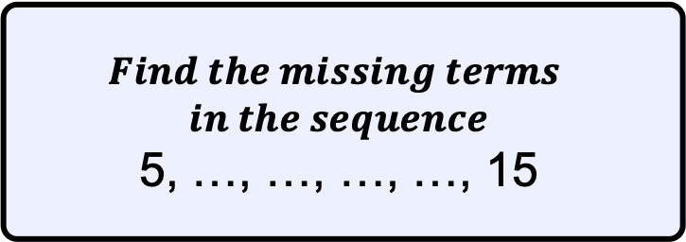
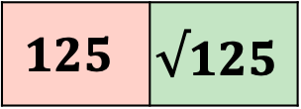
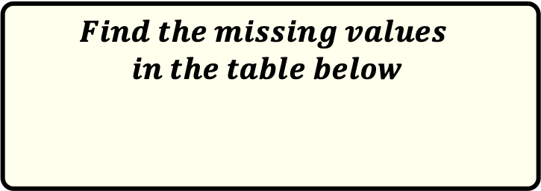
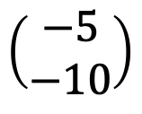
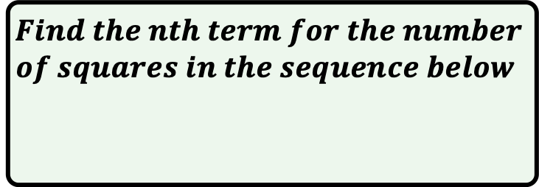
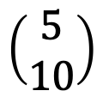
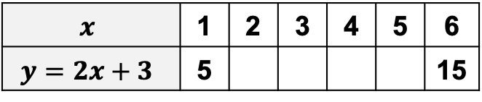
$$A is \left(1, 5\right)and B is \left(6, 15\right). Write$$
$$down \vec{AB} as a column vector$$
$$Find the length of$$
$the missing side$
$$of the triangle$$
$$x$$
10cm
$$\left(\begin{aligned}5 \\ −10\end{aligned}\right)$$
$$\left(\begin{aligned}7 \\ 20\end{aligned}\right)$$
$$\left(\begin{aligned}5 \\ 10\end{aligned}\right)$$
$$\left(\begin{aligned}−5 \\ −10\end{aligned}\right)$$
5cm
$$Find$$
$$the$$
$$length$$
$$of AB$$
$$Find the nth term for the number$$
$$of squares in the sequence below$$
$$125$$ | $$√125$$
$$√75$$ | $$75$$
$$Find the missing terms$$
$$in the sequence$$
5, …, …, …, …, 15
$$Find the missing values$$
$$in the table below$$
$$x$$ | 1 | 2 | 3 | 4 | 5 | 6
$$y=2x+3$$ | 5 |  |  |  |  | 15
$$A car park charges £5 for$$
$$the first hour and £2 for every$$
$$additional hour. How much does$$
$$it cost to park for 6 hours?$$
$$Substitute n=6 into the$$
$$expression below$$
$$3+2 × n$$

