Slide 1
I have 78 cards.
I have 51 cards.
4 friends are playing a game where they need to match 3 cards. If they find a match, they can keep all 3 cards. At the end of the game they counted their cards. Who has miscounted their cards?
I have 64 cards.
I have 42 cards.

Slide 2
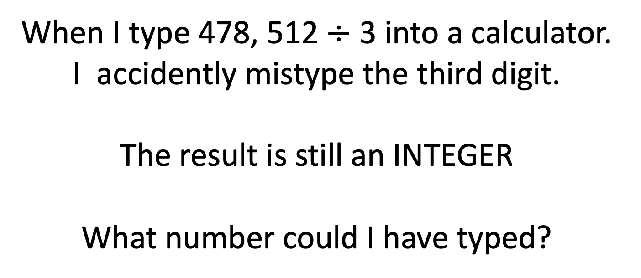
478, 512 is divisible by 3
When I type 478, 512$÷$ 3 into a calculator. I accidently mistype the third digit.
The result is still an INTEGER
What number could I have typed?

Slide 3
8
7
1
4
Can you rearrange the 4 cards above to Make a number that is divisible by 3?
Is it possible to find a number divisible by 3 with just 3 of the cards above?
Notes:
871
874
814
714

