Slide 1
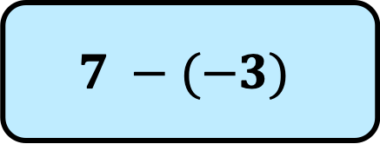
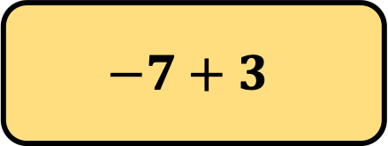
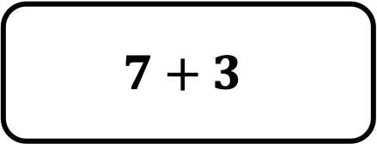
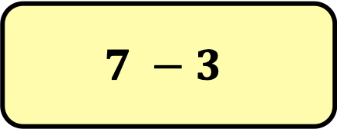
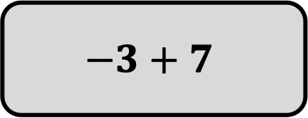
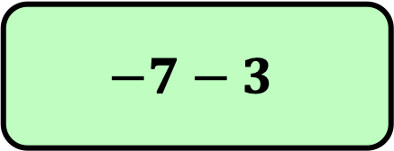
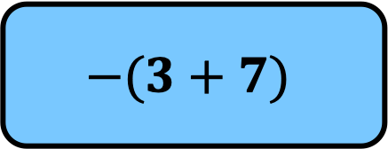
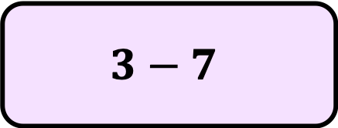
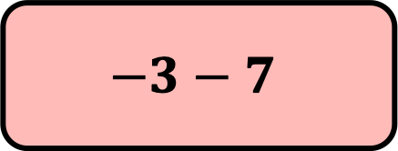
$$7 −3$$
$$7+3$$
$$−3+7$$
$$7 −(−3)$$
$$−7+3$$
$$−3−7$$
$$3−7$$
$$−7−3$$
$$−(3+7)$$
Which of the expressions above are equal in value?
Can you find other expressions that are equal in value?

Slide 2
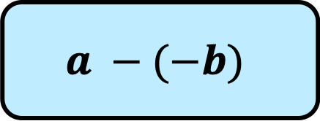




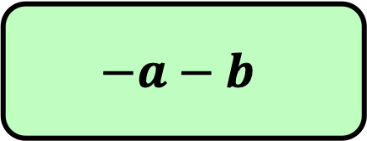
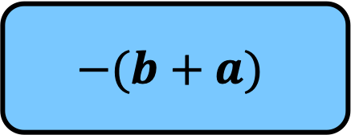

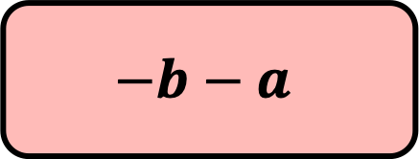
$$a −b$$
$$a+b$$
$$−b+a$$
$$a −(−b)$$
$$−a+b$$
$$−b−a$$
$$b−a$$
$$−a−b$$
$$−(b+a)$$
Which of the expressions above are equal in value?
Can you find other expressions that are equal in value?

