Slide 1
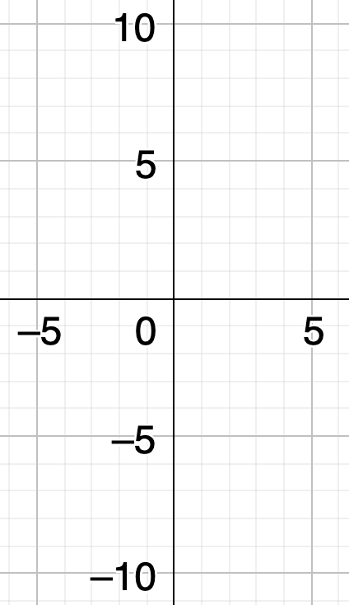
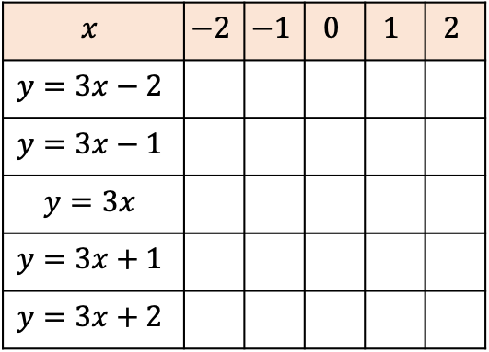
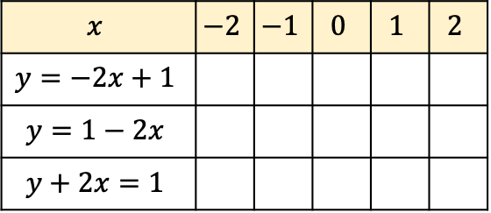
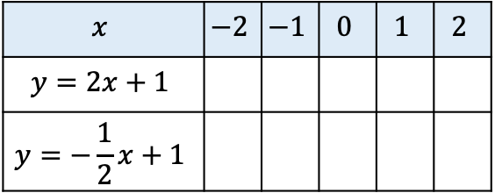
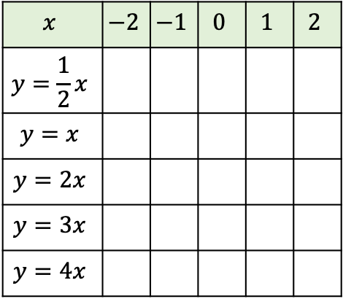
What do you notice?
$$x$$ | $$−2$$ | $$−1$$ | $$0$$ | $$1$$ | $$2$$
$$y=2x+1$$
$$y=−\frac{1}{2}x+1$$
$$x$$ | $$−2$$ | $$−1$$ | $$0$$ | $$1$$ | $$2$$
$$y=3x−2$$
$$y=3x−1$$
$$y=3x$$
$$y=3x+1$$
$$y=3x+2$$
What do you notice?
$$x$$ | $$−2$$ | $$−1$$ | $$0$$ | $$1$$ | $$2$$
$$y=−2x+1$$
$$y=1−2x$$
$$y+2x=1$$
What do you notice?
$$x$$ | $$−2$$ | $$−1$$ | $$0$$ | $$1$$ | $$2$$
$$y=\frac{1}{2}x$$
$$y=x$$
$$y=2x$$
$$y=3x$$
$$y=4x$$
What do you notice?

