Slide 1


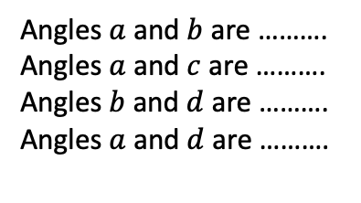

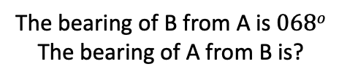


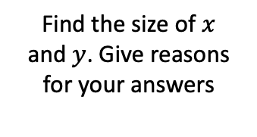






















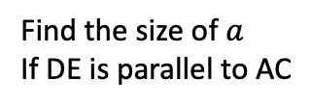




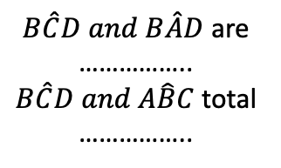







ABCD is a parallelogram.
AB and CD are equal in length and ……………
AD and BC are equal in length and ……………
A
$$a$$
B
$$c$$
$$b$$
$$a$$
$$d$$
$$c$$
$$42o$$
$$85o$$
$$b$$
A
B
D
C
$$b$$
$B\hat{C}D and B\hat{A}D$ are ……………..
$B\hat{C}D and A\hat{B}C$ total ……………..
Angles $a$ and $b$ are ……….
Angles $a$ and $c$ are ……….
Angles $b$ and $d$ are ……….
Angles $a$ and $d$ are ……….
$$c$$
What do you notice about the triangles ABD and BCD?
$$a$$
$$85o$$
D
C
B
B
E
$$c$$
$$a$$
D
Which of the lines are parallel?
$$a$$
D
$$b$$
$$73o$$
C
D
E
$$a$$
B
C
$$123o$$
$$b$$
$$c$$
D
$$82o$$
A
$$71o$$
C
A
$$44o$$
$$48o$$
B
A
C
E
A
$$88o$$
$$78o$$
E
Find the size of $a$
If DE is parallel to AC
H
$$102o$$
Find the missing angle in each of the shapes above
What can you say about triangles ABC and CDE in both?
G
F
Find the missing angles in the regular hexagon below
N
$$y$$
N
$$34o$$
$$x$$
$$47o$$
$$x$$
B
$$b$$
$$y$$
$$56o$$
$$068o$$
$$29o$$
$$a$$
A
Find the size of $x$
and $y$. Give reasons for your answers
The bearing of B from A is $068o$
The bearing of A from B is?
Find the size of the unknown angle

