Slide 1
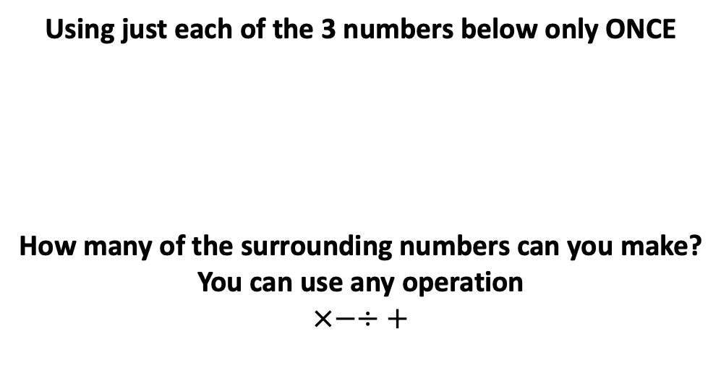
63
– 63
87
175
79
– 71
71
97
37
Using just each of the 3 numbers below only ONCE
How many of the surrounding numbers can you make?
You can use any operation
$$×−÷+$$
– 97
25
4
3
– 13
18
13
– 18
32
24
7
300
25
– 25
103
– 26
26
– 24
112
– 88
88
Notes:
25x4x3
25x4+3
25x3+4
25+3x4
25x4-3
25x3-4
25-4x3
25x(4-3)
25x(4+3)
25+3+4

Slide 2
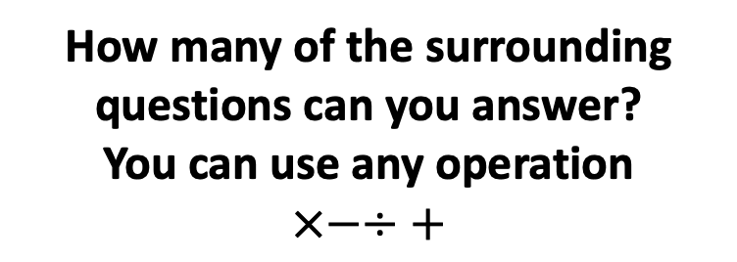
What is the smallest number you can make?
What is the largest number you can make?
What is closest number to 90 you can make?
Using just each of the 3 numbers below ONCE
Can you make a prime number?
50
2
7
Can you make a number that’s a multiple of 3?
How many of the surrounding questions can you answer?
You can use any operation
$$×−÷+$$
Can you make the following numbers?
18
32
Can you make a square number?
What is the largest odd number you can make?
Notes:
25x7=175

Slide 3
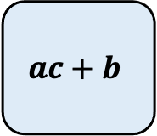
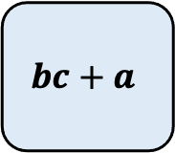
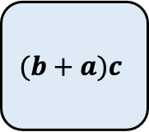
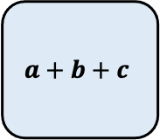
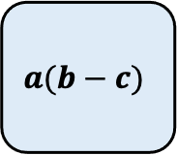
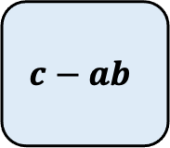
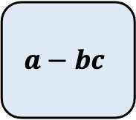
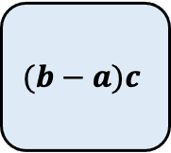
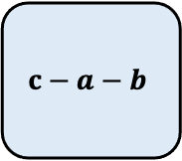
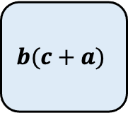
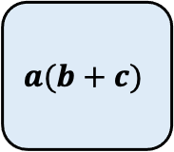
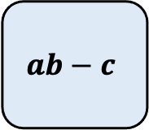
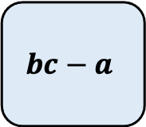
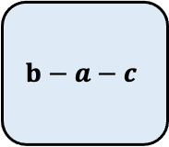
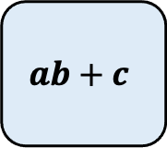
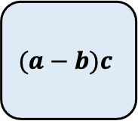
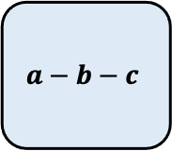
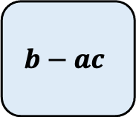
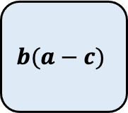
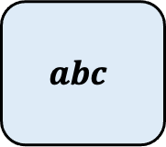
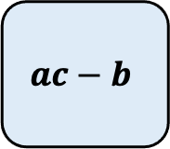
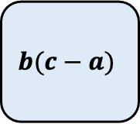
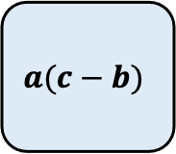
$$abc$$
$$a+b+c$$
$$ab+c$$
$$ab−c$$
$$c−ab$$
$$ac+b$$
$$ac−b$$
$$b(c+a)$$
$$b−ac$$
Using just each of the 3 numbers below only ONCE
How many of the surrounding numbers can you make?
$$b(c−a)$$
a
b
c
$$bc+a$$
$$b(a−c)$$
$$bc−a$$
$$(b−a)c$$
$$c−a−b$$
$$a−bc$$
$$(b+a)c$$
$$(a−b)c$$
$$a(b+c)$$
$$a(b−c)$$
$$a(c−b)$$
$$a−b−c$$
$$b−a−c$$
Notes:
25x4x3
25x4+3
25x3+4
25+3x4
25x4-3
25x3-4
25-4x3
25x(4-3)
25x(4+3)
25+3+4

