Slide 1
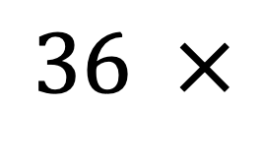
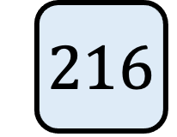
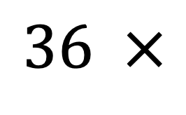
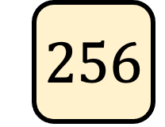
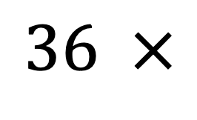
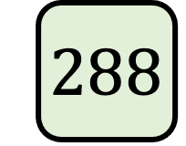
Find as many different values that could fill the box below, so the result of the calculation is a SQUARE number
$$36 ×$$
What do you notice about the values that work?
Which of the following would work?
$$36 ×$$
$$288$$
$$36 ×$$
$$256$$
$$36 ×$$
$$216$$

Slide 2

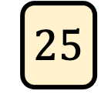

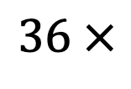
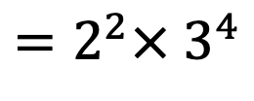
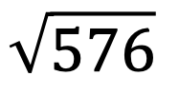
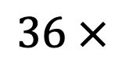
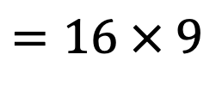
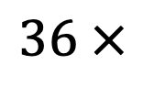
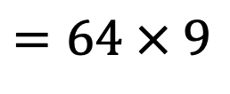
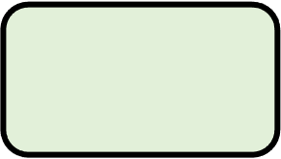
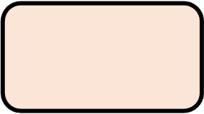
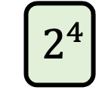
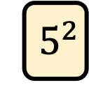

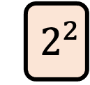
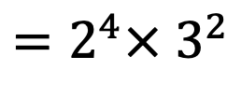
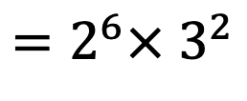
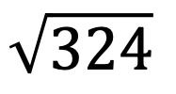
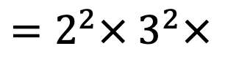
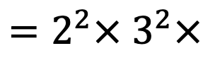



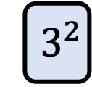
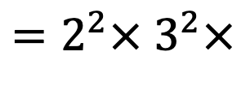

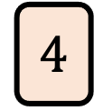
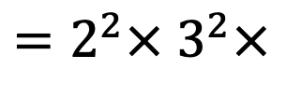
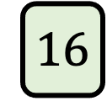
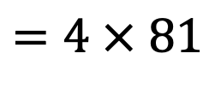
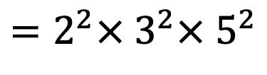


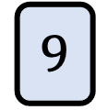
Find as many different values that could fill the box below, so the result of the calculation is a SQUARE number
$$36 ×$$
$$4$$
$${=2}^{2}×{ 3}^{2}×$$
$${ 2}^{2}$$
$$=16 × 9$$
$$=144$$
$${=2}^{4}×{ 3}^{2}$$
$$36 ×$$
$$9$$
$${=2}^{2}×{ 3}^{2}×$$
$${ 3}^{2}$$
$${=2}^{2}×{ 3}^{4}$$
$$=4 × 81$$
$$=324$$
$$36 ×$$
$$16$$
$${=2}^{2}×{ 3}^{2}×$$
$${ 2}^{4}$$
$${=2}^{6}×{ 3}^{2}$$
$$=64 × 9$$
$$=576$$
$$36 ×$$
$$25$$
$${=2}^{2}×{ 3}^{2}×$$
$${ 5}^{2}$$
$${=2}^{2}×{ 3}^{2}×{ 5}^{2}$$
$$=4×9×25$$
$$=900$$
Use the calculations above to evaluate the following:
$$\sqrt{144}$$
$$\sqrt{324}$$
$$\sqrt{576}$$
$$\sqrt{900}$$

