Slide 1
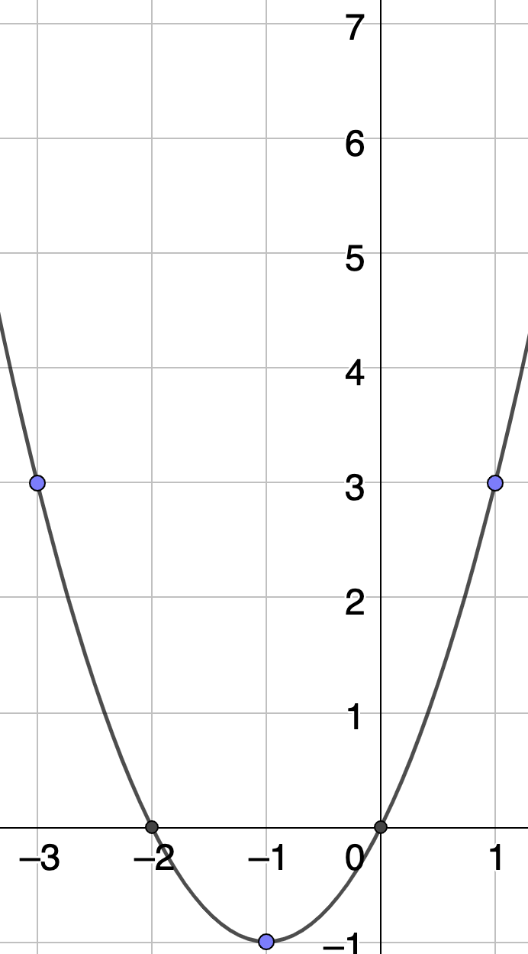
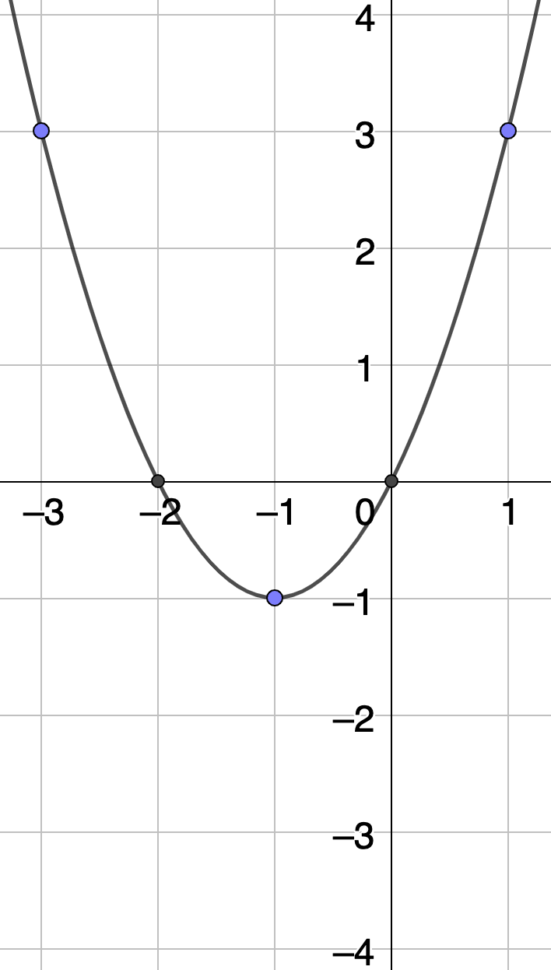
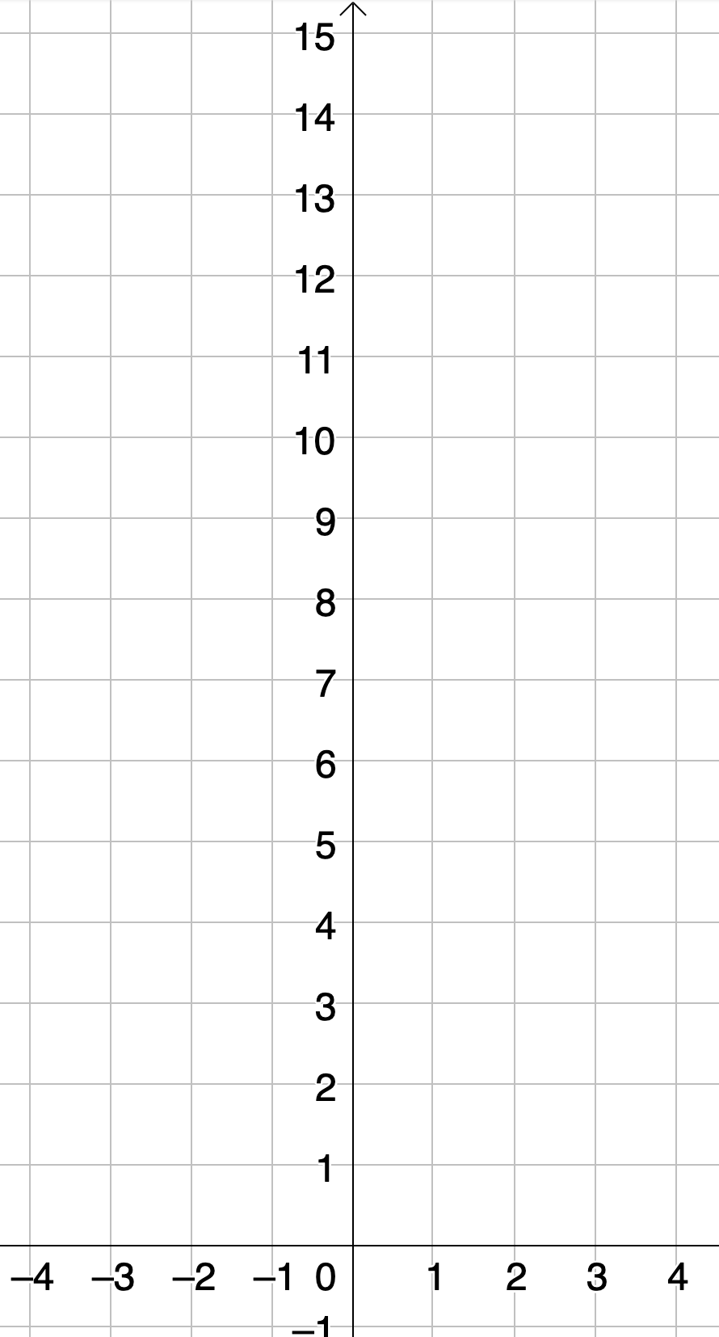
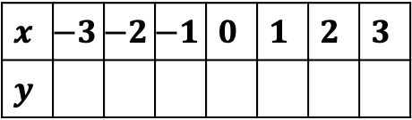

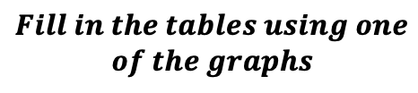
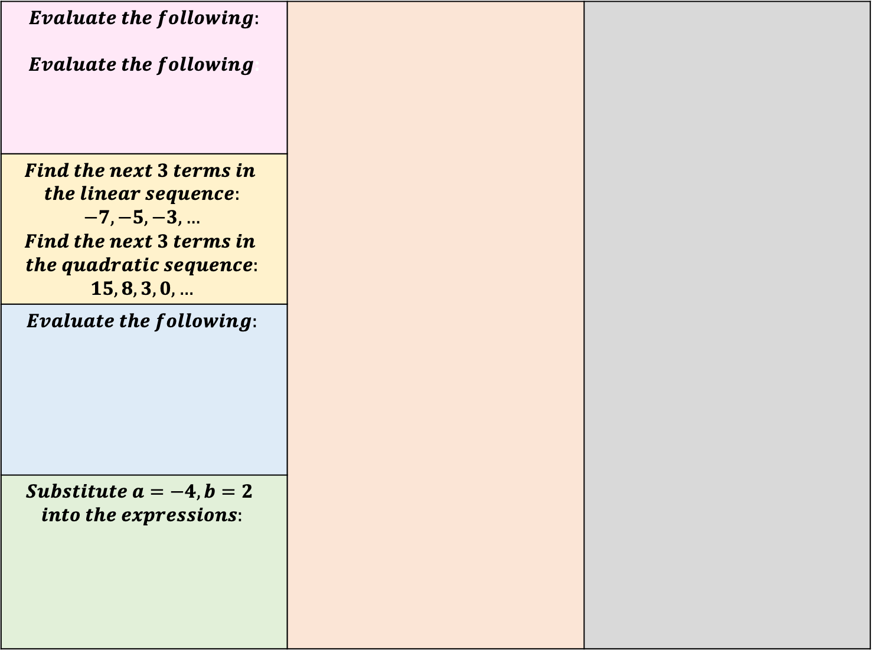

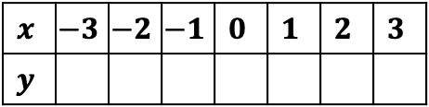

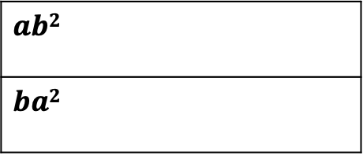
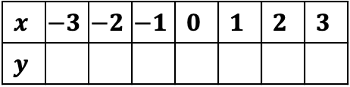
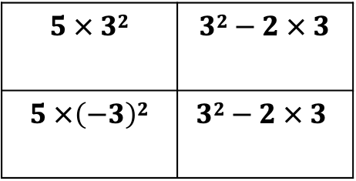


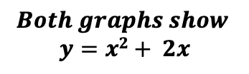
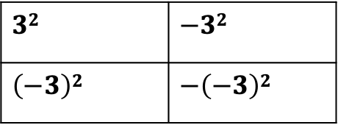
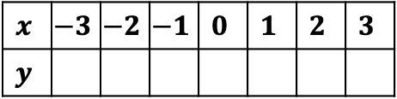
$$Both graphs show$$
$$y=x2+ 2x$$
$$Evaluate the following:$$ $Evaluate the following$:
$$Find the next 3 terms in$$ $$the linear sequence:$$ $$−7, −5, −3,…$$ $$Find the next 3 terms in$$ $$the quadratic sequence:$$ $$15, 8, 3, 0,…$$
$$Evaluate the following:$$
$$Substitute a=−4, b=2$$ $$into the expressions:$$
$$Plot: y=x2−2x$$
$$32$$ | $$−32$$
$$\left(−3\right)2$$ | $$−\left(−3\right)2$$
$$x$$ | $$−3$$ | $$−2$$ | $$−1$$ | $$0$$ | $$1$$ | $$2$$ | $$3$$
$$y$$
$$Fill in the tables using one$$
$$of the graphs$$
$$y=x2+ 2x$$
$$5 × 32$$ | $$32−2 × 3$$
$$5 ×\left(−3\right)2$$ | $$32−2 × 3$$
$$x$$ | $$−3$$ | $$−2$$ | $$−1$$ | $$0$$ | $$1$$ | $$2$$ | $$3$$
$$y$$
$$Fill in the tables and plot$$
$$y=x2+ 2x+4$$
$$x$$ | $$−3$$ | $$−2$$ | $$−1$$ | $$0$$ | $$1$$ | $$2$$ | $$3$$
$$y$$
$$ab2$$
$$ba2$$
$$y=x2+ 2x−3$$
$$x$$ | $$−3$$ | $$−2$$ | $$−1$$ | $$0$$ | $$1$$ | $$2$$ | $$3$$
$$y$$
Notes:
-7, -5, -3, -1, 1, 2

