Slide 1
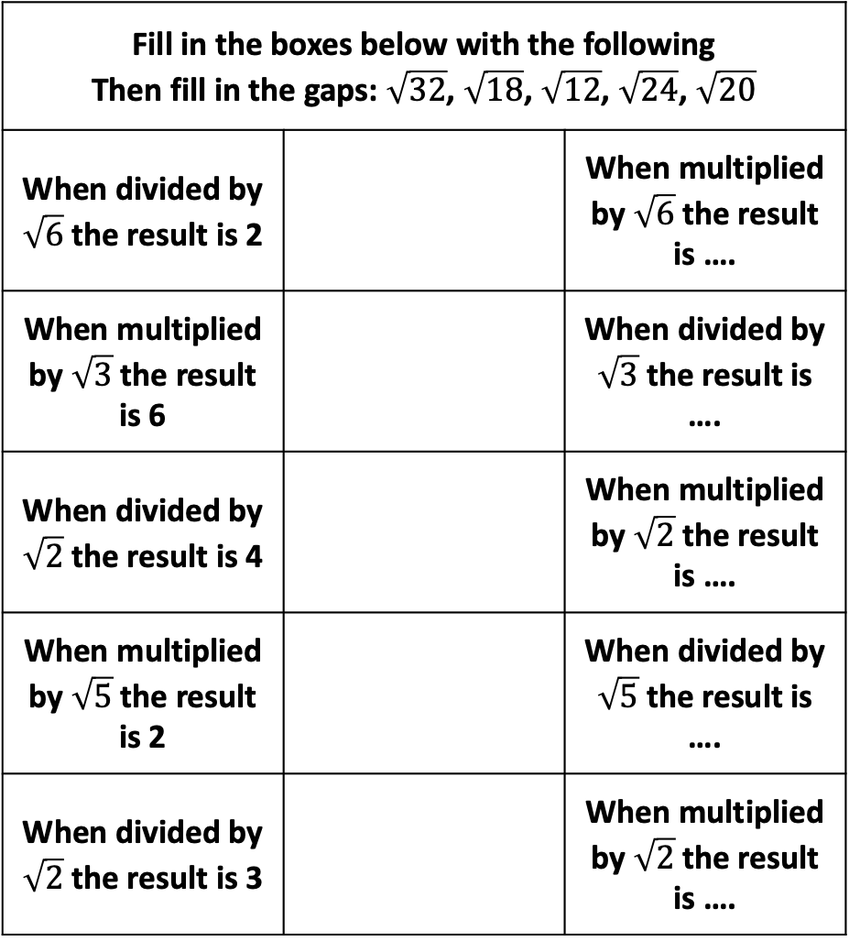





Fill in the boxes below with the following Then fill in the gaps: $\sqrt{32}$, $\sqrt{18}$, $\sqrt{12}$, $\sqrt{24}$, $\sqrt{20}$
When divided by $\sqrt{6}$the result is 2 |  | When multiplied by $\sqrt{6}$the result is ….
When multiplied by $\sqrt{3}$the result is 6 |  | When divided by $\sqrt{3}$the result is ….
When divided by $\sqrt{2}$the result is 4 |  | When multiplied by $\sqrt{2}$the result is ….
When multiplied by $\sqrt{5}$the result is 2 |  | When divided by $\sqrt{5}$the result is ….
When divided by $\sqrt{2}$the result is 3 |  | When multiplied by $\sqrt{2}$the result is ….
$$\sqrt{80}< ? <\sqrt{82}$$
$$\sqrt{34}< \sqrt{?} <6$$
$$10< \sqrt{?} <\sqrt{107}$$
$$7< \sqrt{?} <8$$
$$\sqrt{?} < 3 < \sqrt{?}$$
Notes:
/24
/12
/32
/20
/18

Slide 2
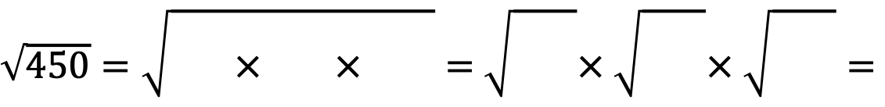

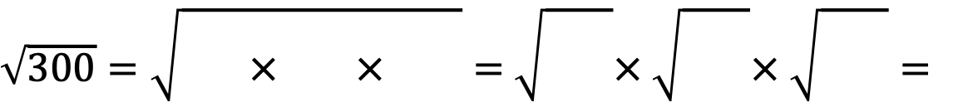
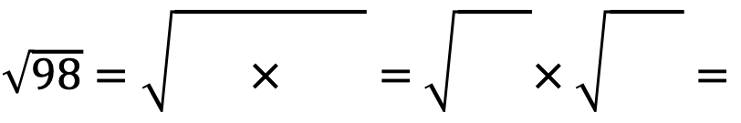
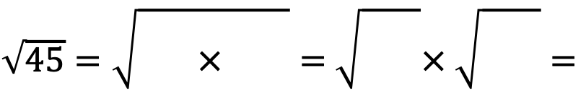
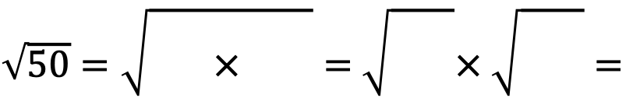
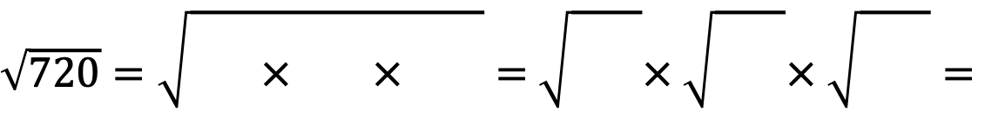
Express the following as a product of their prime factors: 50, 45, 98, 300, 240, 450
$\sqrt{24}=\sqrt{2^{3} × 3}=$ $\sqrt{2^{2}}×\sqrt{2×3}=2\sqrt{6}$
$\sqrt{50}=\sqrt{{}^{}× {}^{}}=$ $\sqrt{{}^{}}× \sqrt{{}^{}}=$
$\sqrt{45}=\sqrt{{}^{}× {}^{}}=$ $\sqrt{{}^{}}× \sqrt{{}^{}}=$
$\sqrt{98}=\sqrt{{}^{}× {}^{}}=$ $\sqrt{{}^{}}× \sqrt{{}^{}}=$
$\sqrt{300}=\sqrt{{}^{}× {}^{}× {}^{}}=$ $\sqrt{{}^{}}× \sqrt{{}^{}}× \sqrt{{}^{}}=$
$\sqrt{450}=\sqrt{{}^{}× {}^{}× {}^{}}=$ $\sqrt{{}^{}}× \sqrt{{}^{}}× \sqrt{{}^{}}=$
$\sqrt{720}=\sqrt{{}^{}× {}^{}× {}^{}}=$ $\sqrt{{}^{}}× \sqrt{{}^{}}× \sqrt{{}^{}}=$

Slide 3



Express the following as a product of their prime factors: 50, 45, 98, 300, 240, 450
$\sqrt{24}=\sqrt{2^{3} × 3}=$ $\sqrt{2^{2}}×\sqrt{2×3}=2\sqrt{6}$
$\sqrt{50}=\sqrt{5^{2}× 2}=$ $\sqrt{5^{2}}× \sqrt{2}=5\sqrt{2}$
$\sqrt{45}=\sqrt{3^{2}× 5}=$ $\sqrt{3^{2}}× \sqrt{5}=3\sqrt{5}$
$\sqrt{98}=\sqrt{7^{2}× 2}=$ $\sqrt{7^{2}}× \sqrt{2}=7\sqrt{2}$
$\sqrt{300}=\sqrt{2^{2}× 5^{2}× 3}=$ $\sqrt{2^{2}}× \sqrt{5^{2}}× \sqrt{3}=2×5\sqrt{3}=10\sqrt{3}$
$\sqrt{450}=\sqrt{5^{2}× 3^{2}× 2}=$ $\sqrt{5^{2}}× \sqrt{3^{2}}× \sqrt{2}=5×3\sqrt{2}=15\sqrt{2}$
$\sqrt{720}=\sqrt{2^{4}× 3^{2}× 5}=$ $\sqrt{2^{4}}× \sqrt{3^{2}}× \sqrt{5}=2^{2}×3\sqrt{5}=$ $12\sqrt{5}$

Slide 4



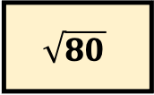

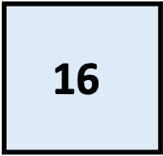



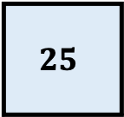

Find the lengths of each of the squares below
The blue shapes are squares. Find the missing areas and length.
?
4
$$\sqrt{125}$$
?
$$\sqrt{72}$$
?
81
9
$$25$$
$$\text{?}$$
80
?
5
$$\sqrt{28}$$
4
$$\sqrt{72}$$
?
7
?
$$\text{?}$$
70
?
9
$$\sqrt{80}$$
?
$$\sqrt{72}$$
?
64
11
$$\text{16}$$
$$\text{?}$$
17
Notes:
/4 x /18
/9 x /8
/36 x /2

Slide 5

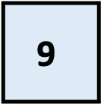
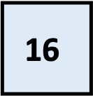
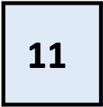




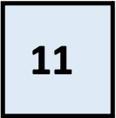






Each of the shapes below have been split into 4 shapes: 2 blue squares and 2 rectangles
Find the TOTAL area of the shapes below and the missing length
$$\text{?}$$
9
$$\text{?}$$
5
$$\text{?}$$
5
$$\text{16}$$
?
$$\text{11}$$
?
$$\text{9}$$
?
Find the missing areas below
$$\text{?}$$
5
$$\text{?}$$
3
$$\text{?}$$
?
$$\text{?}$$
?
$$\text{?}$$
?
$$\text{11}$$
?
$$\text{10}$$
$$\text{7}$$
$$\text{4}$$
Notes:
(10 - /5)(10– /5)
105 – 20/5
/5((10 - /5) = 10/5 – 5
95 – 20/5 + 10 = 105 – 20/5

