Slide 1
Surds

Slide 2
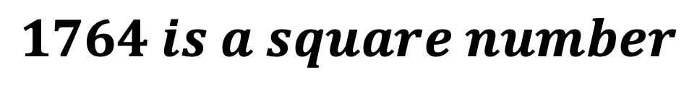


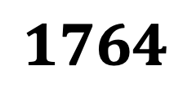


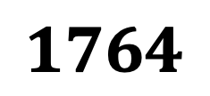

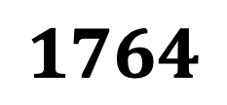



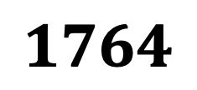
Using 6 different SQUARE numbers. Fill in the 6 boxes to make calculation correct
Using only square number. Fill in the 3 boxes to make the product 1764
Notes:
2x2x3x3x7x7
36 x 49
4 x 441
196 x 9

Slide 3
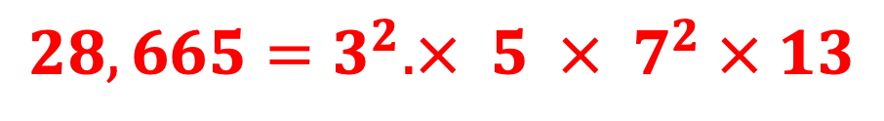
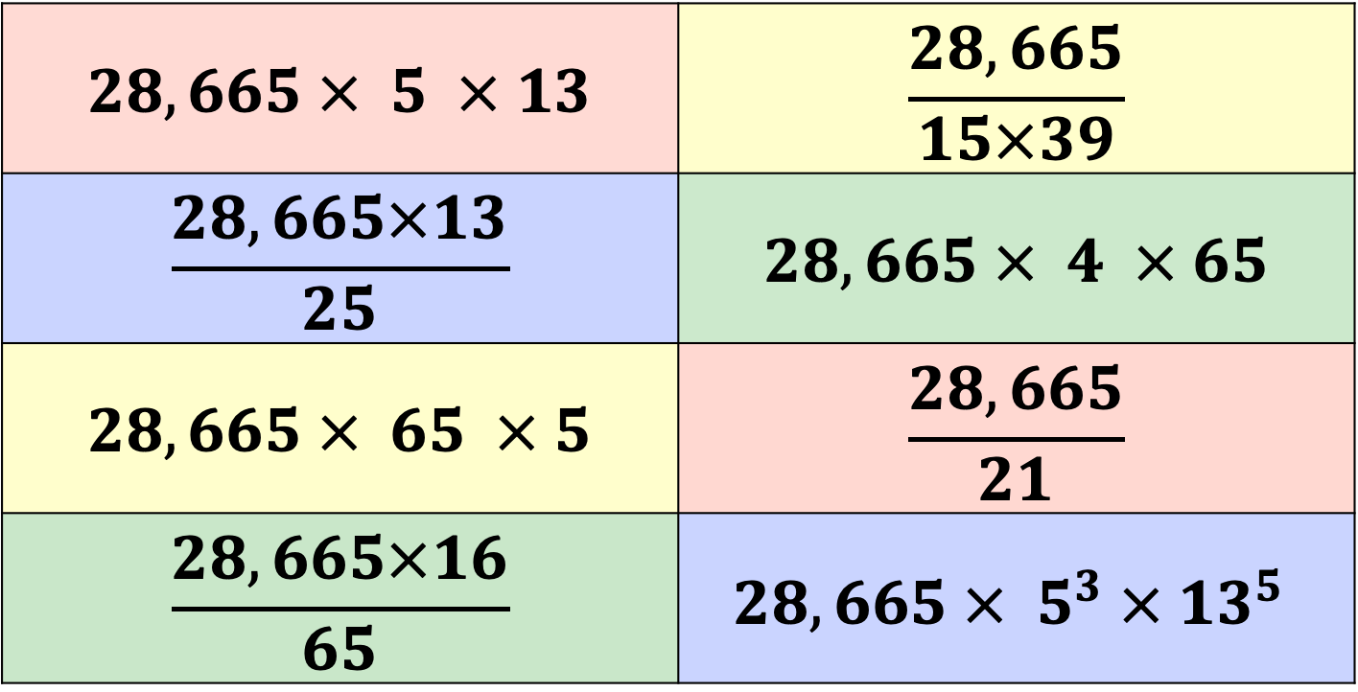
Which of the following calculations below would result in a SQUARE NUMBER?
Notes:
3x3x5x7x7x13

Slide 4
Area
2cm²
?
Area
5cm²
?
Area
3cm²
?
Area
7cm²
2cm²
2cm²
5cm² | 5cm² | 5cm²
5cm² | 5cm² | 5cm²
5cm² | 5cm² | 5cm²
Area
8cm²
Area
8cm²
Area
45cm²
?
Area
45cm²
?
?
?
2cm²
2cm²
3 | 3 | 3 | 3
3 | 3 | 3 | 3
3 | 3 | 3 | 3
3 | 3 | 3 | 3
7 | 7 | 7 | 7 | 7
7 | 7 | 7 | 7 | 7
7 | 7 | 7 | 7 | 7
7 | 7 | 7 | 7 | 7
7 | 7 | 7 | 7 | 7
Area
48cm²
?
Area
48cm²
?
Area
175cm²
Area
175cm²

Slide 5
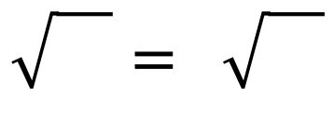
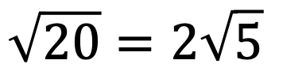
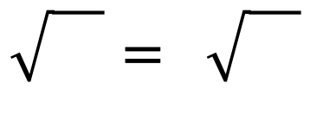
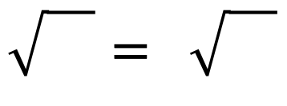
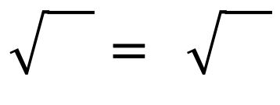
All the shapes below are squares
Find the missing lengths
Fill in the boxes below
5
5
5
20
5 | 5
5 | 5
28
7 | 7
7 | 7
32
2 | 2 | 2 | 2
2 | 2 | 2 | 2
2 | 2 | 2 | 2
2 | 2 | 2 | 2
$$\sqrt{20}=2\sqrt{5}$$
$$\sqrt{}= \sqrt{}$$
$$\sqrt{}= \sqrt{}$$
45
5 | 5 | 5
5 | 5 | 5
5 | 5 | 5
75
3 | 3 | 3 | 3 | 3
3 | 3 | 3 | 3 | 3
3 | 3 | 3 | 3 | 3
3 | 3 | 3 | 3 | 3
3 | 3 | 3 | 3 | 3
$$\sqrt{}= \sqrt{}$$
$$\sqrt{}= \sqrt{}$$

Slide 6
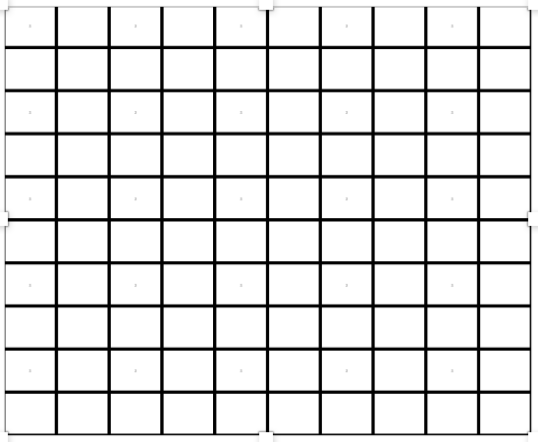

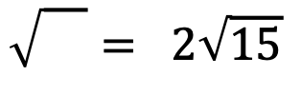
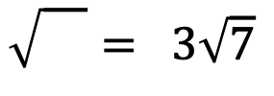









All the shapes below are squares
Find the missing lengths
Fill in the boxes below
?
?
?
$$\sqrt{11}$$
$$2\sqrt{11}$$
?
?
?
$$5\sqrt{2}$$
$$3\sqrt{7}$$
$$2\sqrt{15}$$
$$\sqrt{}=5\sqrt{2}$$
$$\sqrt{}= 3\sqrt{7}$$
$$\sqrt{}= 2\sqrt{15}$$
?
?
$$6\sqrt{3}$$
$$10\sqrt{2}$$
$$\sqrt{}=10\sqrt{2}$$
$$\sqrt{}=6\sqrt{3}$$

Slide 7

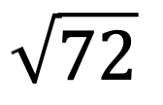
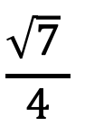
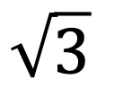

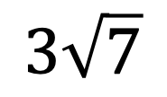
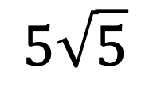
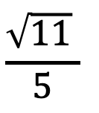
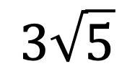

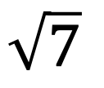
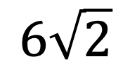
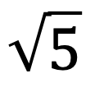




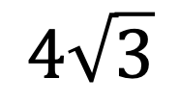
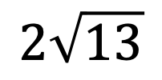

Place either > < or = between each pair below
$$\sqrt{5}$$
$$\sqrt{7}$$
$$6\sqrt{2}$$
$$\sqrt{72}$$
$$\sqrt{3}$$
$$2$$
$$5\sqrt{5}$$
$$2\sqrt{13}$$
$$8$$
$$3\sqrt{7}$$
$$2\sqrt{11}$$
$$3\sqrt{5}$$
$$4\sqrt{3}$$
$$\frac{\sqrt{11} }{5}$$
$$\frac{\sqrt{7} }{4}$$
$$7$$
$$\frac{3 }{\sqrt{5}}$$
$$\frac{\sqrt{5}}{\sqrt{3}}$$
$$\sqrt{201}$$
$$10\sqrt{2}$$

