Slide 1
Surds

Slide 2
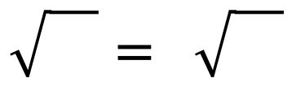
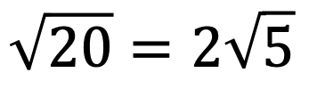
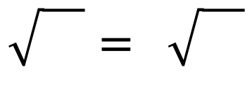
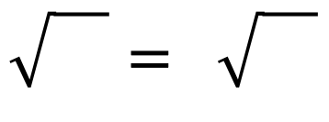
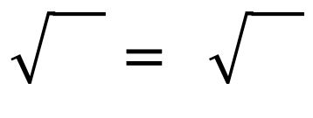
All the shapes below are squares
Find the missing lengths
Fill in the boxes below
5
5
5
20
5 | 5
5 | 5
28
7 | 7
7 | 7
32
2 | 2 | 2 | 2
2 | 2 | 2 | 2
2 | 2 | 2 | 2
2 | 2 | 2 | 2
$$\sqrt{20}=2\sqrt{5}$$
$$\sqrt{}= \sqrt{}$$
$$\sqrt{}= \sqrt{}$$
45
5 | 5 | 5
5 | 5 | 5
5 | 5 | 5
75
3 | 3 | 3 | 3 | 3
3 | 3 | 3 | 3 | 3
3 | 3 | 3 | 3 | 3
3 | 3 | 3 | 3 | 3
3 | 3 | 3 | 3 | 3
$$\sqrt{}= \sqrt{}$$
$$\sqrt{}= \sqrt{}$$

Slide 3
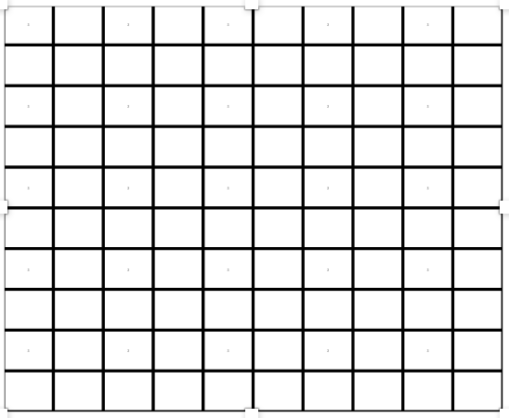

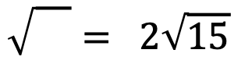
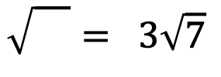









All the shapes below are squares
Find the missing lengths
Fill in the boxes below
?
?
?
$$\sqrt{11}$$
$$2\sqrt{11}$$
?
?
?
$$5\sqrt{2}$$
$$3\sqrt{7}$$
$$2\sqrt{15}$$
$$\sqrt{}=5\sqrt{2}$$
$$\sqrt{}= 3\sqrt{7}$$
$$\sqrt{}= 2\sqrt{15}$$
?
?
$$6\sqrt{3}$$
$$10\sqrt{2}$$
$$\sqrt{}=10\sqrt{2}$$
$$\sqrt{}=6\sqrt{3}$$

Slide 4





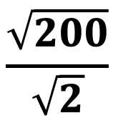



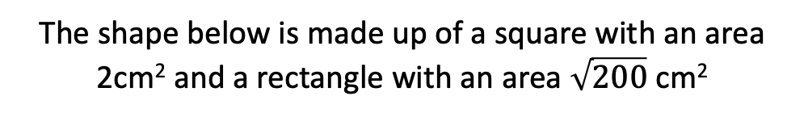
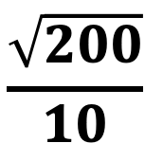



The shape below is made up of a square with an area 2cm² and a rectangle with an area $\sqrt{200}$ cm²
$$b$$
$$c$$
$$a$$
2
$$\sqrt{200}$$
$$d$$
Which of the areas or lengths could each of the expressions below be referring to?
$$\frac{\sqrt{200}}{\sqrt{2}}$$
$$\sqrt{2}$$
$$10\sqrt{2}$$
$$10+\sqrt{2}$$
$$\frac{\sqrt{200}}{10}$$
$$\sqrt{100}$$
$$10$$
$$2+10\sqrt{2}$$

Slide 5
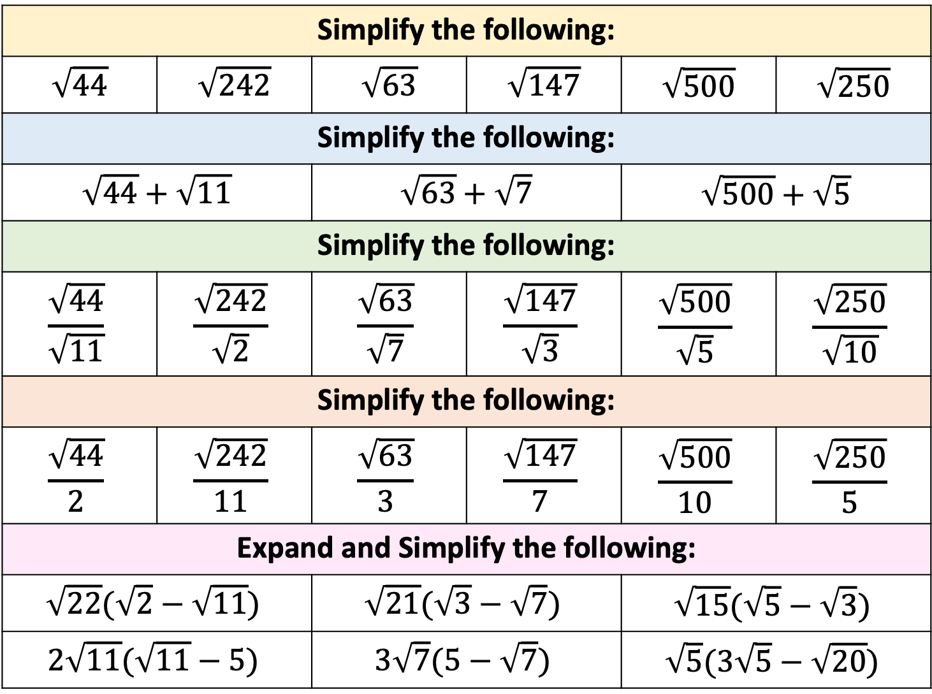
Simplify the following:
$$\sqrt{44}$$ | $$\sqrt{242}$$ | $$\sqrt{63}$$ | $$\sqrt{147}$$ | $$\sqrt{500}$$ | $$\sqrt{250}$$
Simplify the following:
$$\sqrt{44}+\sqrt{11}$$ | $$\sqrt{242}$$ | $$\sqrt{63}+\sqrt{7}$$ | $$\sqrt{147}$$ | $$\sqrt{500}+\sqrt{5}$$ | $$\sqrt{250}$$
Simplify the following:
$$\frac{\sqrt{44}}{\sqrt{11}}$$ | $$\frac{\sqrt{242}}{\sqrt{2}}$$ | $$\frac{\sqrt{63}}{\sqrt{7}}$$ | $$\frac{\sqrt{147}}{\sqrt{3}}$$ | $$\frac{\sqrt{500}}{\sqrt{5}}$$ | $$\frac{\sqrt{250}}{\sqrt{10}}$$
Simplify the following:
$$\frac{\sqrt{44}}{2}$$ | $$\frac{\sqrt{242}}{11}$$ | $$\frac{\sqrt{63}}{3}$$ | $$\frac{\sqrt{147}}{7}$$ | $$\frac{\sqrt{500}}{10}$$ | $$\frac{\sqrt{250}}{5}$$
Expand and Simplify the following:
$$\sqrt{22}(\sqrt{2}−\sqrt{11})$$ |  | $$\sqrt{21}(\sqrt{3}−\sqrt{7})$$ |  | $$\sqrt{15}(\sqrt{5}−\sqrt{3})$$
$$2\sqrt{11}(\sqrt{11}−5)$$ |  | $$3\sqrt{7}(5−\sqrt{7})$$ |  | $$\sqrt{5}(3\sqrt{5}−\sqrt{20})$$
Notes:
1, 4, 9, 16, 25, 36, 49, 64

Slide 6

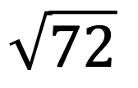
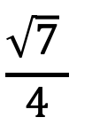
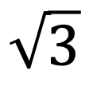

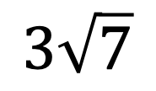
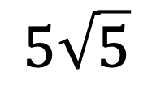
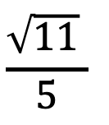
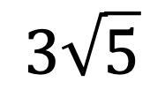

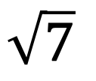
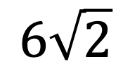
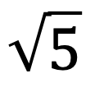




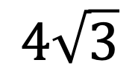
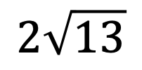

Place either > < or = between each pair below
$$\sqrt{5}$$
$$\sqrt{7}$$
$$6\sqrt{2}$$
$$\sqrt{72}$$
$$\sqrt{3}$$
$$2$$
$$5\sqrt{5}$$
$$2\sqrt{13}$$
$$8$$
$$3\sqrt{7}$$
$$2\sqrt{11}$$
$$3\sqrt{5}$$
$$4\sqrt{3}$$
$$\frac{\sqrt{11} }{5}$$
$$\frac{\sqrt{7} }{4}$$
$$7$$
$$\frac{3 }{\sqrt{5}}$$
$$\frac{\sqrt{5}}{\sqrt{3}}$$
$$\sqrt{201}$$
$$10\sqrt{2}$$

